Slide 1
BIOMES PICTURES
Fill the following slides with pictures to help you visualize the different kinds of biomes, and so you can study for the Biomes Picture Quiz.
Know the locations of biomes too…

Slide 2
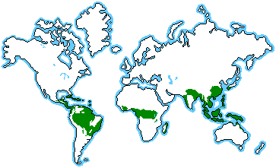
Tropical Rain Forest

Slide 3
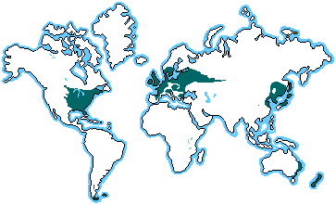
Temperate Deciduous Forest

Slide 4
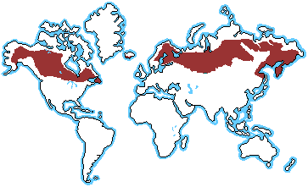
Boreal Forest, Coniferous Forest, Taiga

Slide 5
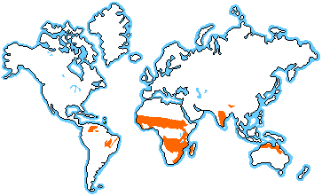
Tropical Grassland, Savanna

Slide 6
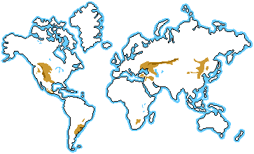
Temperate Grassland, Prairie

Slide 7
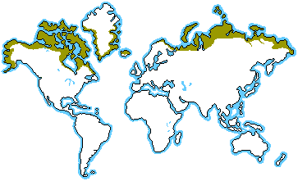
Polar Grassland, Tundra

Slide 8
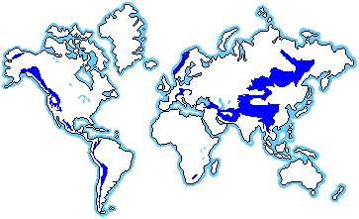
Alpine Tundra

Slide 9
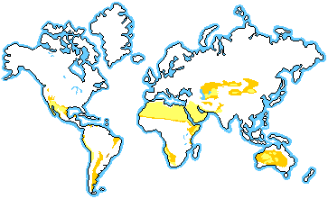
Desert

Slide 10
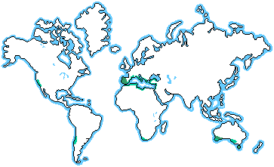
Chaparral

Slide 11
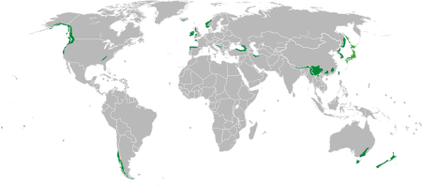
Temperate Rainforest

Slide 12
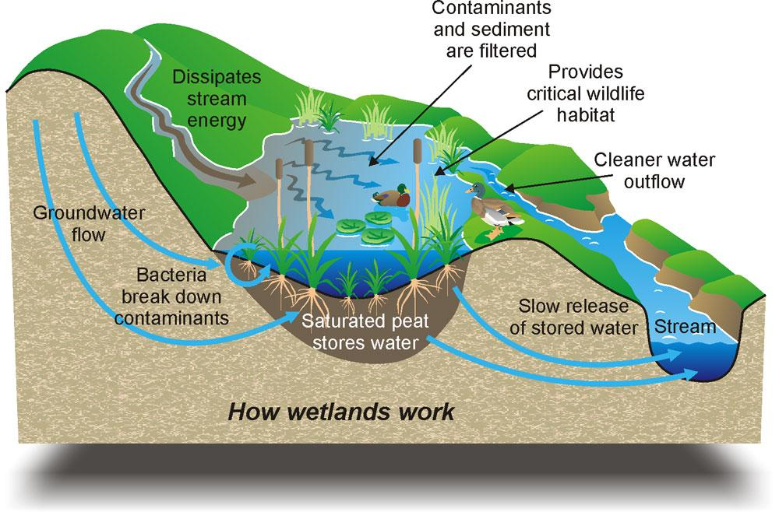
Wetlands

Slide 13
Estuaries

Slide 14
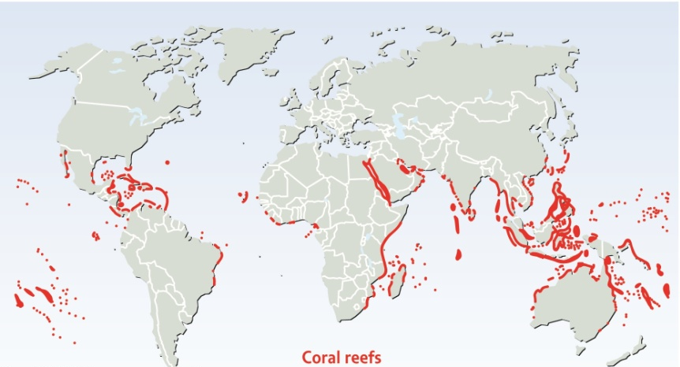
Coral Reef

Slide 15
Open Ocean

Slide 16
Lakes, Ponds

Slide 17
Rivers, Streams

