Slide 1
Environmental Science: Studying the State of Our Earth
Chapter 1

Slide 2
Module
1
Environmental Science
Learning Objectives
After this module, you should be able to:
Define the field of environmental science and discuss its importance.
Identify ways in which humans have altered and continue to alter our environment.

Slide 3
What is “Environmental Science”?
Environmental Science
… the study of how the earth works, how we interact with the earth and how to deal with environmental problems.
The goals of environmental science are to learn:
how nature works
how the environment effects us
how we effect the environment
how to deal with environmental problems
how to live more sustainably

Slide 4
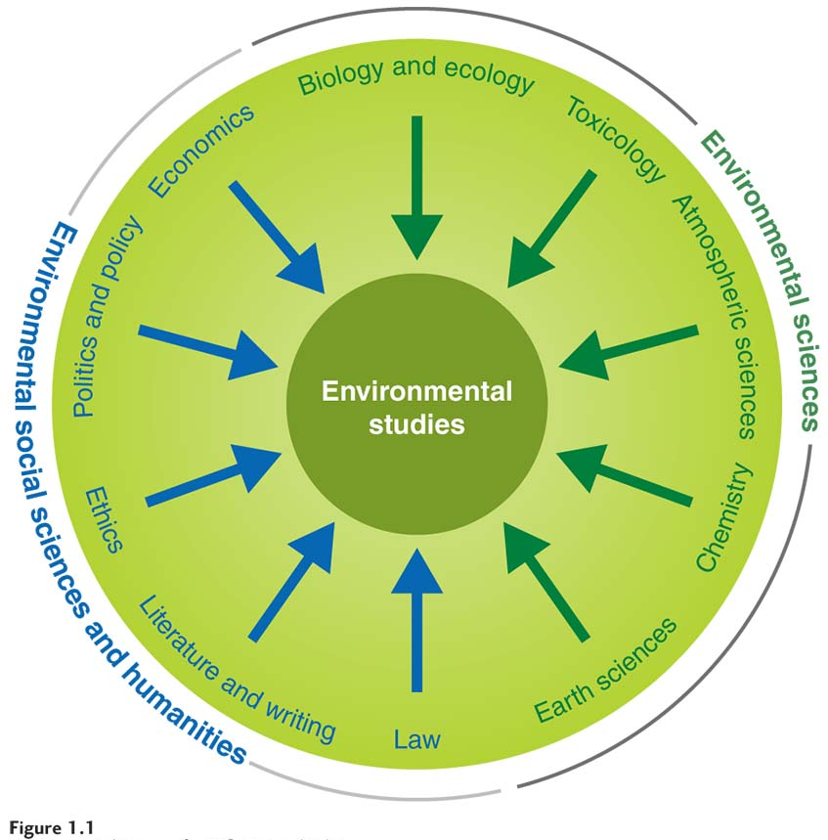
What is “Environmental Science”?
Environmental Science is an interdisciplinary study of how humans interact with living and non-living things:
Natural Sciences Biology, chemistry, earth science
Social Sciences Politics, geography, demography, etc.
Humanities Ethics, philosophy, etc.

Slide 5
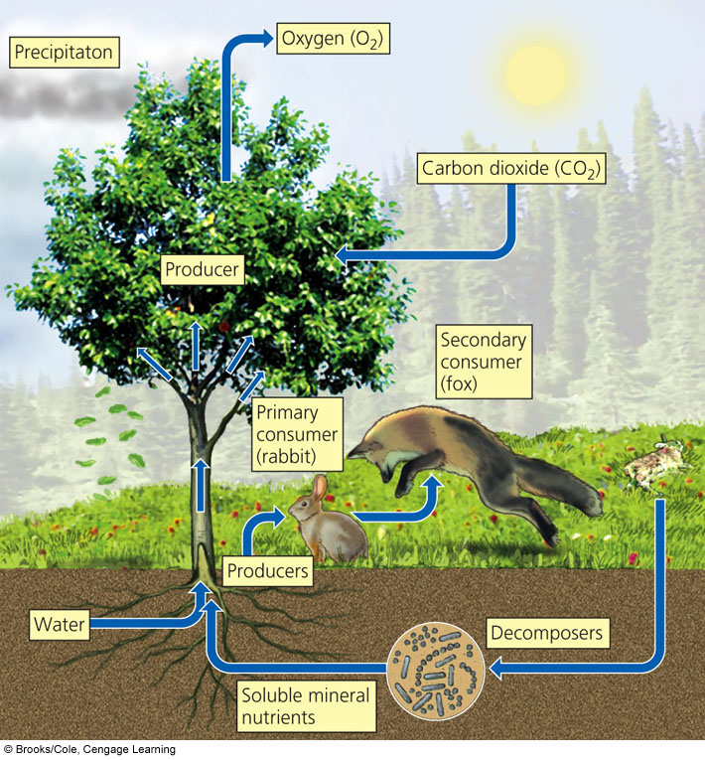
Ecosystems Have Living and Nonliving Components
Ecosystems consist of living (biotic) and nonliving (abiotic) components.
Biotic or Abiotic?
Plants
Water
Animals
Temperature
Rocks/Minerals
Bacteria
Solar Energy
Landforms
Soil

Slide 6
Environmentalism vs. Environmental Science
Environmentalism is a “social movement that seeks to protect the environment through lobbying, activism, and education.”
Not quite the same as Environmental Science, but shares some goals (i.e., sustainable living, etc.)
Env. Sci. studies interactions, but does not necessarily actively promote certain outcome(s).

Slide 7
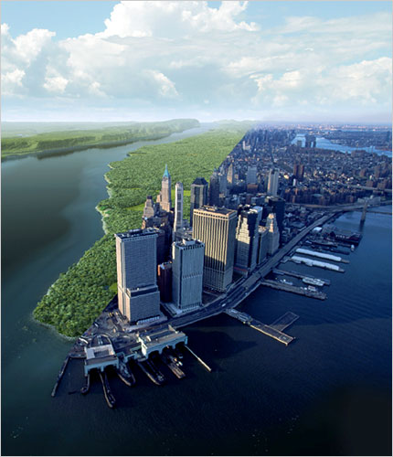
Humans alter natural systems
Humans manipulate the environment more than any other species
A few examples:
Conversion of land
(agriculture, urban area, etc.)
Extinction of species
(mammoths, bison)
Air/water pollution
(CFCs, CO₂)
Anthropogenic climate change

Slide 8
Module
2
Environmental Indicators and Sustainability
Learning Objectives
After this module, you should be able to:
Identify key environmental indicators and their trends over time.
Define sustainability and explain how it can be measured using the ecological footprint.

Slide 9
Environmental Indicators
Nature delivers us with ecosystem services: Processes and resources provided at no cost.

Slide 10
Environmental Indicators
We use environmental indicators to describe the current state of these services.
Five major global indicators are:
Biological diversity
Food production
Average temp. and CO₂ levels
Human population
Resource depletion

Slide 11
1. Biological Diversity
Biodiversity is a measure of the variety of life in an environment
We can study biodiversity at three different levels of complexity: Ecosystem, species, and genetic.

Slide 12
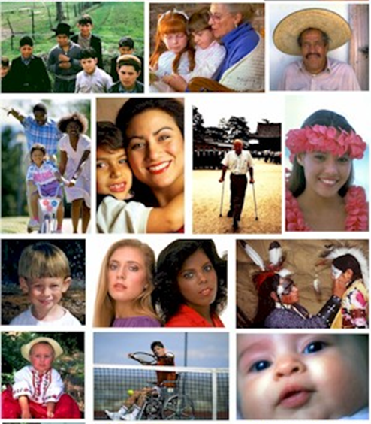
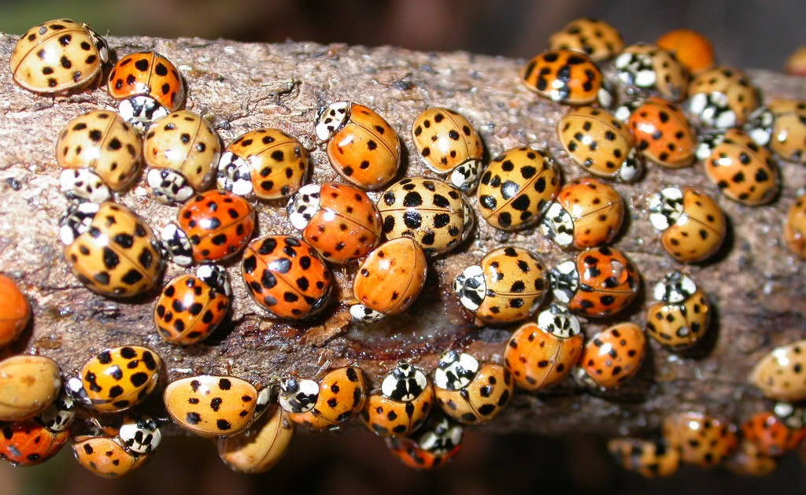
1. Biological Diversity
Genetic diversity measures the genetic differences between individuals of a population.
Populations with high genetic diversity are better able to respond to environmental change than populations with lower genetic diversity.

Slide 13
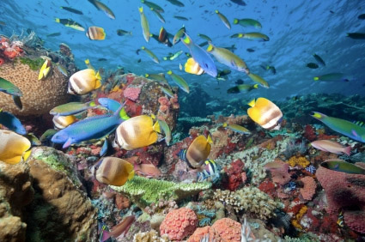
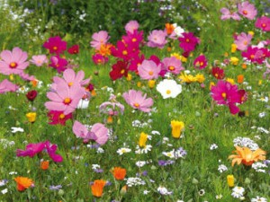
1. Biological Diversity
Species Diversity measures the amount and variety of different species in an area.
Ecosystems with high species diversity are more productive and better able to recover from disasters.
Speciation and extinction influence species diversity.

Slide 14
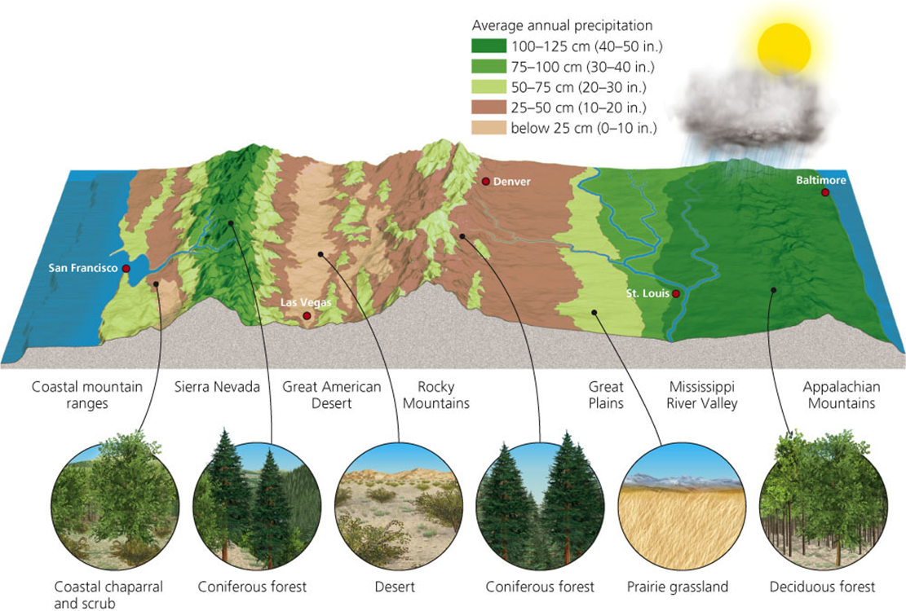
1. Biological Diversity
Ecosystem Diversity measures the variety of different habitats in a region.
Includes not only biotic, but also abiotic factors such as temperature, precipitation, etc.

Slide 15
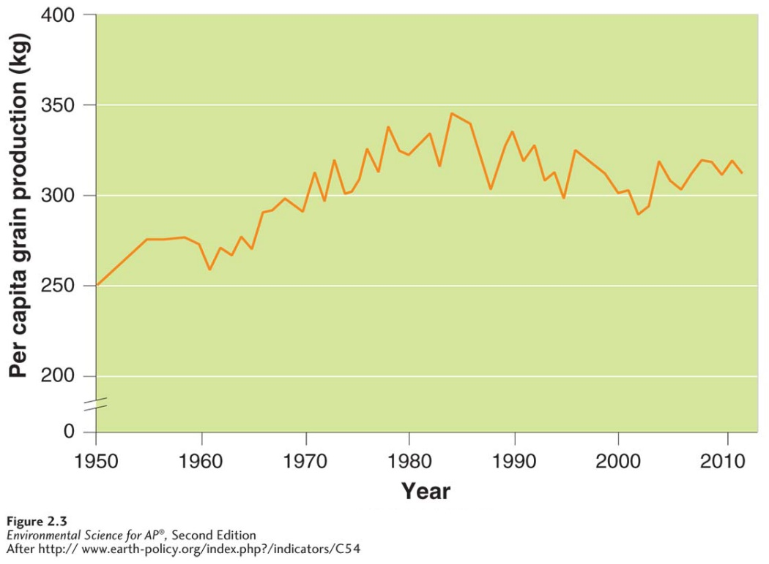
2. Food Production
Science has allowed us to drastically increase the amount of food produced, but it has come with a cost…
Soil degradation
Habitat destruction
Agrobiodiversity loss
Water/air pollution
Per capita = per person
Agriculture is the #1 way humans negatively affect the environment.

Slide 16
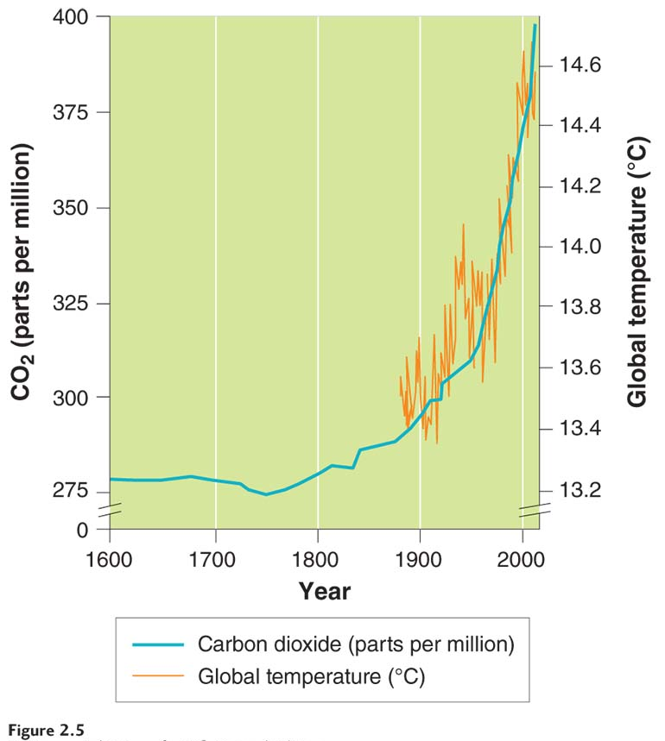
3. Average Temperature/CO₂
Anthropogenic greenhouse gas production is increasing global temperatures.
In turn, increased temperatures are accelerating environmental changes (i.e., “Climate Change”)

Slide 17
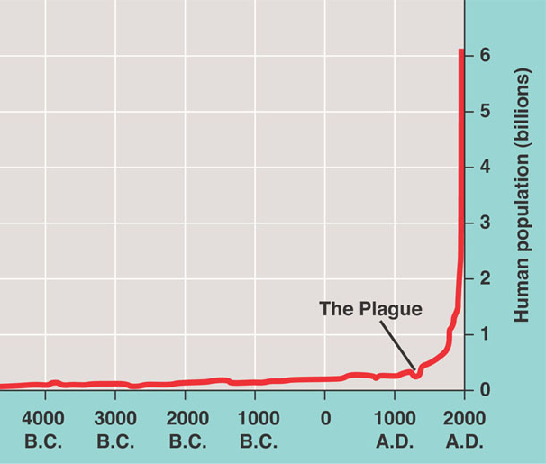
4. Human Population
Human population is currently ~7.2 billion
Places additional demands on nature for food, water, space, etc.
Also contributes to resource depletion

Slide 18
5. Resource Depletion
Humans require more resources as population grows
Some resources will become limited and depleted over time
Resource use is not equal… developed countries (20% of total) use 80% of worlds resources

Slide 19
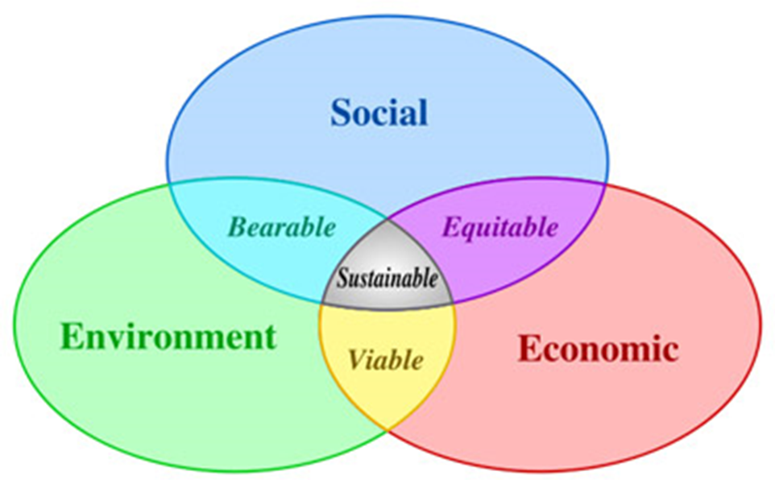
Sustainability
Sustainability: Ability to survive and adapt to changing conditions indefinitely.
Three “requirements” to sustainability:
Systems must not be damaged beyond ability to recover
Renewable resources must not be used faster than they regenerate
Nonrenewable resources must be used sparingly

Slide 20
Ecological Footprint
Ecological Footprint (what you use)
Measure of amount of land needed to supply resources and deal with waste from a person’s lifestyle
Biological Capacity (what nature provides)
Ability of environment to replenish resources and absorb/recycle waste
EFP < BC is good;
EFP > BC is bad

Slide 21
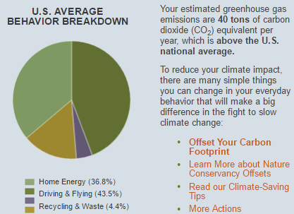
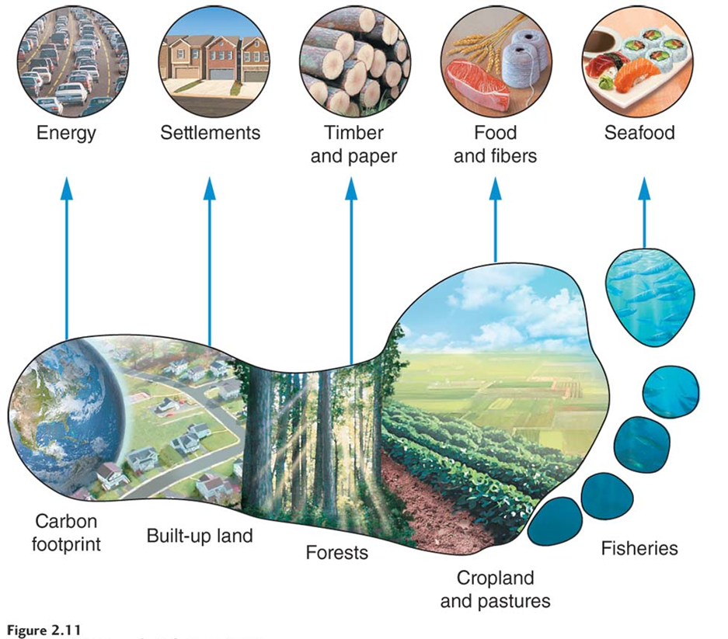
Footprint Calculators
There are many different footprint calculators available on the Internet.

Slide 22
Module
3
Scientific Method
Learning Objectives
After this module, you should be able to:
Explain the scientific method and its application to the study of environmental problems.
Describe some of the unique challenges and limitations of environmental science.

Slide 23
What is Science?
Science tries to understand the world around us.
Science/scientists...
Assumes world is understandable
Ideas are subject to change as new data becomes available
Science explains and predicts, but cannot provide complete answers to all questions
Tries to identify and avoid bias
Uses processes and social interactions
How Scientific Is It?
Focuses on natural world
Aims to explain natural world
Uses testable ideas
Relies on evidence
Involves the scientific community
Leads to ongoing research
Benefits from scientific behavior

Slide 24
A Scientific Method
No single “Scientific Method” (although many processes share similarities)
Common terms/concepts:
Hypothesis: testable prediction of how something works “Bean plants grow taller in soil with compost than soil without compost”
Null Hypothesis: prediction that there is no difference “Bean plants do not grow taller in soil with compost than soil without compost”

Slide 25
Hypotheses ≠ Theory
A hypothesis is NOT the same as a theory!
HYPOTHESIS
THEORY
Reasoned or educated prediction/explanation of a phenomenon
Usually narrow and specific in scope; not always a lot of evidence to support it
Conceptual framework that explains observations and helps to make predictions
Supported by large amount of evidence

Slide 26
Natural Experiments
Scientists use environmental events as natural experiments – where a lab experiment might be too difficult/expensive or ethically questionable.
Environmental Science poses unique challenges:
Isn’t another Earth to serve as a control
Results can sometimes be subjective
So many interacting parts, hard isolate variables

Slide 27
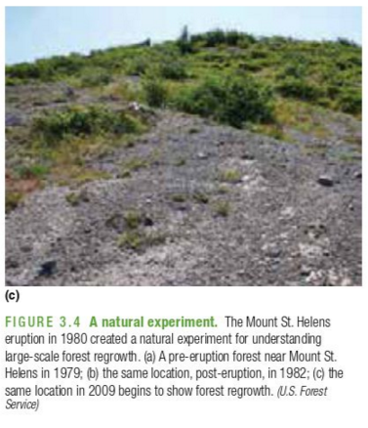
Natural Experiment Example
1980 Mt. St. Helens Eruption
Used to study primary succession
Yellowstone National Park:
Used huge 1988 fire to study forest regrowth and ecosystem recovery
Used reintroduction of wolves to study impact of top predators on an ecosystem

