Slide 1
Environmental Systems
Chapter 2

Slide 2
Module
4
Systems and Matter
Learning Objectives
After this module, you should be able to:
Describe how matter comprises atoms and molecules that move along different systems.
Explain why water is an important component of most environmental systems.
Discuss how matter is conserved in chemical and biological systems.

Slide 3
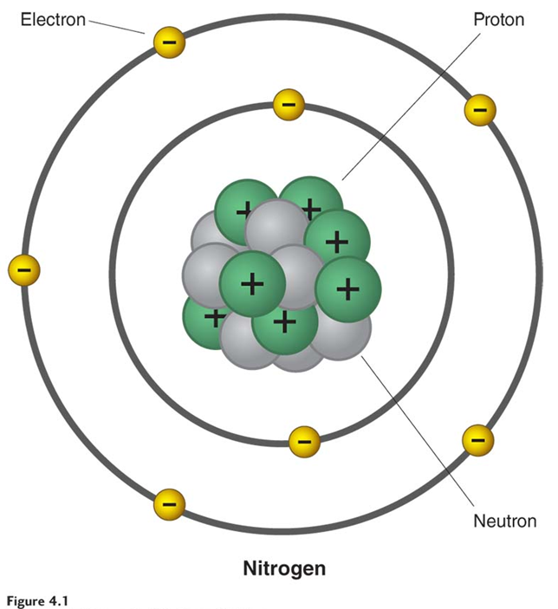
Basic Chemistry Review
Matter is anything with mass that takes up space
Mass measures the amount of matter in an object
 | Elements: One type of atom; can’t be broken down into anything simpler
Molecule: Contains 2 or more atoms N₂, O₂ | Compounds: Two or more elements in a fixed proportion H₂O, CO₂

Slide 4
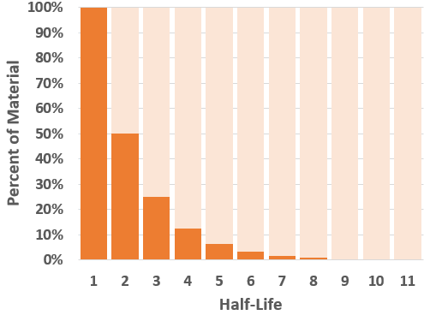
Radioactivity and Half-Life
Half-Life | Original | Decayed
0 | 100% | 0%
1 | 50% | 50%
2 | 25% | 75%
3 | 12.5% | 87.5%
4 | 6.25% | 93.75%
5 | 3.125% | 96.875%
Some isotopes are unstable and undergo radioactive decay (break down, releasing energy/matter)
Half-life measures the amount of time it takes half of the original amount to decay

Slide 5
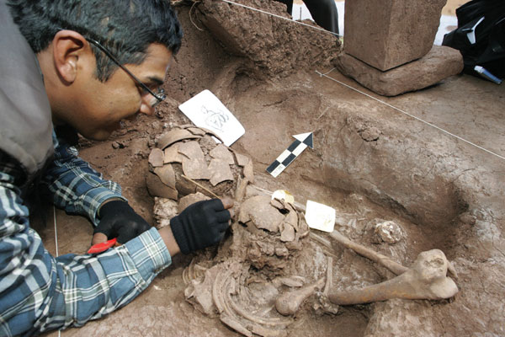
Practical Use of Half-Life
Scientists can use the half-life of Carbon-14 (an isotope of Carbon) to estimate the age of substances.
It can help determine how long it will take for radioactive wastes to become safe – important for considering storage options

Slide 6
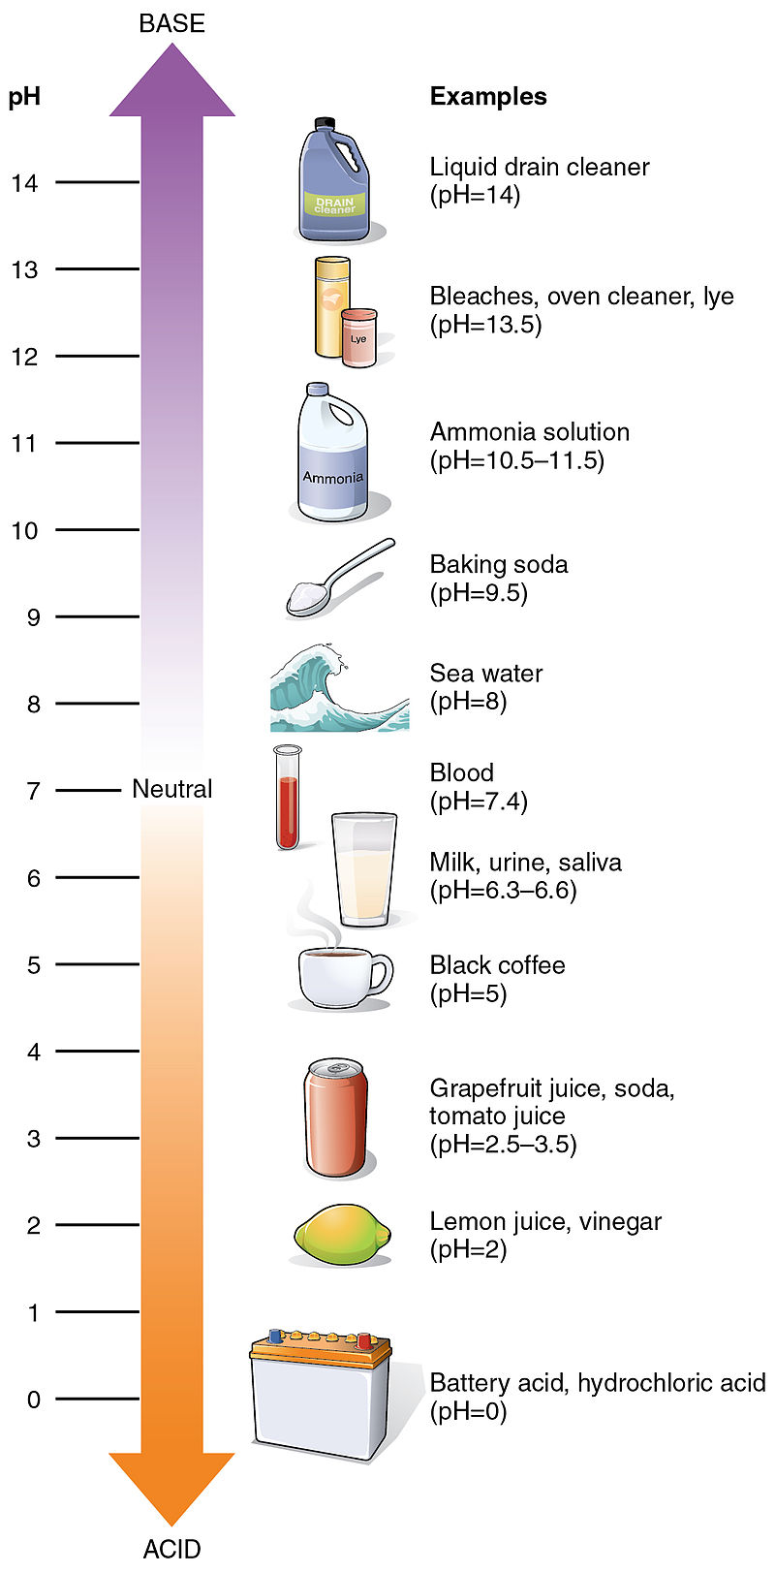
pH
Some compounds contribute certain ions to solutions. These are called acids and bases.
Acids contribute H+ ions to solutions
Bases contribute OH- ions to solutions
pH: a scale that measures the relative strength of acids and bases

Slide 7
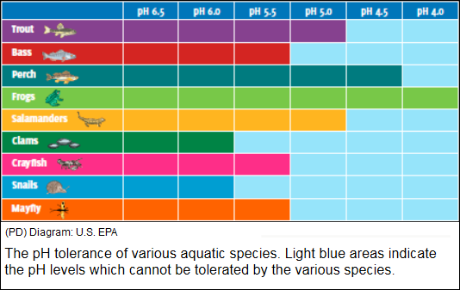
pH Scale
What pH range can all species survive? Base/acid/neutral?
What pH range do fewest survive? Base/acid/neutral?
Species most sensitive to acidic environments? How can you tell?
Which are most tolerant? How can you tell?
Why do you think pH is important in determining ecosystem health?

Slide 8
Chemical Reactions
Chemical change involves a chemical reaction which changes the arrangement of the elements or compounds involved.
However, when a physical or chemical change occurs, no atoms are created or destroyed – this is the Law of Conservation of Matter
Example:
$$6 CO_{2}+12H_{2}O\underset{→}{Light}C_{6}H_{12}O_{6}+6O_{2}+6H_{2}O$$
Reactants:
6 Carbon
24 Oxygen
24 Hydrogen
Products:
6 Carbon
24 Oxygen
24 Hydrogen

Slide 9
Organic Compounds Are the Chemicals of Life
Organic compounds – compounds contain carbon atoms combined with one another and with various other atoms.
Carbohydrates: Short-term energy storage
Ex. glucose (C₆H₁₂O₆)
Proteins: Structural support, energy storage, transport
Nucleic Acids: Store genetic “blueprints” for life
Lipids: Membranes, long-term energy storage, etc.
Hydrocarbons: compounds of carbon and hydrogen
Ex. methane (CH₄)
All other compounds are inorganic compounds.

Slide 10
Module
5
Energy, Flows, and Feedbacks
Learning Objectives
After this module, you should be able to:
Distinguish among various forms of energy and understand how they are measured.
Discuss the first and second laws of thermodynamics and explain how they influence environmental systems.
Explain how scientists keep track of energy and matter inputs, outputs, and changes to environmental systems.

Slide 11
Energy
Energy is the ability to do work or transfer heat and is required for life to exist
Comes in two classes: Kinetic (energy of motion) and Potential (stored energy)

Slide 12
Forms of Energy
Major forms of energy include:
Nuclear (P)
Gravitational (P)
Chemical (P)
Mechanical (K & P)
Electrical (K & P)
Thermal/Heat (K)
Electromagnetic Radiation (K)
How could these be both POTENTIAL and KINETIC?

Slide 13
Energy Changes Are Governed by Two Scientific Laws
The first law of thermodynamics: energy cannot be created or destroyed, only changed from one form to another.
Energy input always equals energy output
The second law of thermodynamics: energy quality always decreases.
When energy changes from one form to another, it always degrades to a less useful and more dispersed form (usually heat)
its ability to do work is diminished

Slide 14
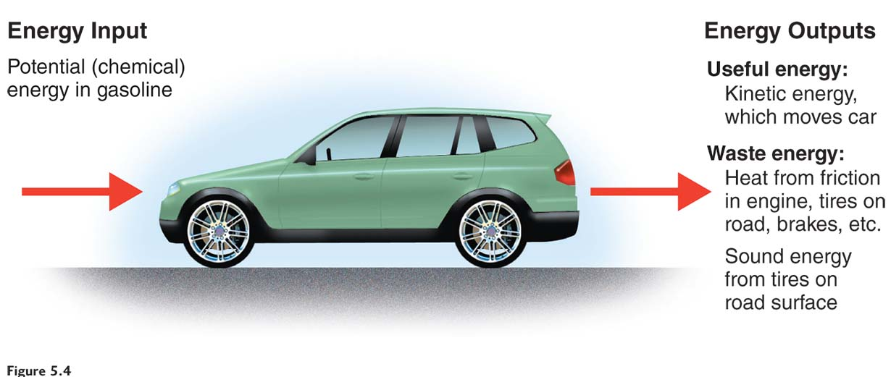
Laws of Energy

Slide 15
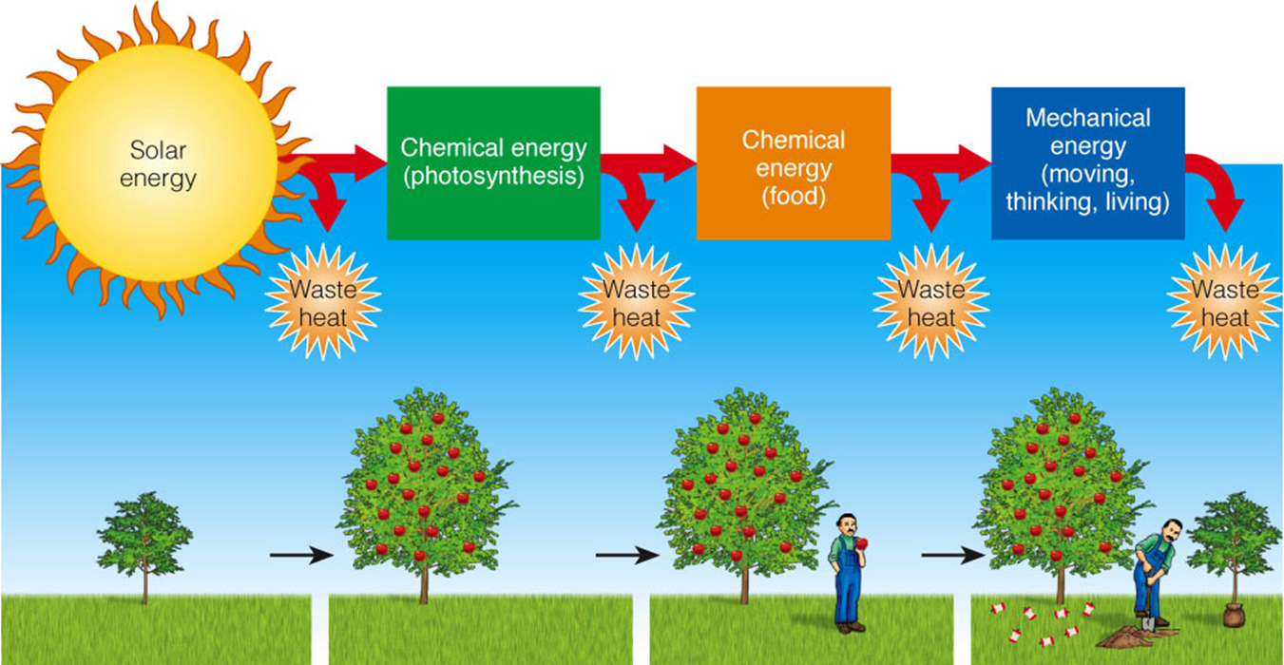
Laws of Energy
Each time energy changes from one form to another, some of the initial input of high-quality energy is degraded, usually to low-quality heat that is dispersed into the environment as heat.

Slide 16
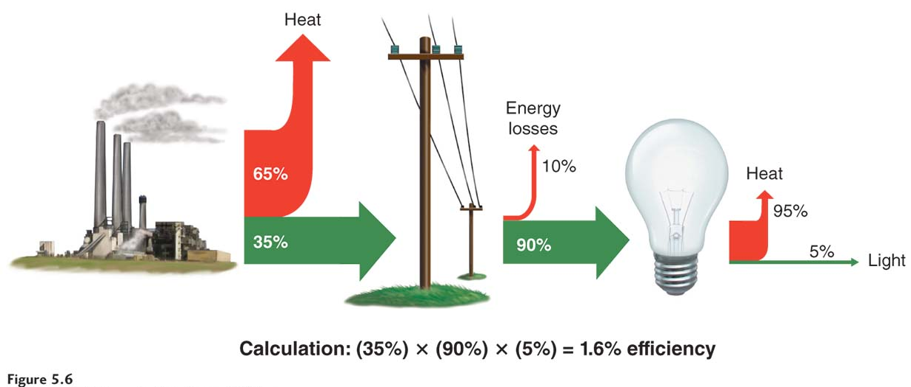
Energy Efficiency
The proportion of energy converted into the form we want is energy efficiency.
Notice how energy is never created or destroyed!

Slide 17
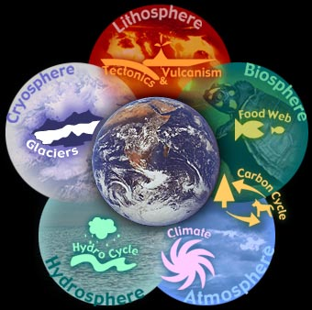
Systems
A system is the part of the universe being studied…it can be large (planet) or small (micro-ecosystem like a puddle of water)
Systems help us study how matter and energy flow in the environment.

Slide 18
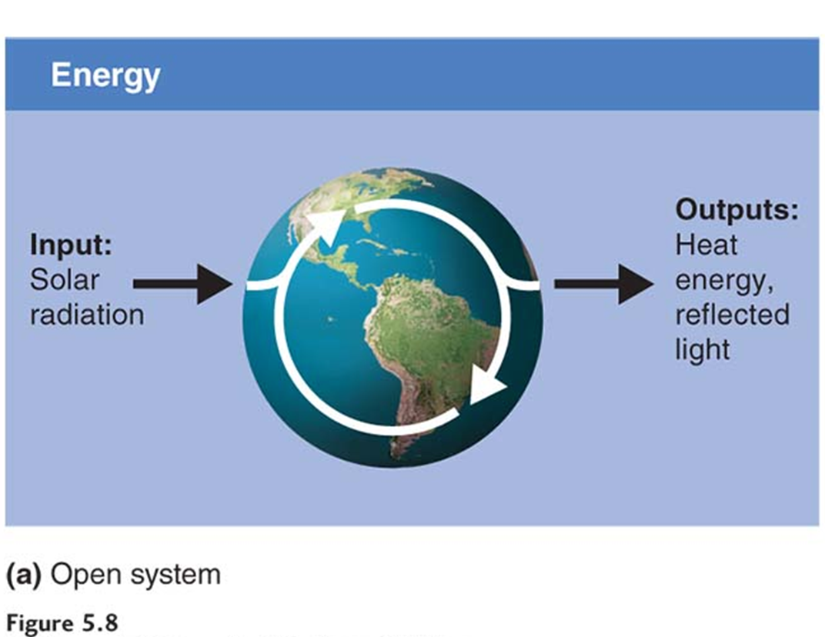
Types of Systems
OPEN SYSTEM
Common in nature
Matter or energy can move in and out
Examples:
Almost all ecosystems on Earth
Car engine
Human body
Earth for ENERGY

Slide 19
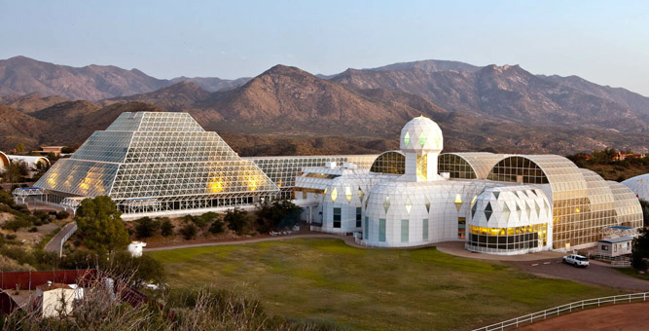
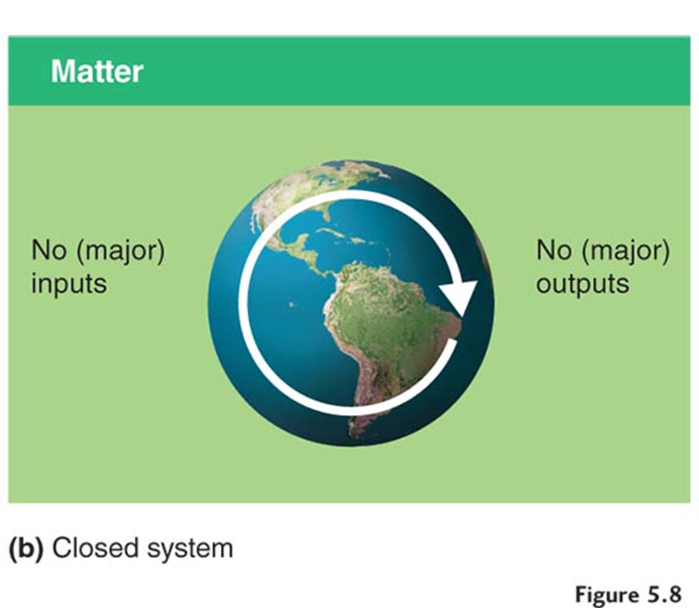
Types of Systems
CLOSED SYSTEM
Not common in nature
Matter or energy cannot move in and out
Damage that occurs stays in the system (i.e. pollution)
Examples:
Some caves (sort of…)
Earth for MATTER

Slide 20
Feedbacks
Outputs of matter, energy, or information fed back into a system can cause the system to do more or less of what it was doing.
How systems respond to change are called feedbacks.
Positive feedback loop causes a system to change further in the same direction; change is amplified.
Does NOT mean that the change is a positive thing
Negative (corrective) feedback loop causes a system to change in the opposite direction; change to system is reduced.
System returns to “normal”

Slide 21
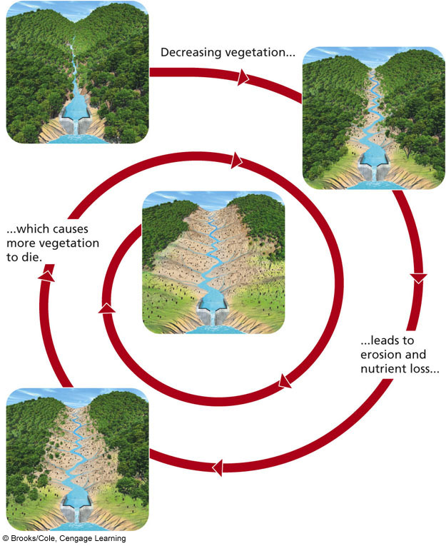
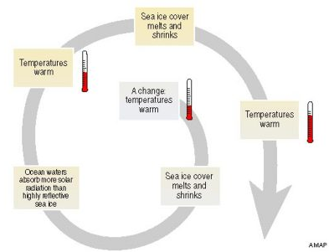
Positive Feedback Loop
Every step amplifies change

Slide 22
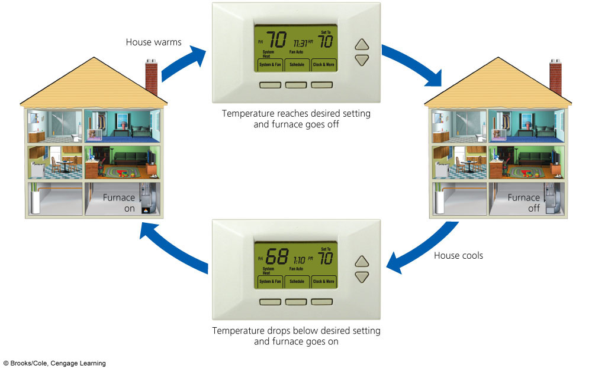
Negative Feedback Loop
Every step decreases change OR returns system to “normal”

Slide 23
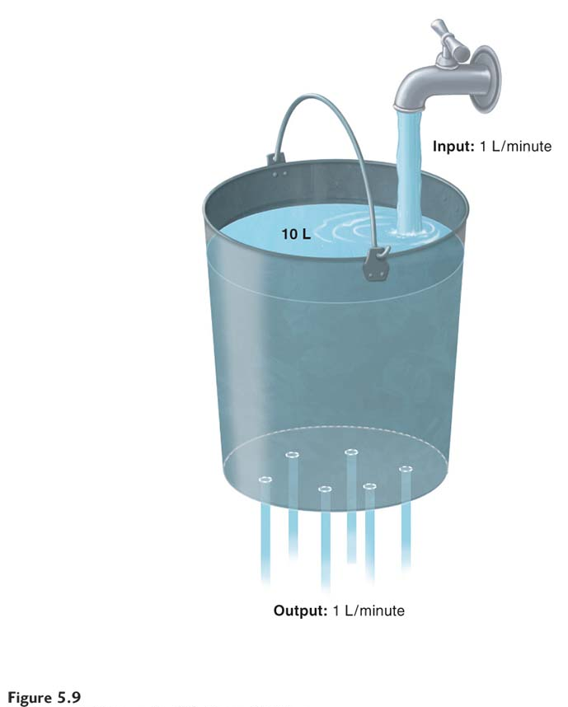
Steady State
A steady state occurs when inputs and outputs of a system are equal.

