Slide 1
Land, Public and Private
Chapter 10

Slide 2
Module
29
Land Use Concepts and Classification
Learning Objectives
After this module, you should be able to:
explain how human land use affects the environment.
describe the various categories of public land used globally and in the United States.

Slide 3
Human land use affects the environment in many ways
Every human use of land alters it in some way.
Agriculture, housing, recreation, industry, mining, waste disposal, etc.
People do not always agree on land use and management priorities.
To understand land use and management issues, environmental scientists use 3 concepts:
Tragedy of the commons
Externalities
Maximum sustainable yield

Slide 4
Tragedy of the Commons
Tragedy of the commons: The tendency of a shared, limited resource to become depleted because individual users act according to their own self-interest for short-term gain, contrary to the common good of all users.
Individuals gain; the group loses
“If I don’t do it, someone else will.”
When many people share a common resource without agreement on or regulation of its use, it is likely to become overused very quickly.
Air, water, ocean, large expansive forests or rangelands, etc.

Slide 5
Tragedy of the Commons
Solutions – Resource users or government agencies put laws or policies in place that limit use or access.
OR
Convert the resource to private ownership.

Slide 6
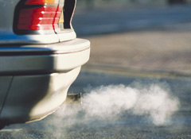
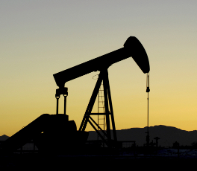
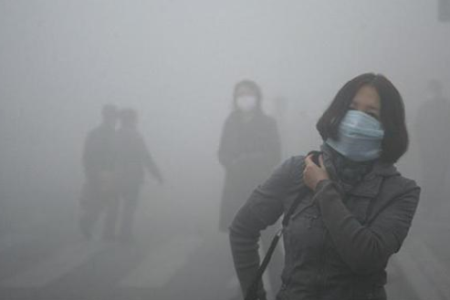
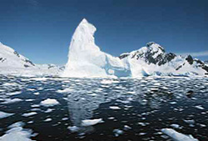
Externalities
Externality: The cost or benefit of a good or service that is not included in the purchase price of that good or service.
Positive externality = something good not included in cost
Negative externality = something bad not included in cost
Environmental scientists are concerned about negative externalities because of the environmental damage for which no one bears the cost.
Ex. When you buy gasoline, you do NOT pay for the environmental or human health damage caused.

Slide 7
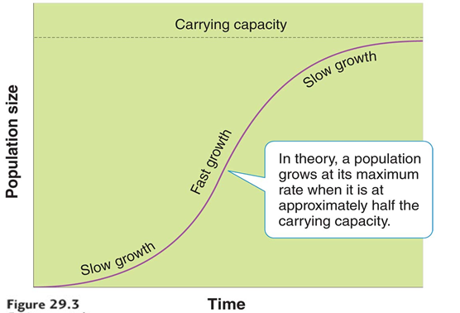
Maximum Sustainable Yield
Maximum sustainable yield (MSY): The maximum amount of a renewable resource that can be harvested without compromising the future availability of that resource.
Every population has a point at which a maximum number of individuals can be harvested sustainably.
That point is often reached when the population size is about one-half the carrying capacity.

Slide 8
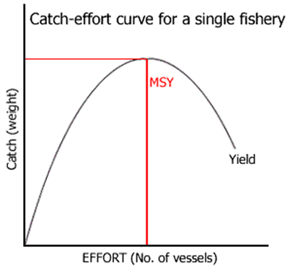
Maximum Sustainable Yield
It is very difficult to calculate MSY because we rarely have all the information needed to be accurate.
Total population, species interactions, birth rates, death rates, carrying capacity, etc.
Even when we do calculate MSY, it can take months or years of trial and error to determine whether a yield is truly sustainable.
Optimum sustained yield (OSY)
Recalculates MSY taking into account the interactions with other species and allows for more room for error.

Slide 9
Public lands are classified according to their use
Approximately 42% of the land in the U.S. is publicly owned, with 25% owned by the federal government.
Six main categories of public lands:
National parks: managed for scientific, educational, and recreational use, and sometimes for their beauty or unique landforms.
Managed Resource Protected Areas: designated for the sustained use of biological, mineral, and recreational resources.
Habitat/Species Management Areas: actively managed to maintain biological communities.
Strict Nature Reserves and Wilderness Areas: set aside to protect species and ecosystems.
Protected Landscapes and Seascapes: permit nondestructive use of natural resources while allowing for tourism and recreation.
National Monuments: designated to protect unique sites of special natural or cultural interests.
Notes:
Fix spacing and size so the next slide and this match.

Slide 10
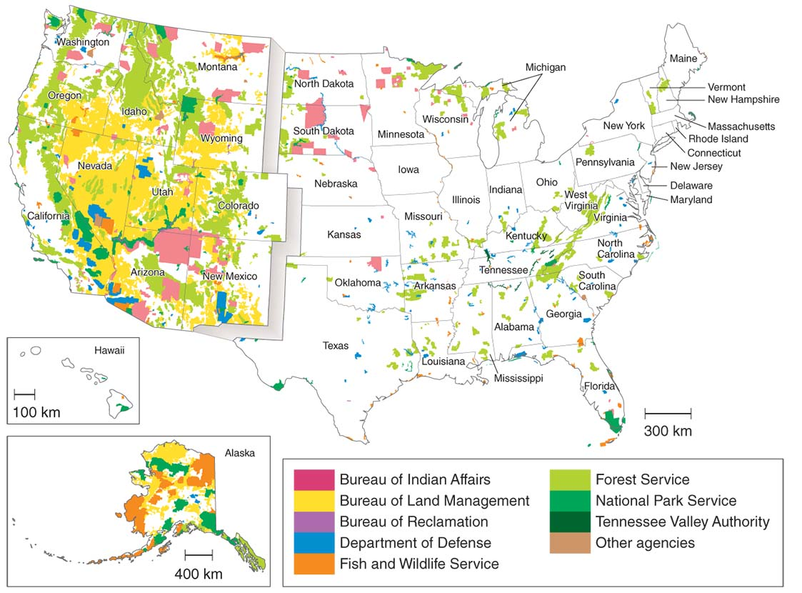
Public Lands in the United States

Slide 11
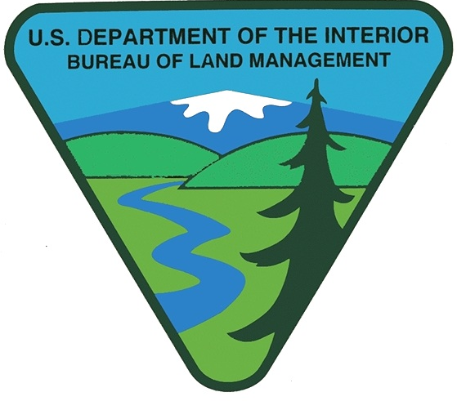
Public Lands in the United States
More than 95 percent of all federal lands are managed by four federal agencies.
Bureau of Land Management (BLM)
grazing, mining, timber harvesting and recreation
U.S. Forest Service (USFS)
timber harvesting, grazing, and recreation
National Park Service (NPS)
recreation and conservation
Fish and Wildlife Service (FWS)
conservation, hunting, and recreation

Slide 12
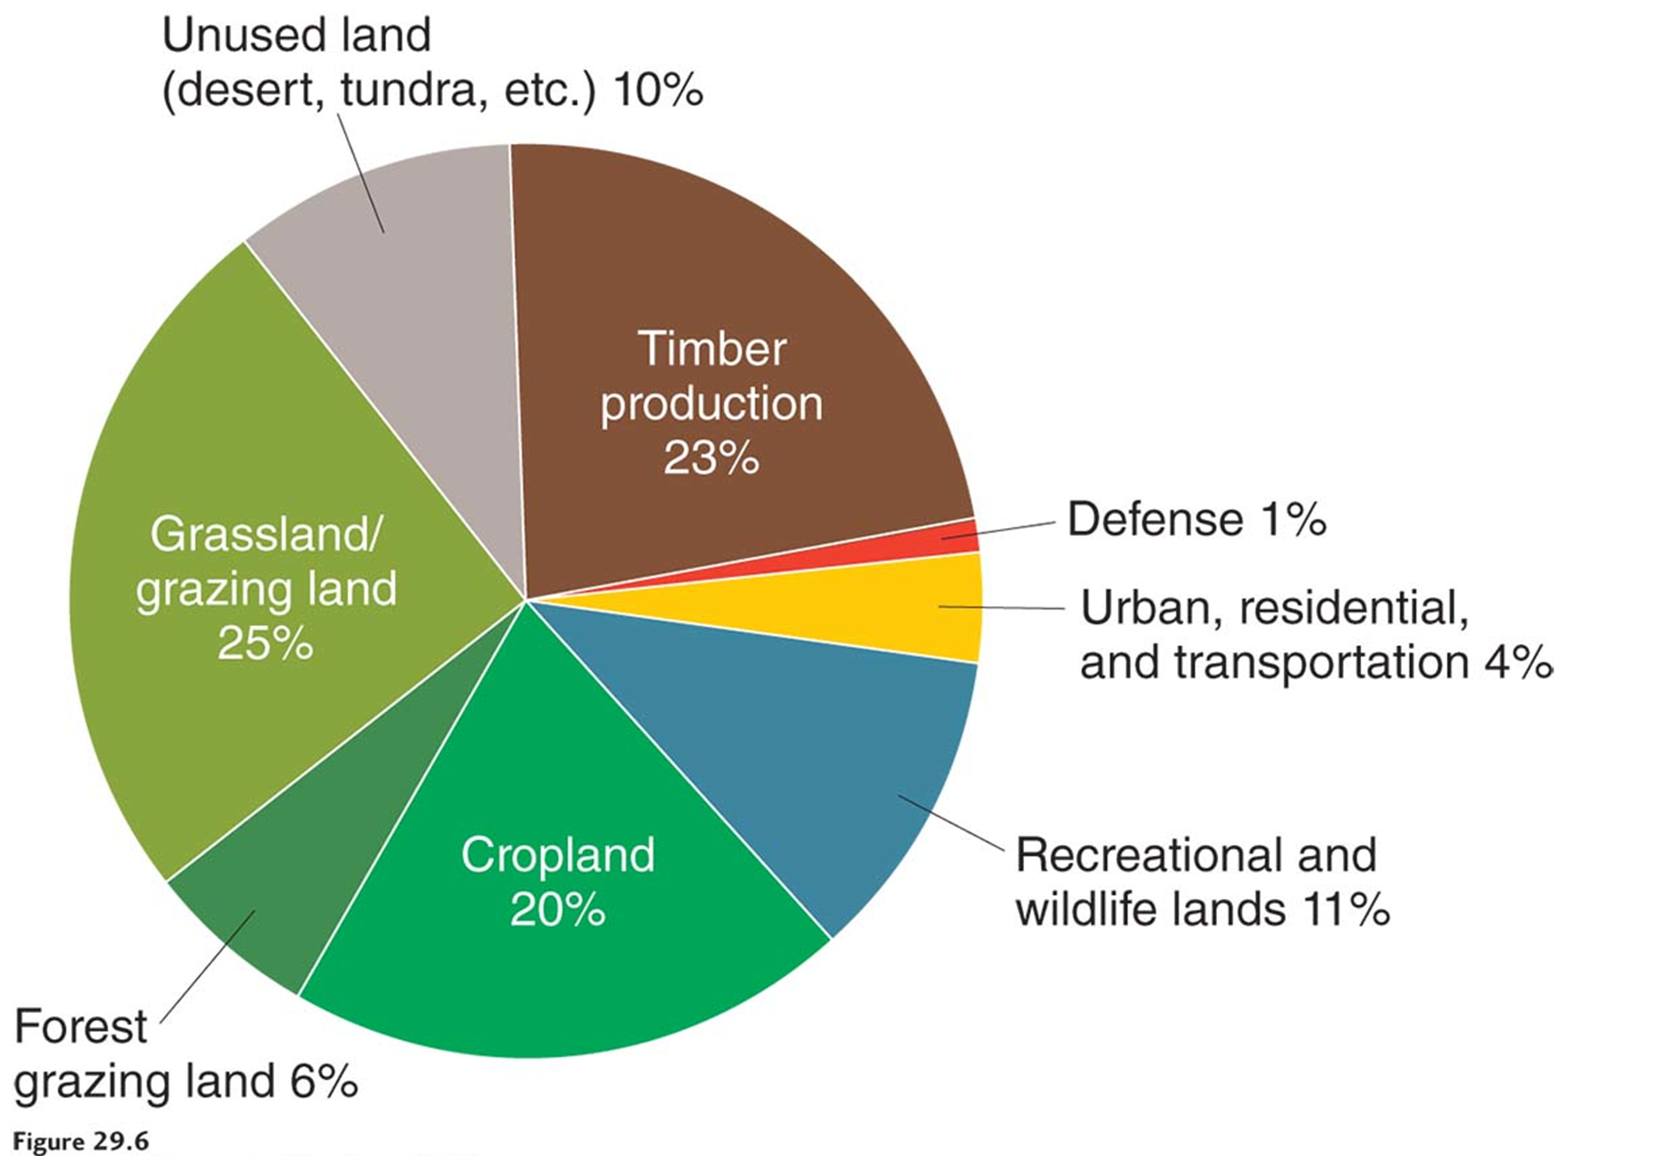
Land Use in the United States

Slide 13
Module
30
Land Management Practices
Learning Objectives
After this module, you should be able to:
explain specific land management practices for rangelands and forests.
describe contemporary problems in residential land use and some potential solutions.

Slide 14
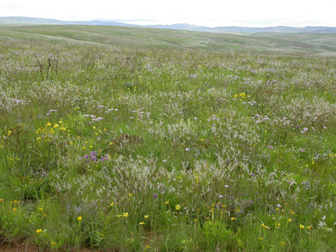
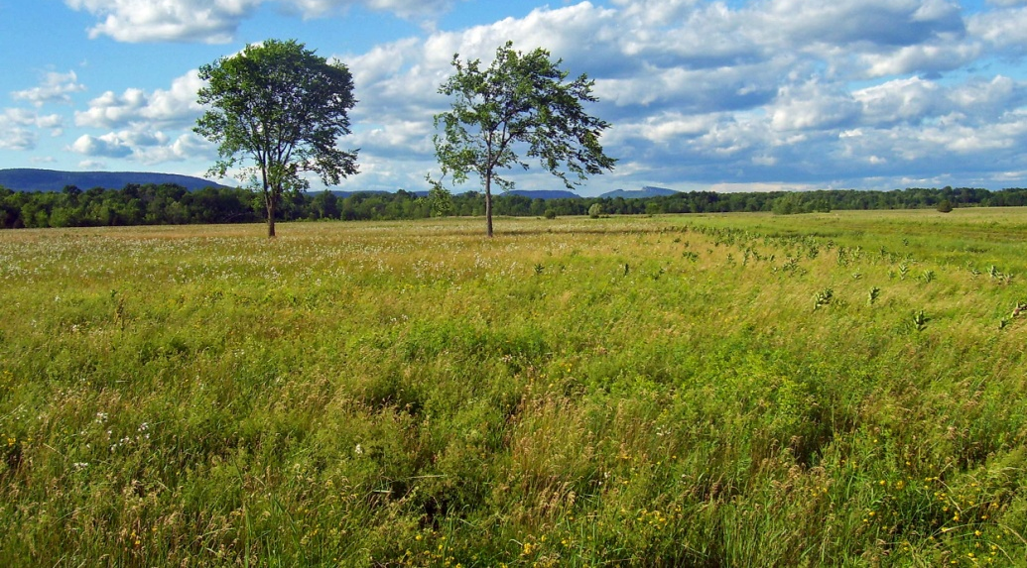
Grasslands
Important ecological services of grasslands:
Soil formation
Erosion control
Nutrient cycling
Storage of atmospheric carbon dioxide in biomass
Maintenance of diversity

Slide 15
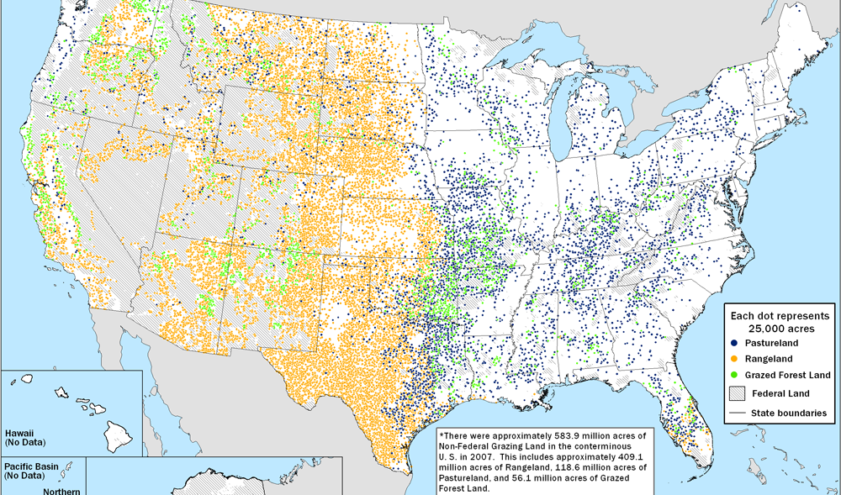
Rangelands
Cattle grazing is the #1 use of land in the U.S.
Rangelands: natural grasslands
Pastures: managed grasslands

Slide 16
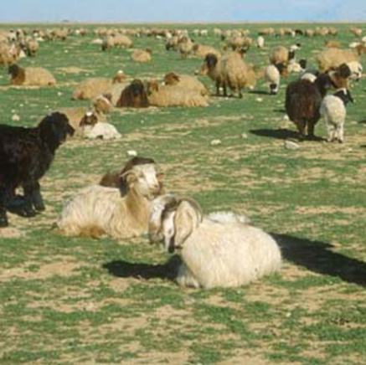
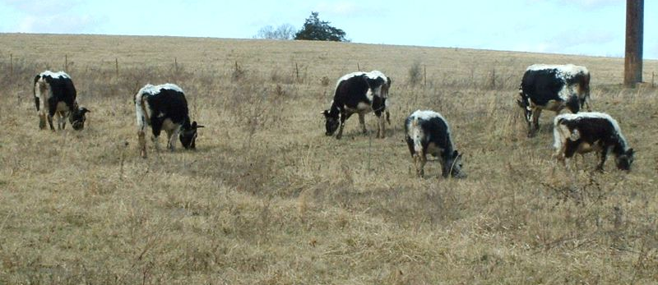
Managing Rangelands
We can sustain rangeland productivity by controlling the number and distribution of livestock and by restoring degraded rangeland.
Overgrazing occurs when too many animals graze for too long and exceed carrying capacity of a grassland area.
Grass/shrubs are damaged beyond repair
Reduces grass cover
Leads to erosion of soil by water and wind

Slide 17
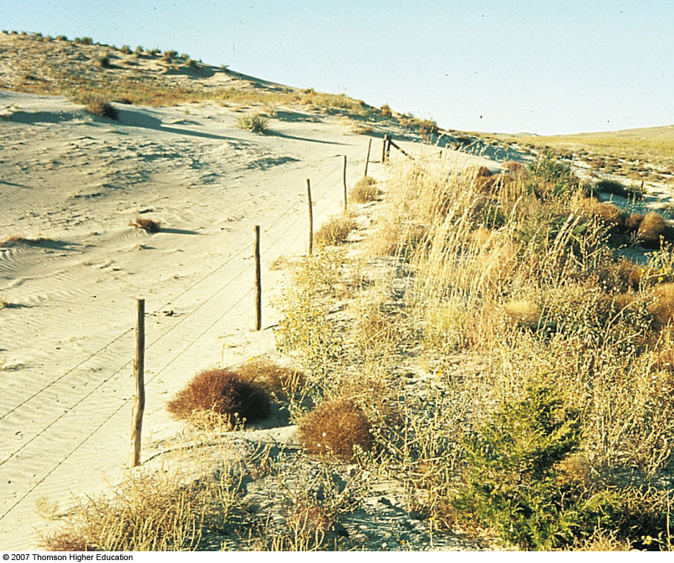
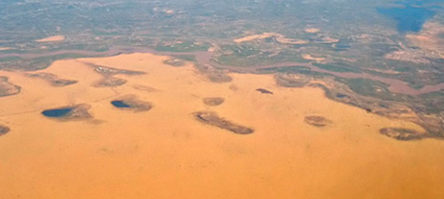
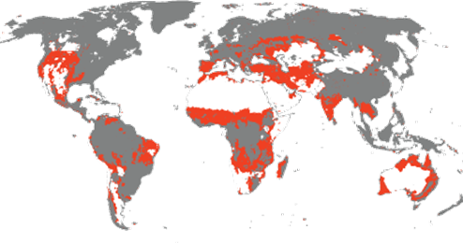
Managing Rangelands
Desertification - The degradation of land that results in a desert.
Caused by overgrazing, deforestation, or overuse
The worlds deserts are getting bigger
Prevention of overgrazing:
Rotational grazing
Replant barren areas
Apply fertilizer
Reduce soil erosion

Slide 18
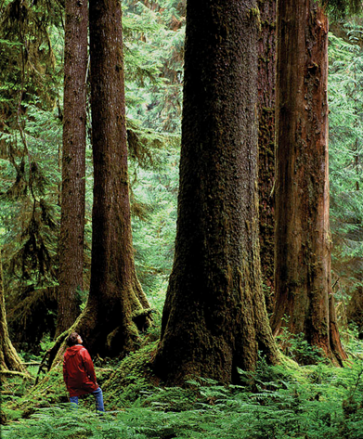
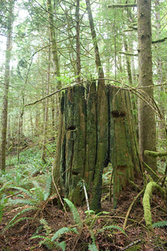
Forests
Old-growth forest: Original forests that have not been disturbed for logging, road building, or development
Also called primary, ancient, virgin, or primeval forests
High biodiversity because of many specialized niches
Second-growth forest: Area which has re-grown after a major disturbance such as fire, insect, or timber harvest
The area is reclaimed by the natural process of secondary succession

Slide 19
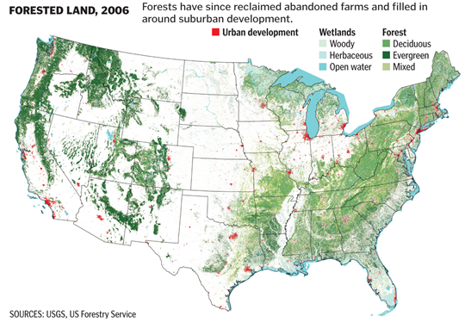
Forests

Slide 20
Forests Provide Important Economic and Ecological Services
Estimated annual value:
Economic services
$1.8 trillion
Ecological services
$4.7 trillion

Slide 21
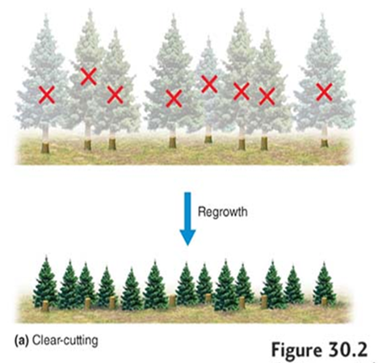
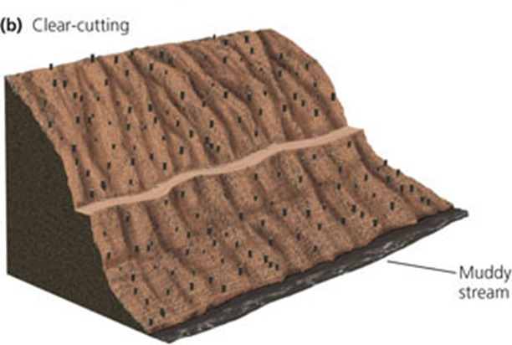
Timber Harvest Practices
Clear-cutting: A method of harvesting trees that removes most, if not all, trees from an area and is often coupled with replanting.
High timber yields
Maximum profits
Greatly reduces biodiversity
Destroys and fragments habitats
Increases runoff and flooding
Eliminates most recreational value

Slide 22
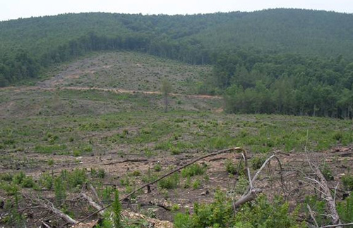
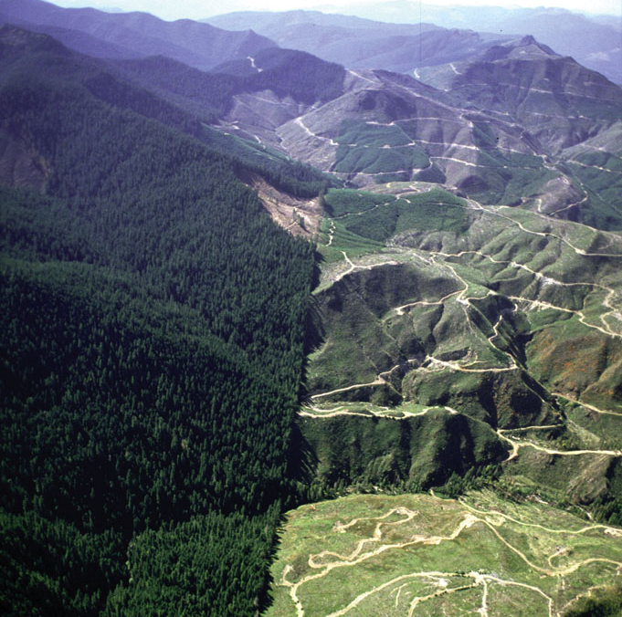
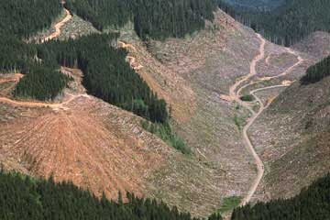
Timber Harvest Practices
Clear-cutting

Slide 23
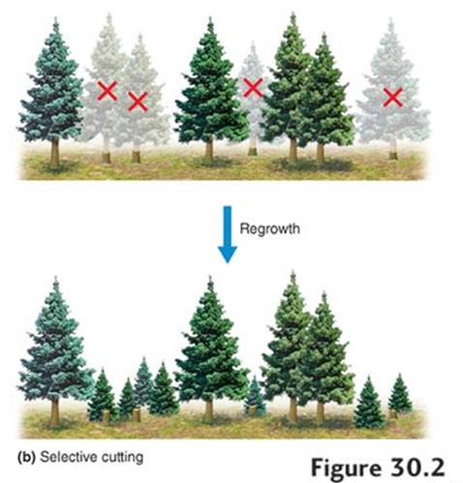
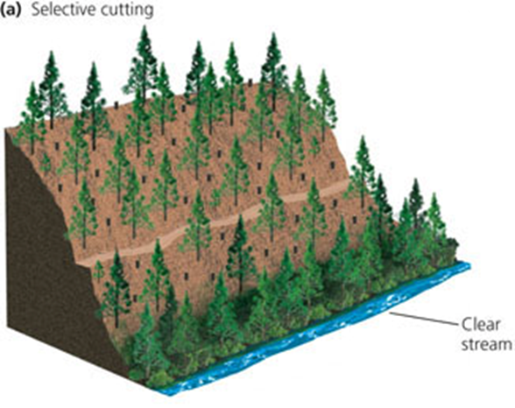
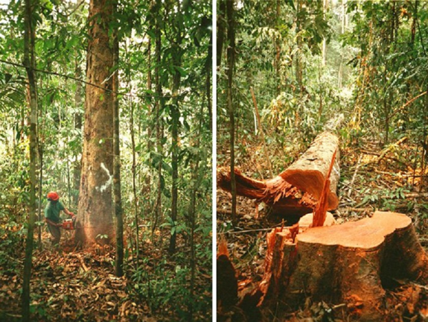
Timber Harvest Practices
Selective cutting: The method of harvesting trees that involves removing single trees or small numbers of trees. The resulting forest consists of trees of varying ages.
Mature trees are harvested individually
Younger trees left to harvest later
Encourages growth of younger trees
Reduces crowding
Removes diseased trees

Slide 24
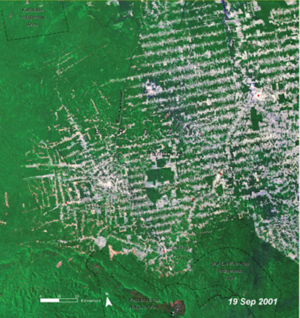
Deforestation
Timber production presents ecological challenges.
Deforestation – temporary or permanent removal of large areas of forests resulting from unsustainable cutting of trees
Human activities have reduced the earth’s forest cover by as much as half.
Losses are concentrated in developing countries.
Use it for fuel – heating and/or cooking
Tropical forests
Latin America, Indonesia, and Africa
Boreal forests
Alaska, Canada, Scandinavia, and Russia

Slide 25
Deforestation

Slide 26
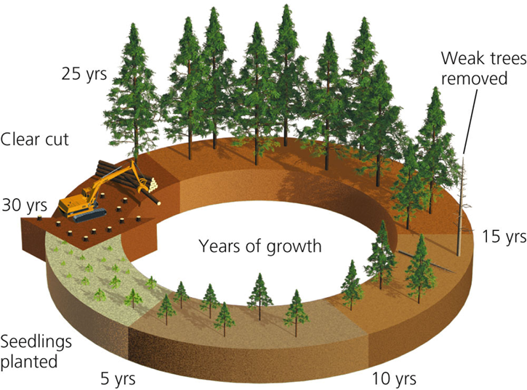
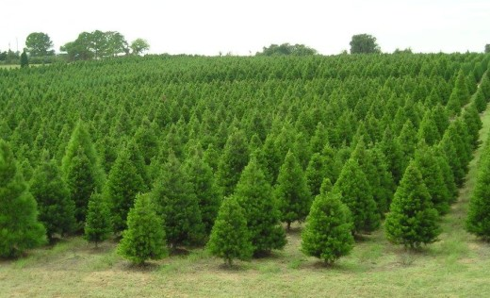
Reforestation
Tree plantation (tree farm): Planted stands of a particular tree species that are maintained, harvested, and replanted
Typically planted with a rapidly growing tree species
Typically used for paper or particle board
Replaces complex forest ecosystems with a single tree species

Slide 27
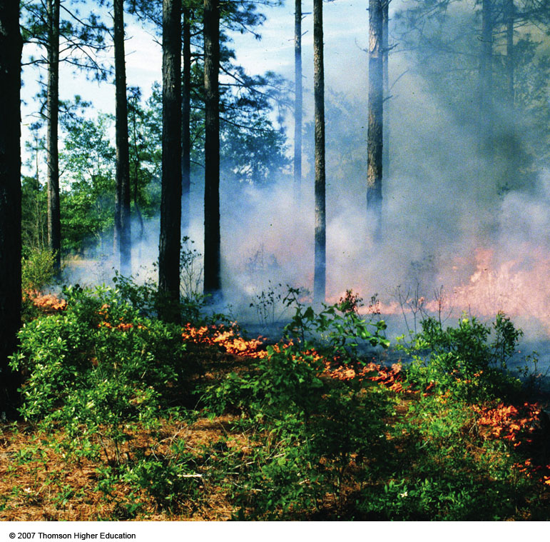
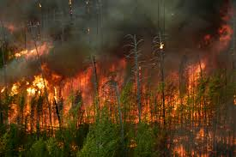
Fire Management
Fires are a natural process that can either benefit or harm forests:
Burn away flammable ground material
Prevent larger, more destructive fires
Release valuable mineral nutrients
Stimulate new forest growth

Slide 28
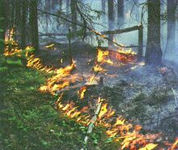
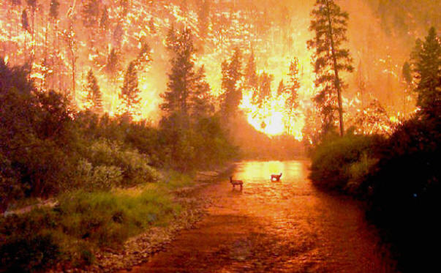
Fire Management
Surface fires
Low intensity, slow moving
Usually burn leaf litter and undergrowth
Crown fires
Extremely hot, fast moving, fierce and hard to control
Burns whole trees, jump from treetop to treetop

Slide 29
Fire Management
Fire prevention programs have been very effective…too effective.
Large amounts of highly flammable underbrush have accumulated
Leads to larger, more destructive crown fires
To reduce fire damage:
Prescribed burn: A fire deliberately set under controlled conditions in order to reduce the accumulation of fuel (dead biomass on a forest floor).
Allow fires to burn on public lands if they don’t threaten life and property.
Clear small areas around property subject to fire.

Slide 30
National Parks
Important Definitions:
Conservation
Focuses on the proper use of nature
Seeks to regulate the human use of wilderness and its resources
Preservation
Focuses on the protection of nature from use
Seeks to eliminate the human use of wilderness and its resources

Slide 31
National Parks
National park – a reserve of land managed for scientific, educational, and recreational use, and sometimes for their beauty or unique landforms.
Worldwide, countries have established more than 1,100 national parks.
58 Major national parks in the U.S. (400+ if you include National Monuments, Historical Parks, etc.)
Original intent of the U.S. parks was to preserve and manage the resources, for human use.
In the 1960’s ecology and ecosystem management became the focal point.
Conservation and wildlife management became key.

Slide 32
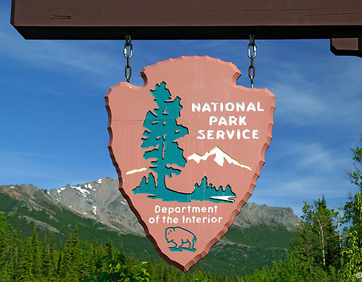
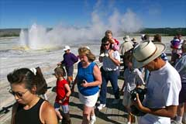
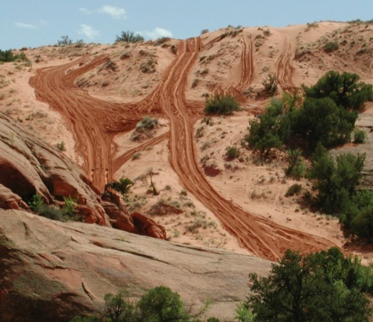
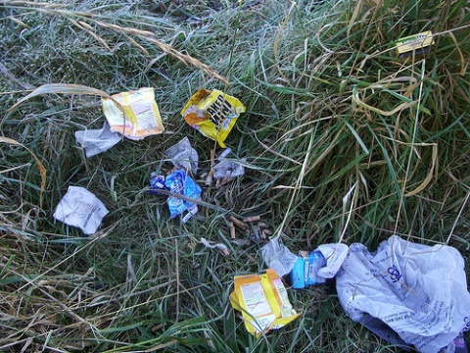
National Parks
Despite being protected, most National Parks are still threatened by human activities:
Overused due to popularity – litter, trampling, off road vehicles, etc.
Many species are isolated and fragmented from the ecosystems around them
Air pollution as a result of activities outside of park

Slide 33
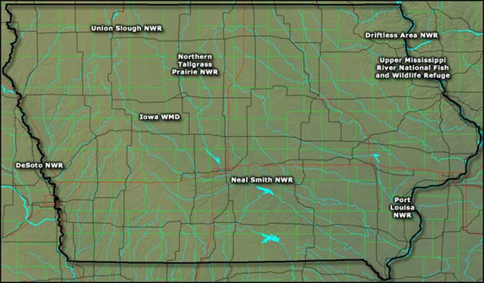
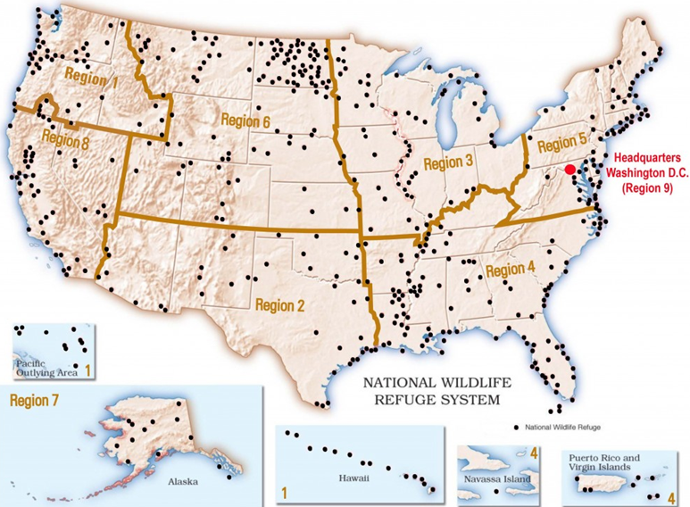
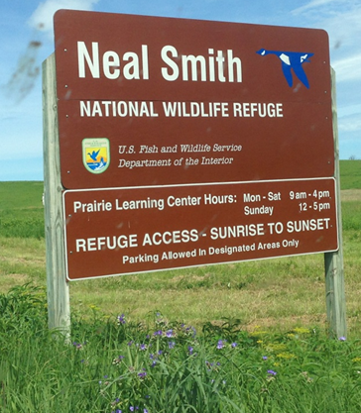
Wildlife Refuges
National wildlife refuge: A federal public land managed for the primary purpose of protecting wildlife, fish, and plants.
Land conservation and habitat restoration, endangered species, migratory birds, public engagement and education
560 national wildlife refuges; with at least one in every U.S. state and territory

Slide 34
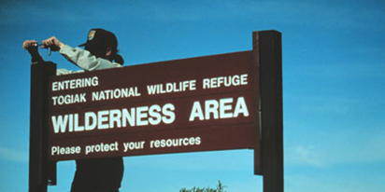
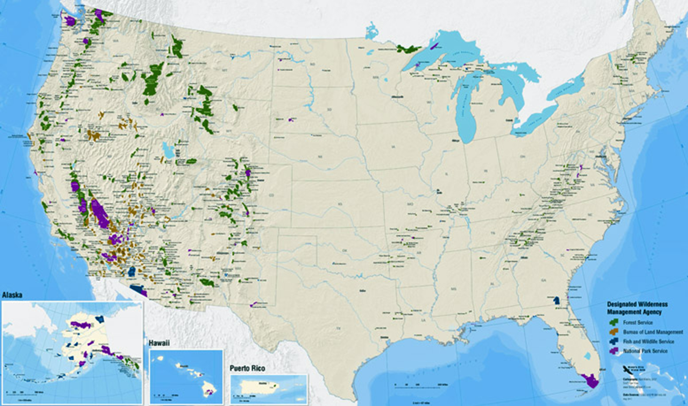
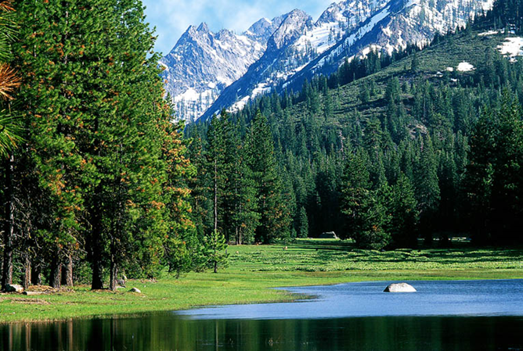
Wilderness Areas
National wilderness area: An area set aside with the intent of preserving a large tract of intact ecosystem or a landscape.
Only about 4% of the land area of the U.S. has been protected as wilderness.

Slide 35
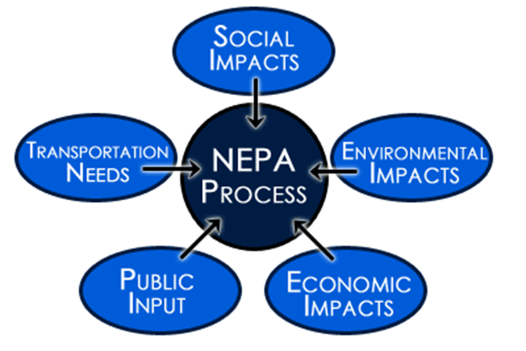
Federal Regulation of Land Use
National Environmental Policy Act (NEPA) A 1969 U.S. federal act that mandates an environmental assessment of all projects involving federal money or federal permits.
Assures that proper consideration is given to the environment prior to undertaking any major federal action that significantly affects the environment.

Slide 36
Federal Regulation of Land Use
Environmental impact statement (EIS): A document outlining the scope and purpose of a development project, and a systematic assessment the environmental impacts of proposed actions and consideration of alternative actions which are less damaging to, and protective of, the environment.
In addition to obvious environmental impacts, sometimes new ones are discovered.
Federal funds are withheld until creation of a mitigation plan
Environmental mitigation plan: A plan that outlines how a developer will address concerns raised by a project’s impact on the environment.

Slide 37
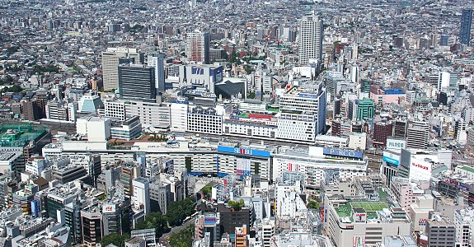
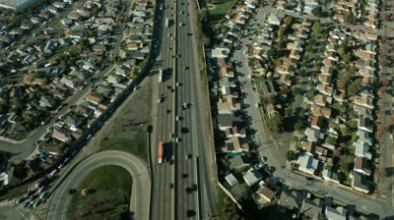
Residential land use is expanding
Land availability determines whether a city must grow vertically or if it can spread out horizontally
Compact cities (Hong Kong, China; Tokyo, Japan)
Dense development, high-rise buildings, mass transit
Dispersed cities (U.S. and Canada)
Plentiful land, cheap gasoline, network of highways, dependence on cars

Slide 38
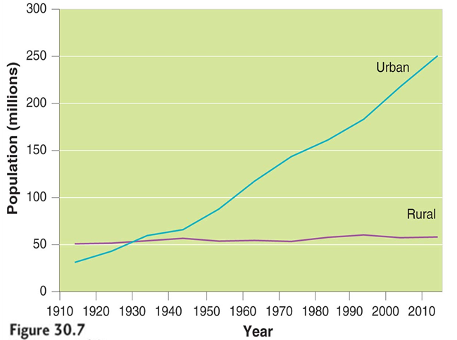
Residential land use is expanding
Suburb: An area surrounding a metropolitan center, with a comparatively low population density.
Exurb: An area similar to a suburb, but unconnected to any central city or densely populated area.
Since 1950 more than 90% of the population growth in metropolitan areas has occurred in suburbs, and 2/3 people now live in suburban or exurban communities.

Slide 39
Urban vs. Suburban

Slide 40
Urban Sprawl
Urban sprawl: Low-density urbanized areas that spread into rural areas, removing clear boundaries between the two.
Contributing factors to urban sprawl in the U.S.:
Ample land to spread out
Low-cost gasoline; highways encourage vehicle use
Greater cost of living in cities
Government policies that encourage growth and
home ownership
Urban blight – the degradation of a city that results
from, and contributes to, people moving to suburbs.

Slide 41
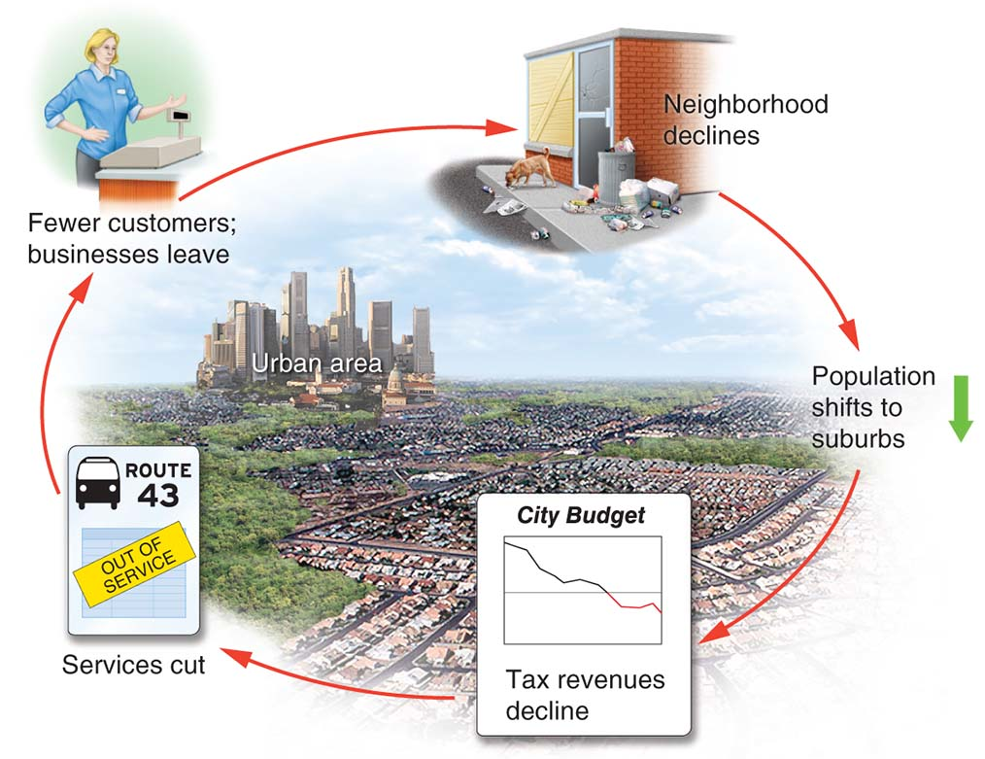
Urban Sprawl

Slide 42
Urban Sprawl
Zoning: A planning tool where parcels of land are designated for specific uses
Used to separate industry and business from residential neighborhoods.
Discourages innovation because everything has to fit a “type”
Multi-use zoning: A zoning classification that allows retail and high-density residential development to coexist in the same area.

Slide 43
Smart Growth
Smart growth: can help control growth patterns discourage urban sprawl, reduce car dependence, and protect ecologically sensitive areas.

Slide 44
Smart Growth
Conventional housing development
Bulldoze woods or farmland and build rows of houses on uniform sized lots
Cluster development
Houses concentrated on one portion of the land with the rest used for commonly shared open space.
Cheaper
More aesthetically pleasing
More open recreational space

Slide 45
Smart Growth
There is a growing movement to create mixed-use villages and neighborhoods within urban areas where people can live, work and shop close to their homes.
Environmental sustainability
Mixed-use and diversity
Quality urban design
Smart transportation
Walkability

