Slide 1
Achieving Energy Sustainability
Chapter 13

Slide 2
Module
37
Conservation, Efficiency, and Renewable Energy
Learning Objectives
After this module, you should be able to:
describe strategies to conserve energy and increase energy efficiency.
explain differences among the various renewable energy resources.

Slide 3
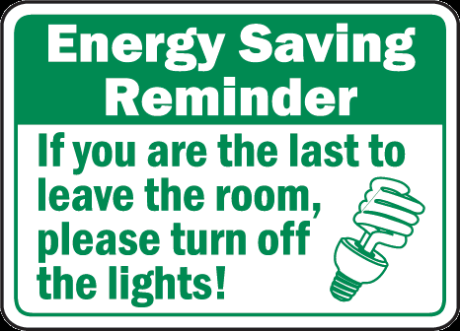

We can use less energy through conservation and increased efficiency
Energy conservation and energy efficiency are the least expensive and most environmentally sound options for maximizing our energy resources.
Energy conservation
  A decrease in energy use as a result of a decrease in the amount of wasted energy – “Use less”
Energy efficiency
  The measure of work we can get out of a unit of energy we use – “Use it better”

Slide 4
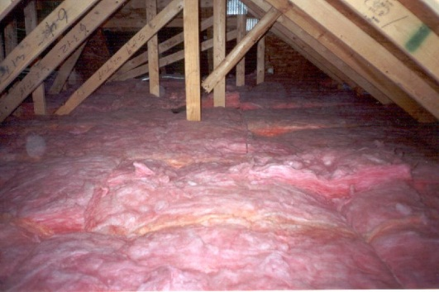

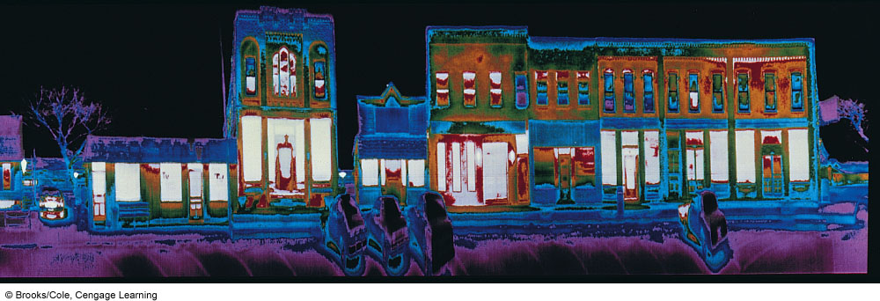
Energy Conservation and Efficiency in Your Home
Insulate and plug leaks
Use energy-efficient windows
Stop other heating and cooling losses
Heat houses more efficiently
Heat water more efficiently
Use energy-efficient appliances
Use energy-efficient lighting
About 1/3 of the heated air in typical U.S. homes and buildings escapes through closed windows, holes, and cracks.

Slide 5
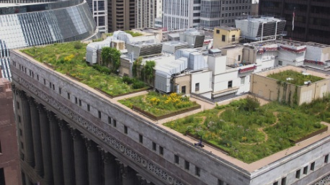
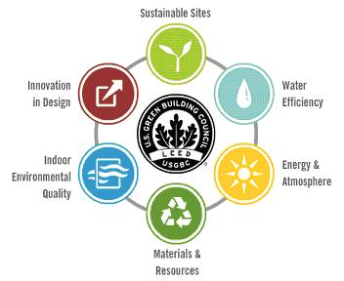

Sustainable Design
Green architecture
  Makes use of passive solar heating, natural lighting, natural ventilation, rain water collection, cogeneration of heat/electricity, geothermal heat pumps, and recycled building materials
Living or green roofs
Superinsulation
U.S. Green Building Council’s Leadership in Energy and Environmental Design (LEED)
Graded on 100 possible points:
Certified - 40 - 49 points
Silver - 50 - 59 points
Gold - 60 - 79 points
Platinum - 80 points up

Slide 6
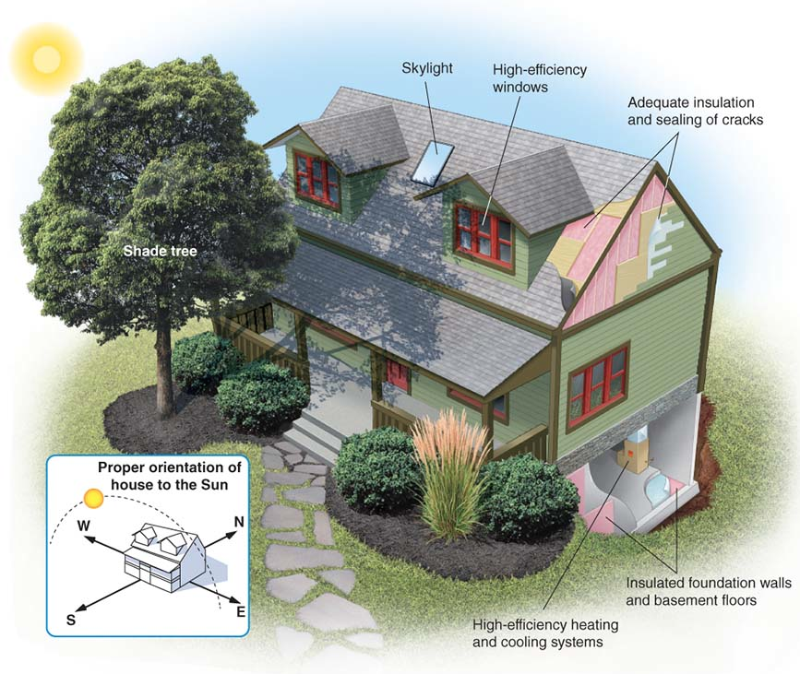

Sustainable Design
An energy-efficient home: A sustainable building design incorporates proper solar orientation and landscaping as well as insulated windows, walls, and floors.
In the Northern Hemisphere, a southern exposure allows the house to receive more direct rays from the Sun in winter when the path of the Sun is in the southern sky.

Slide 7
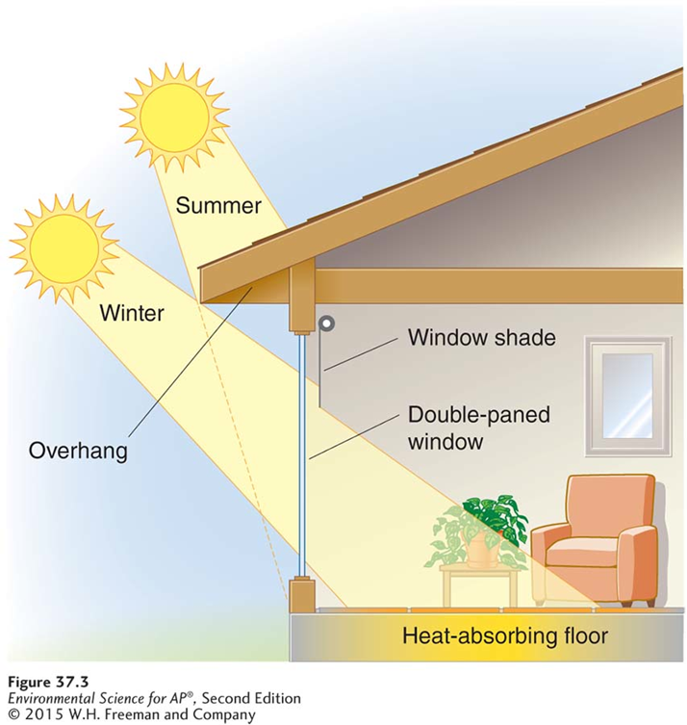
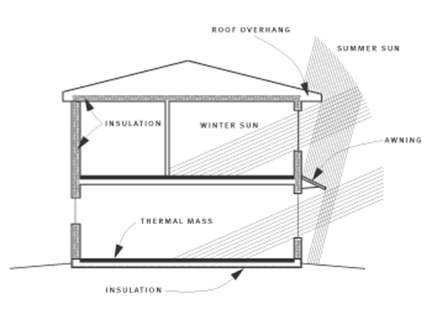
Sustainable Design
Passive solar design: Construction designed to use solar radiation to maintain indoor temperature without the use of pumps or other mechanical devices.
  Thermal mass: A property of a building material that allows it to maintain heat or cold.

Slide 8
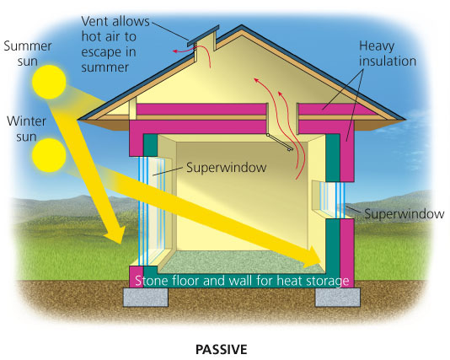
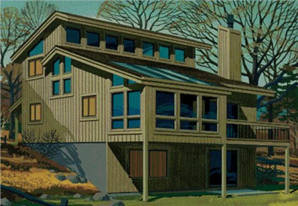
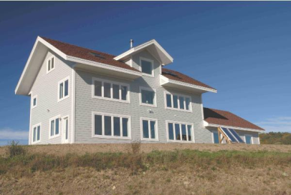
Sustainable Design
Passive solar heating system:
  Absorbs/stores heat from the sun within a structure without the need for pumps to distribute the heat
  Lots of windows on the south side of house
  Trees provide shade in the summer but let light through in the winter
  Roof overhangs allow the winter sun in through the windows, but block the summer sun.

Slide 9
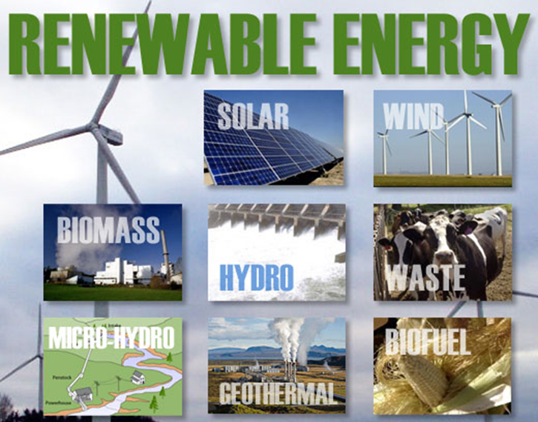
Renewable Energy
Renewable: In energy management, an energy source that is either potentially renewable or non-depletable.
  Potentially renewable: An energy source that can be regenerated indefinitely as long as it is not overharvested.
  Non-depletable: An energy source that cannot be used up no matter how much we use them.

Slide 10
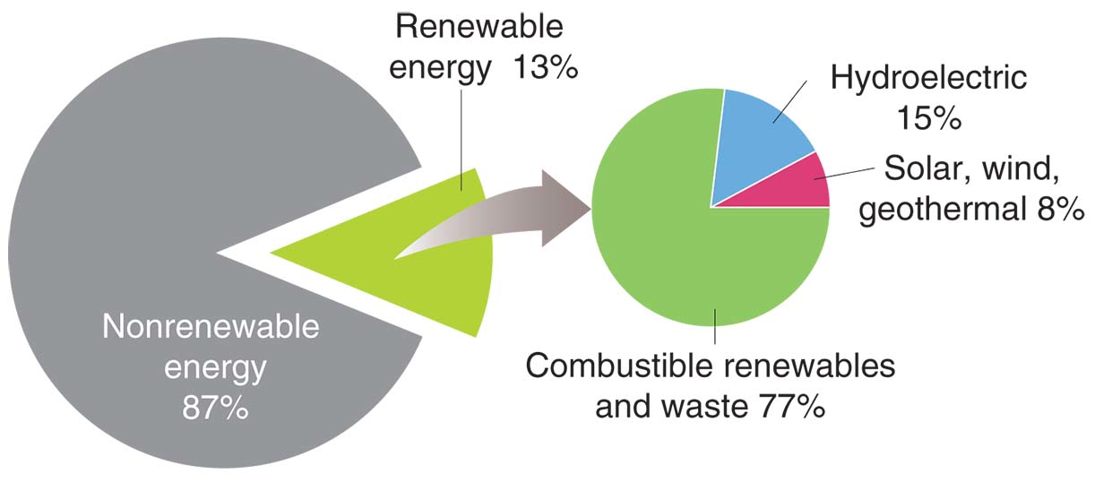

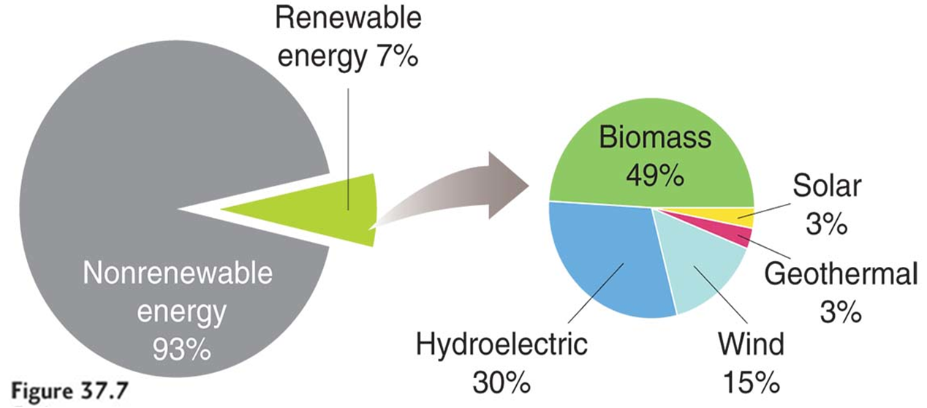
Renewable Energy
Global Energy Use
U.S. Energy Use

Slide 11
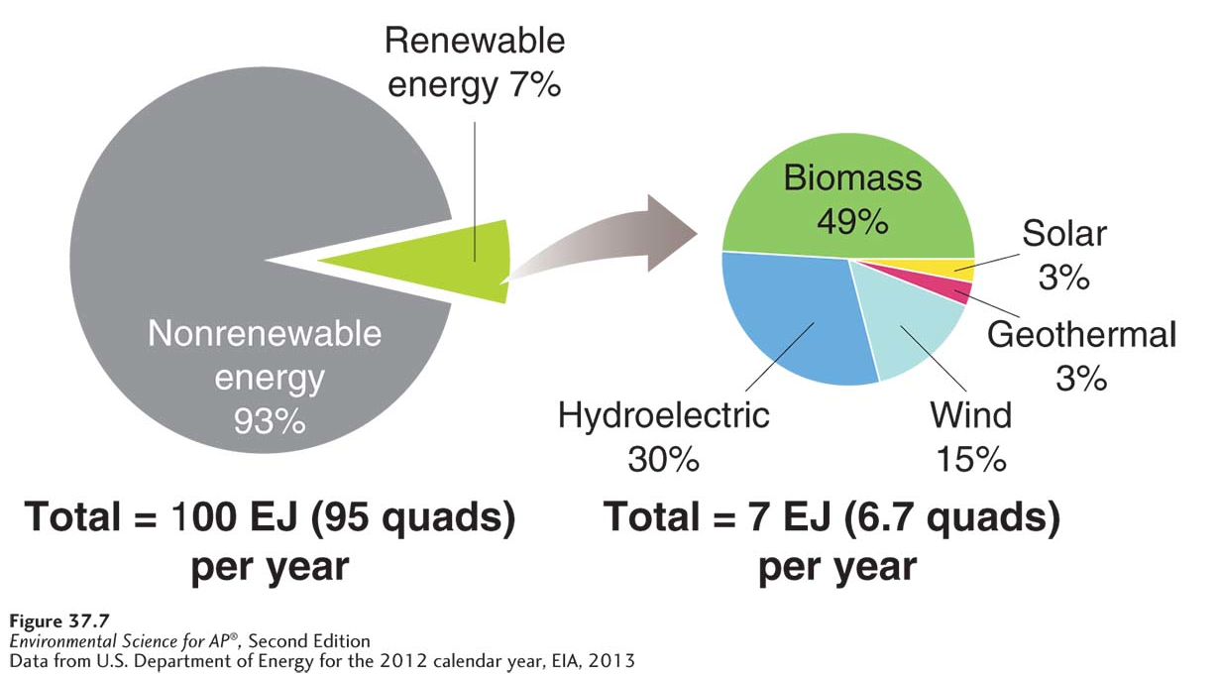

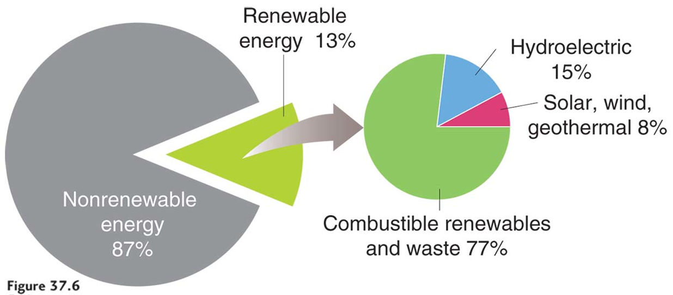
Renewable Energy
U.S. Energy Use
Global Energy Use

Slide 12
Module
38
Biomass and Water
Learning Objectives
After this module, you should be able to:
describe the various forms of biomass.
explain how energy is harnessed from water.

Slide 13
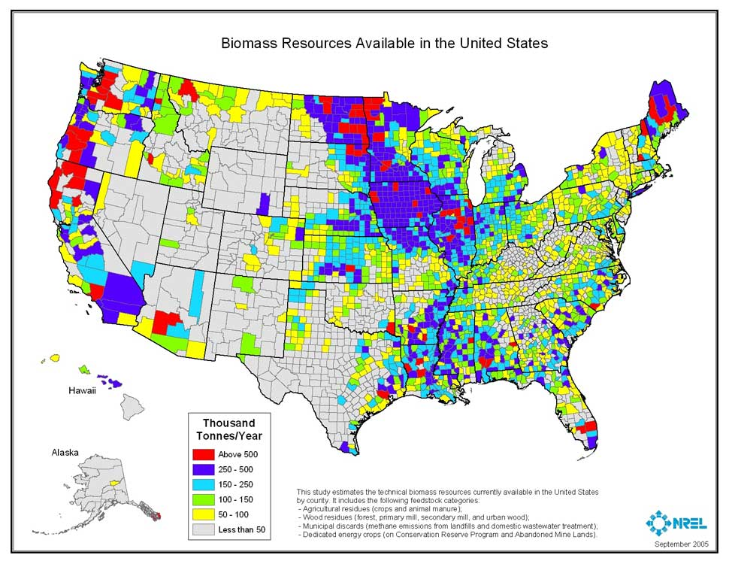
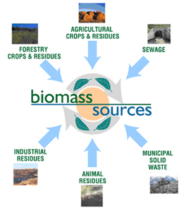
Biomass

Slide 14
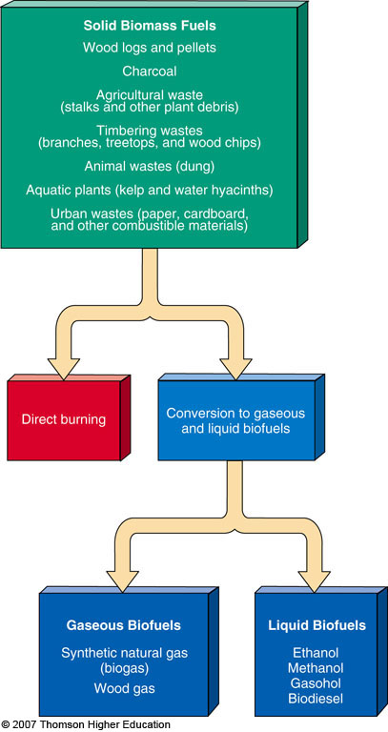
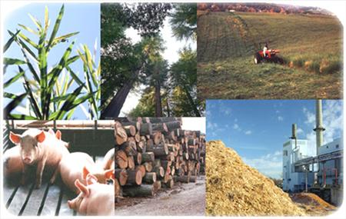
Biomass
Plant materials and animal wastes can be burned to provide heat/electricity or converted into biofuels.

Slide 15
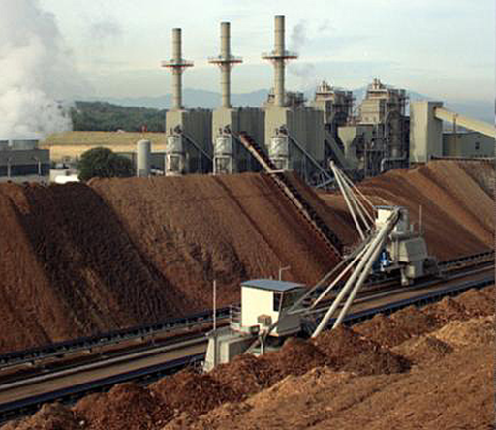
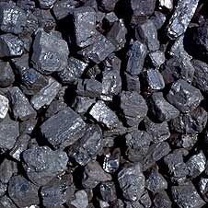
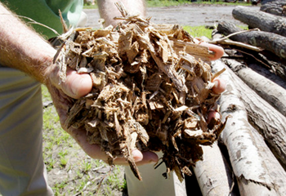
Modern Carbon Vs. Fossil Carbon
Modern carbon: Carbon in biomass that was recently in the atmosphere.
  CO₂ is “recycled”; no “new” CO₂ is added to the atmosphere
Fossil carbon: Carbon in fossil fuels that has been out of the carbon cycle for a long period of time.
  Another name for this is sequestered.

Slide 16
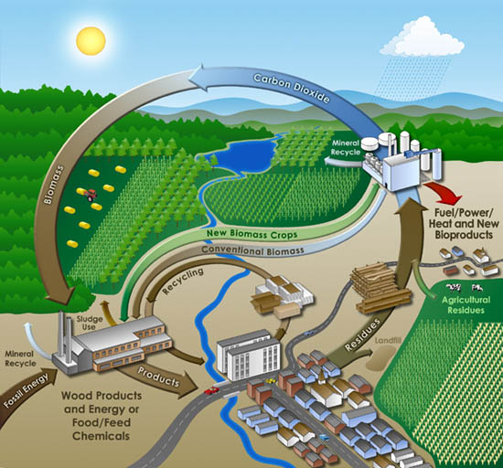
Modern Carbon Vs. Fossil Carbon
Carbon neutral: An activity that does not change atmospheric CO₂ concentrations.

Slide 17


Solid Biomass:
Wood, Charcoal, and Manure
Wood, charcoal and manure are used to heat homes throughout the world.
In the developing world, people often cannot afford fossil fuels or do not have access to them.
  Fuelwood crisis: As the population increases, fuelwood is being harvested at unsustainable rates in developing countries.
  Biomass is used for: cooking, heat, and boiling water

Slide 18
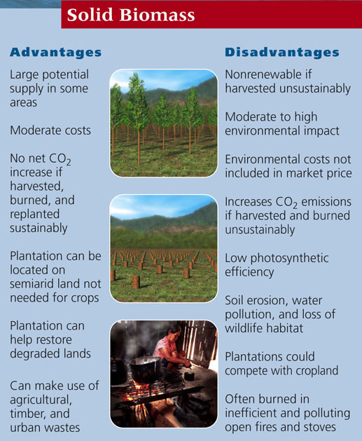
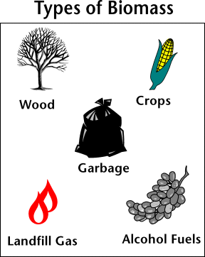
Solid Biomass:
Advantages and Disadvantages

Slide 19
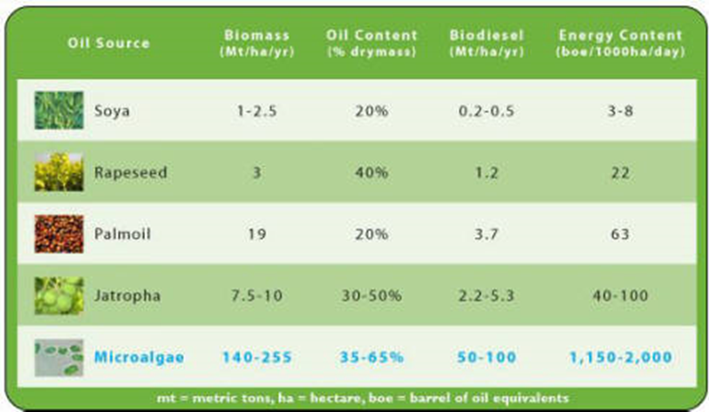
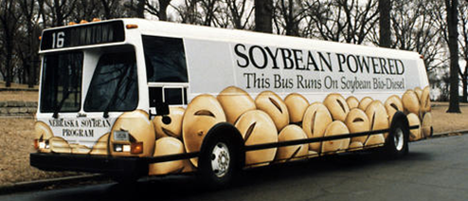

Biofuels: Ethanol and Biodiesel
Biofuel: Liquid fuel created from processed or refined biomass that can be used as a substitute for gasoline and/or diesel.
Biodiesel: production from vegetable oil from a variety of different plants or even from animal fats.

Slide 20
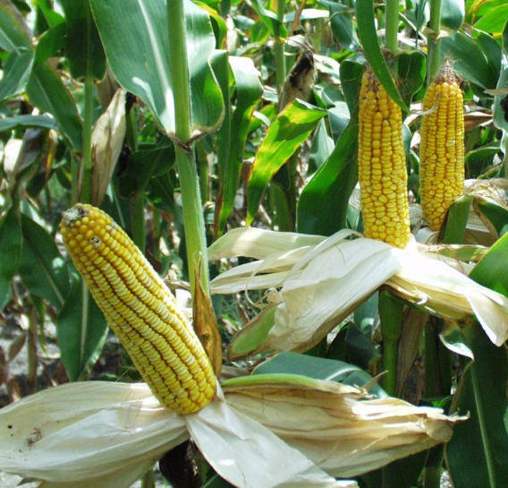
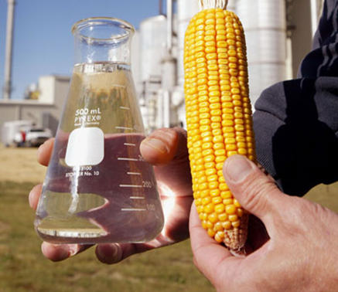
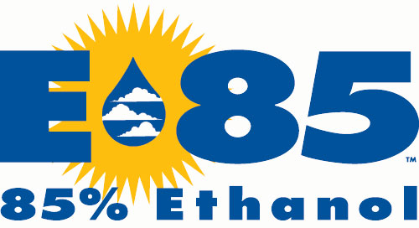
Biofuels: Ethanol and Biodiesel
Ethanol: involves fermenting the sugars in certain crops such as sugarcane, corn, and switchgrass and agricultural, forestry and municipal wastes.
The ethyl alcohol is then added to gasoline.
  Regular ethanol = 15% ethanol & 85% gasoline
  E-85 = 85% ethanol & 15% gasoline

Slide 21
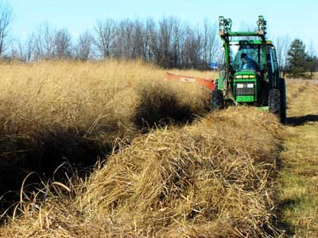
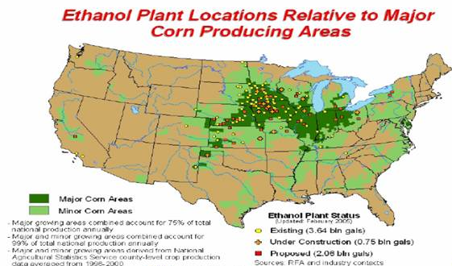
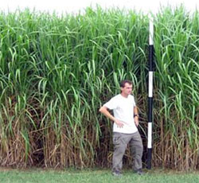
Biofuels: Ethanol and Biodiesel
Cellulosic ethanol: alternative to corn ethanol
  Sources: switchgrass, crop residues, municipal wastes

Slide 22
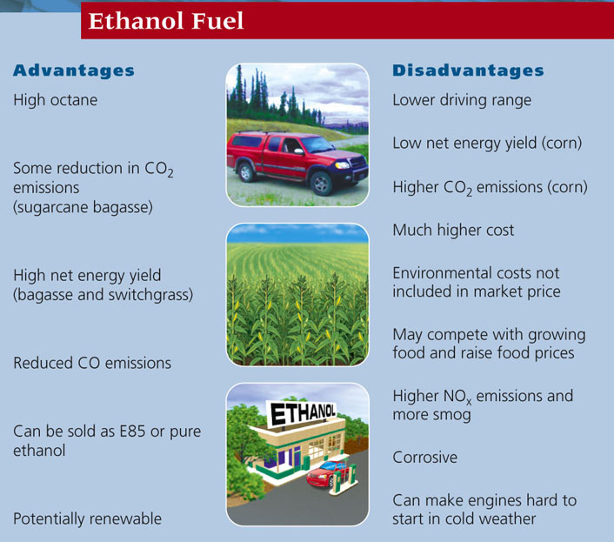
Ethanol:
Advantages and Disadvantages
Competition with the food industry over the use of corn
Full accounting must include the fossil fuels used in agriculture
Growing corn also has environmental impacts beyond fossil fuel use.

Slide 23
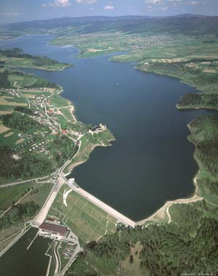
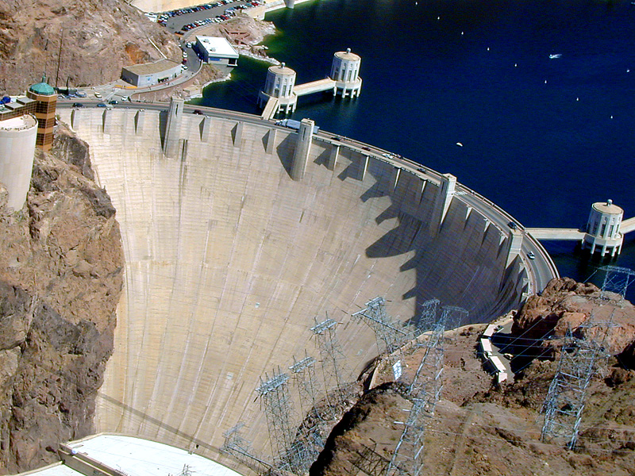
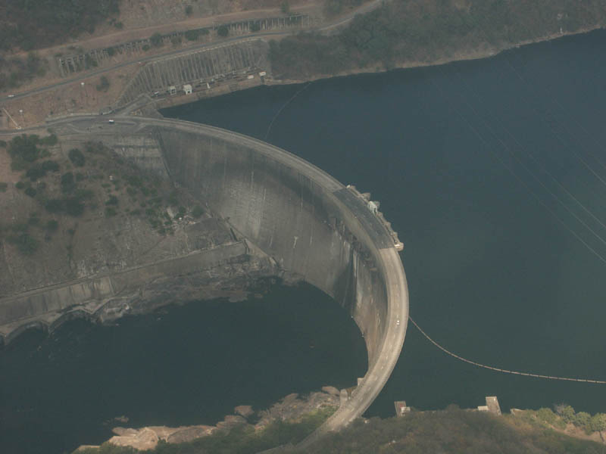
Hydroelectricity

Slide 24
The kinetic energy of water can generate electricity
Hydroelectricity: Electricity generated by the kinetic energy of moving water.
World’s leading renewable energy source used to produce electricity
  16% of the world’s electricity
  99% in Norway, only 7% in the U.S. (Western U.S.)
Water impoundment: The storage of water in a reservoir behind a dam.
  Build a high dam across a large river
  Water builds up into a reservoir
  Let water flow through large pipes and turn turbines to produce electricity

Slide 25
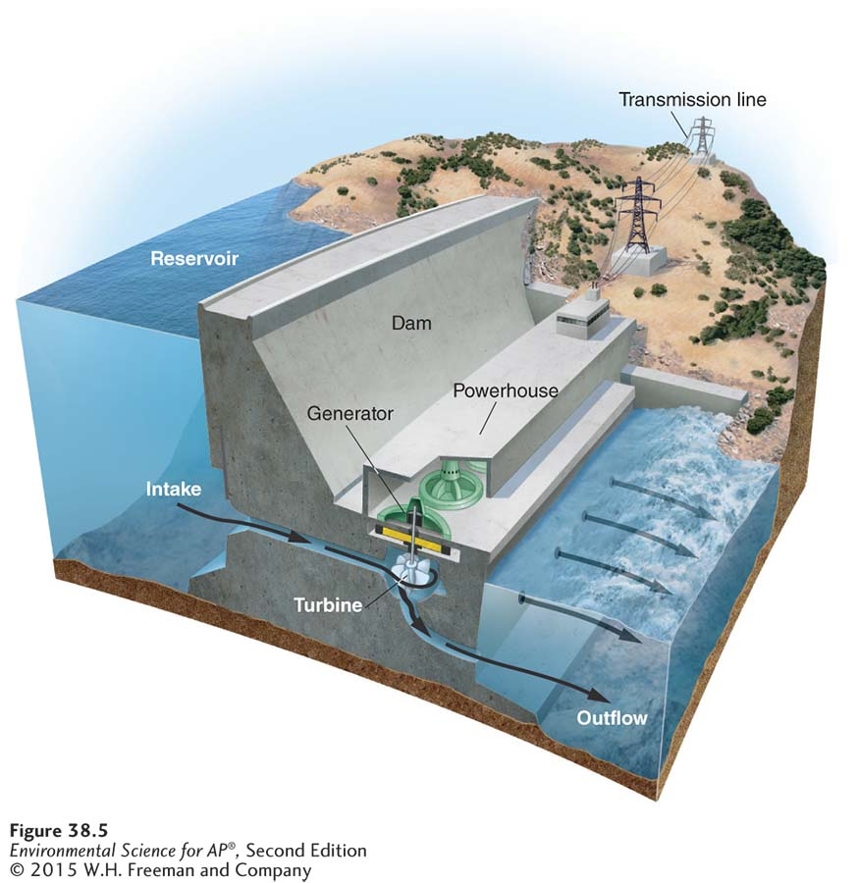
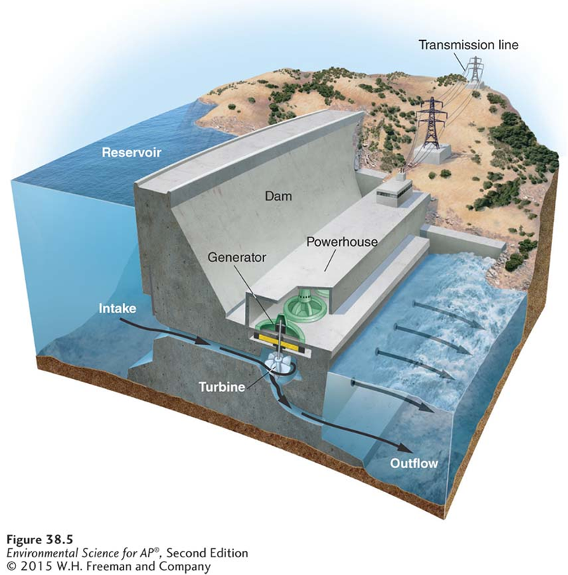
Hydroelectricity

Slide 26
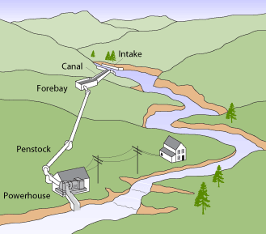
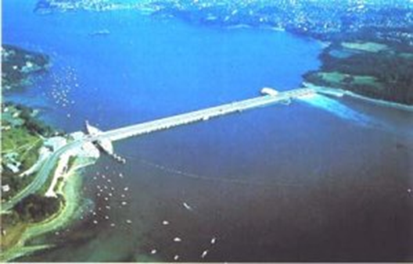
The kinetic energy of water can generate electricity
Run-of-the-river: small-scale electricity generation in which water is retained behind a low dam or no dam.
  Do not store water in reservoirs…no flooding
Tidal energy: harnessing the periodic rise and fall of ocean levels along coastlines.
  Few suitable sites
  High costs

Slide 27
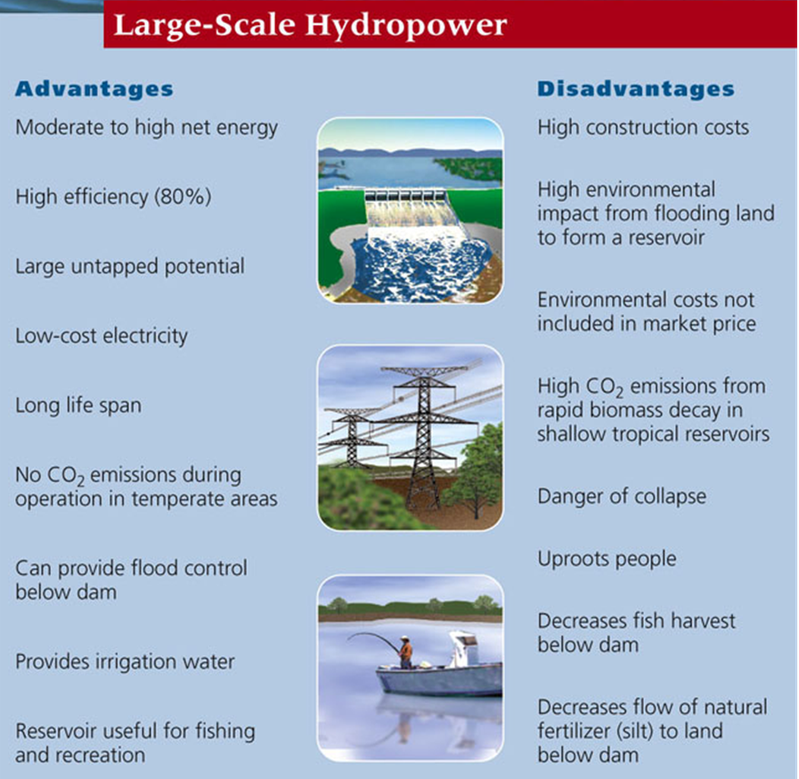
Hydroelectricity:
Advantages and Disadvantages

Slide 28
Module
39
Solar, Wind, Geothermal, and Hydrogen
Learning Objectives
After this module, you should be able to:
list the different forms of solar energy and their application.
describe how wind energy is harnessed and its contemporary uses.
discuss the methods of harnessing the internal energy from Earth.
explain the advantages and disadvantages of energy from hydrogen.

Slide 29
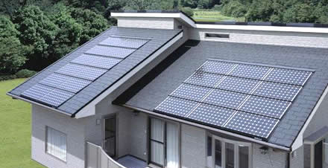
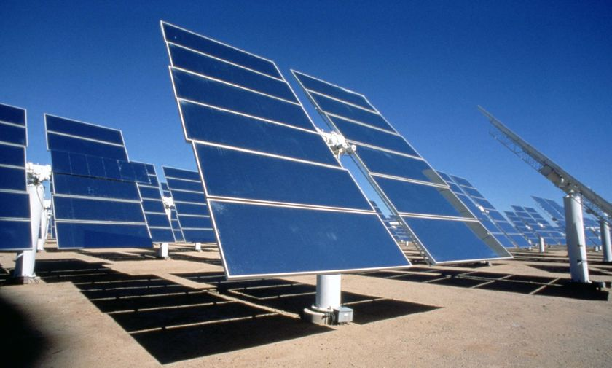
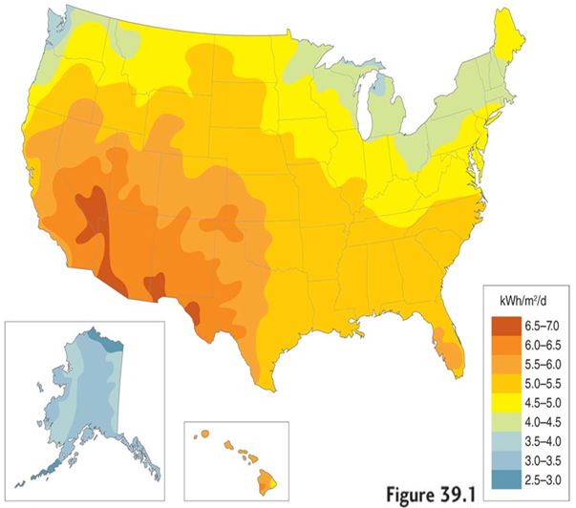
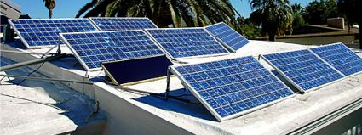
Solar Power

Slide 30
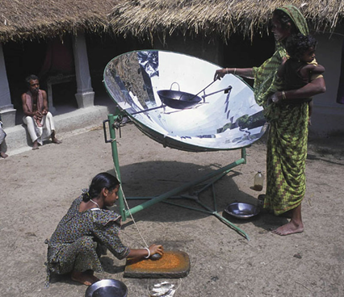
Solar Energy
Passive Solar Heating: Harnessing the sun without the use of pumps or advanced technology.
  Solar cookers: solution to the fuelwood crisis??
Active solar energy: Energy captured from sunlight with advanced technologies.
Technologies that employ active solar energy include:
  Solar water heating systems
  Photovoltaic systems
  Concentrating solar thermal (CST) systems

Slide 31
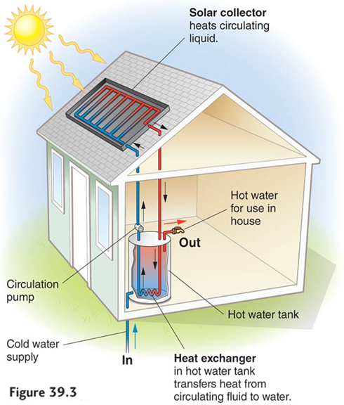
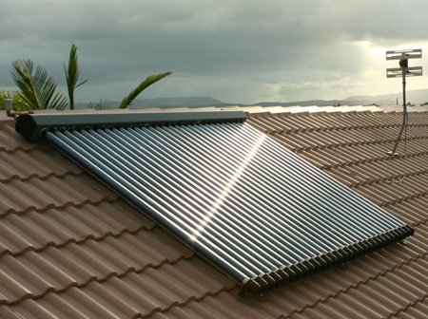
We Can Heat Buildings and Water with Solar Energy
Solar water heating system
  Pumping a liquid such as water or an oil through rooftop collectors. This liquid then can be used to heat the house (i.e. radiators)
  Can also provide hot water

Slide 32


We Can Use Solar Cells to
Produce Electricity
Photovoltaic (PV) cells (solar cells)
  Convert solar energy to electric energy
  Can be made in all shapes and sizes and can be included in the building design and construction.

Slide 33


We Can Use Solar Cells to
Produce Electricity
Solar cells can be used in rural villages with ample sunlight who are not connected to an electrical grid.
  Mostly for pumping water

Slide 34

We Can Use Sunlight to Produce High-Temperature Heat and Electricity
Concentrating Solar Thermal (CST) systems
  Sunlight is directed towards a central tower where and oil absorbs the heat and is used to create high temperature steam to turn a turbine.
Large arrays of solar collectors in sunny deserts
Costs are high and energy yield is low.

Slide 35



We Can Use Solar Cells to
Produce Electricity
Solar cells currently supply less than 2% of the world’s electricity, but has the largest POTENTIAL for supplying electrical power to the world.
http://www.seia.org/research-resources/solar-industry-data

Slide 36


Photovoltaic Cells:
Advantages and Disadvantages
PV cells costs were high but are quickly falling as a result of mass production and new designs.
PV cells are not a fuel, they are a technology, so they will improve.

Slide 37





Wind

Slide 38
Wind energy is the most rapidly growing source of electricity
Wind energy: Non-depleatable energy generated from the kinetic energy of moving air.
  Indirectly, powered by the sun (creates winds)
Wind power is capable of becoming a major contributor to America's electricity supply.
  Together with solar, wind energy is the fastest growing major source of electricity in the world.
Much of the world’s potential for wind power remains untapped.
Capturing only 20% of the wind energy at the world’s best energy sites could meet all the world’s energy demands.
  Ignoring storage and transmission. ☺

Slide 39

Generating Electricity from Wind
Wind turbine: A turbine that converts wind energy into electricity.
The wind turns the blades, which transfer energy to the gear box that transfers energy to the generator.
Wind turbines on land are typically installed in rural locations were open space is plentiful, or in the ocean just off the coastline.
Turbines are typically grouped into wind farms.

Slide 40

Generating Electricity from Wind

Slide 41



Producing Electricity from Wind Energy
Is a Rapidly Growing Global Industry

Slide 42




Producing Electricity from Wind Energy
Is a Rapidly Growing Global Industry
In 2009, Iowa generated only 14.5% of it’s electricity from wind.

Slide 43

Wind Power:
Advantages and Disadvantages
A network of wind farms in just four states could meet all U.S. electricity means.
The U.S. Dept. of Energy has examined a goal of 20% of electricity generation from wind energy by 2030.
  Currently, the U.S. gets 4.7% of its electricity from wind

Slide 44



GEOTHERMAL

Slide 45
Earth’s internal heat is a source of non-depletable energy
Geothermal energy: Heat energy that comes from the natural radioactive decay of elements deep within Earth.
Two main ways we can use geothermal energy:
  The direct use of steam to make electricity or hot water for homes/industry
  Taking advantage of the high thermal mass of the ground to transfer heat between the ground and buildings
The largest geothermal energy producers are the United States, China, and Iceland.

Slide 46


Getting Energy from the
Earth’s Internal Heat
Deeper more concentrated hydrothermal reservoirs can be used to heat homes and buildings and spin turbines to make electricity.
    Iceland
Geothermal energy: two problems
  High cost of tapping large-scale hydrothermal reservoirs
  Dry- or wet-steam geothermal reservoirs could be depleted

Slide 47

Ground Source Heat Pumps
Geothermal heat pump (GHP) : A technology that exploits the difference between the earth’s surface and underground temperatures.
  Depending on latitude, starting at a depth of 5-10 feet, the temperature remains a constant 50-55˚ F.
  Can heat/cool a building using 30-70% less energy than traditional furnaces and air conditioners.
The house is heated in the winter by transferring heat from the ground into the house.
In the summer the heat from the house is discharged into the ground.

Slide 48


Geothermal:
Open Loop vs. Closed Loop
Open Loop systems actually pump water from an underground aquifer through the geothermal heat pump and then discharge that water to a drainage ditch or pond.
Many times a re-injection well is used to return the water to the aquifer.

Slide 49



Getting Energy from the
Earth’s Internal Heat
Geothermal:
Open Loop vs. Closed Loop
Closed Loop systems involve passing an antifreeze solution through a closed loop of tubes or pipes.
  The same liquid is re-circulated over and over

Slide 50



HYDROGEN

Slide 51
Hydrogen Is a Promising Fuel but
There Are Challenges
Some energy experts view hydrogen gas as the best fuel to replace oil during the last half of the century, but there are several hurdles to overcome:
  Hydrogen is chemically locked up in water and organic compounds
  It takes energy and money to produce it so the net energy is low.
Electrolysis: The use of an electric current to split water molecules into hydrogen and oxygen.
CO₂ levels dependent on the method of hydrogen production
  No reduction of CO₂ emissions if hydrogen is obtained by using fossil fuels.

Slide 52

Hydrogen fuel cells have many
potential applications
  Fuel cells are the best way to use hydrogen.
  Combines hydrogen gas (H₂) and oxygen gas (O₂) to produce electricity.
(2H₂+O₂ → 2H₂O)
Emits no air pollution or CO₂ if the hydrogen is produced from renewable energy sources.
  Only water vapor!
Fuel-efficient vehicles powered by a fuel cell that runs on hydrogen gas are being developed.
Notes:
52

Slide 53




Fuel Cell Vehicles
Notes:
53

Slide 54



Fuel Cell Use in Homes

Slide 55
Module
40
Planning Our Energy Future
Learning Objectives
After this module, you should be able to:
discuss the environmental and economic options we must assess in planning our energy future.
consider the challenges of a renewable energy strategy.

Slide 56
Our Energy Future
No single energy can replace nonrenewable energy resources in a way that is completely renewable, nonpolluting, and free of impacts on the environment.
A sustainable energy strategy must combine:
  Energy efficiency
  Energy conservation
  Development of renewable energy resources and further improvement of nonrenewable energy resources
A sustainable energy strategy must consider the costs, benefits, and limitations of each energy source.
Convenience, reliability, and logistical considerations are also important.

Slide 57


Our Energy Future
Smart grid: An efficient, self-regulating electricity distribution network that accepts many sources of electricity and distributes it automatically to end users.
  Optimizes the use of energy in a home by continuously coordinating energy use with energy availability.

Slide 58
Our Energy Future
Governments can use a combination of subsidies, tax breaks, rebates, taxes and public education to promote or discourage use of various energy alternatives:
  Can keep prices artificially low to encourage selected energy resources.
  Can keep prices artificially high to discourage other energy resources.
  Emphasize consumer education.

Slide 59


