Slide 1
Global Change
Chapter 19

Slide 2
Module
62
Global Climate Change and the Greenhouse Effect
Learning Objectives
After this module, you should be able to:
distinguish among global change, global climate change, and global warming.
explain the process underlying the greenhouse effect.
identify the natural and anthropogenic sources of greenhouse gases.

Slide 3
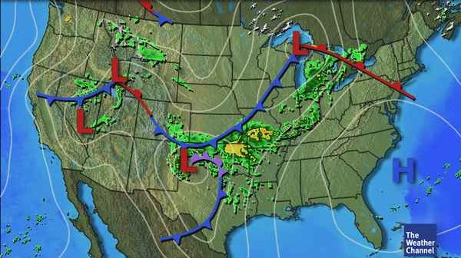
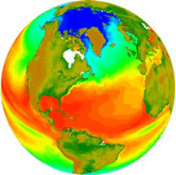
Weather vs. Climate
Weather: a local area’s short-term physical conditions such as temperature and precipitation.
Climate: a region’s average weather conditions over a long period of time (at least 30 years).
“Climate is what we expect, weather is what we get.”
-- Mark Twain
“If you don’t like the weather, wait 5 minutes;
If you don’t like the climate…MOVE.”
-- Paraphrased Mark Twain

Slide 4
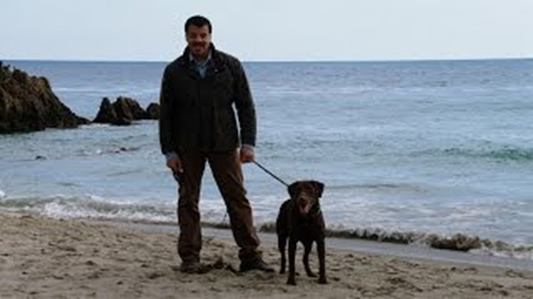
Climate
Climate variability: variations in climate from season to season or year to year.
Explains why one winter may be warmer to colder than last year to next year.
Influenced by large scale natural processes like El Niño
Averaged out over longer periods of time
http://www.weather.gov/dvn/climategraphics?n=climategraphics
https://www.youtube.com/watch?v=cBdxDFpDp_k

Slide 5
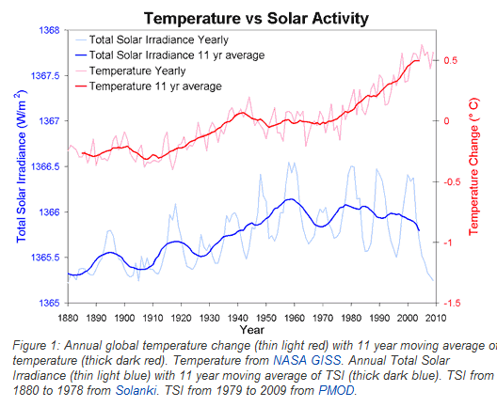
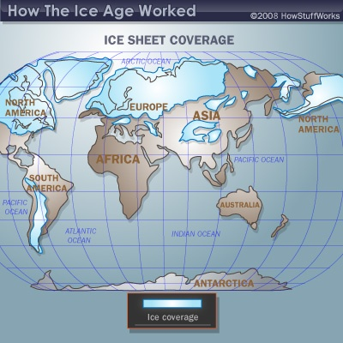
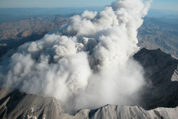
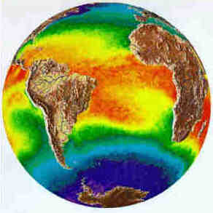
Climate
Climatology: the study of Earth’s climate and the factors that cause past, present, and future climate changes
Over the Earth’s history the climate has been altered by:
Volcanic emissions
Changes in solar input
Movement of the continents
Impacts by meteors

Slide 6
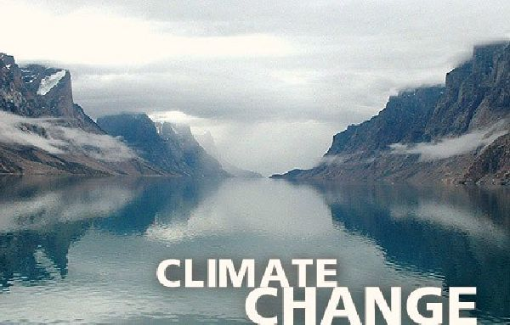
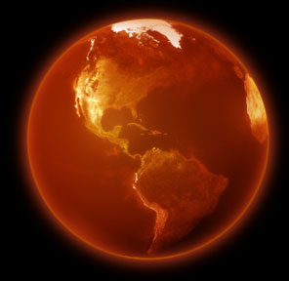
Global Warming vs. Climate Change
Important distinction:
Global Warming vs. Climate Change
Global warming = the warming of the troposphere and the oceans as a result of an increase in the natural greenhouse effect
Global climate change = a broader term referring to any changes in the Earth’s climate over a period of decades

Slide 7
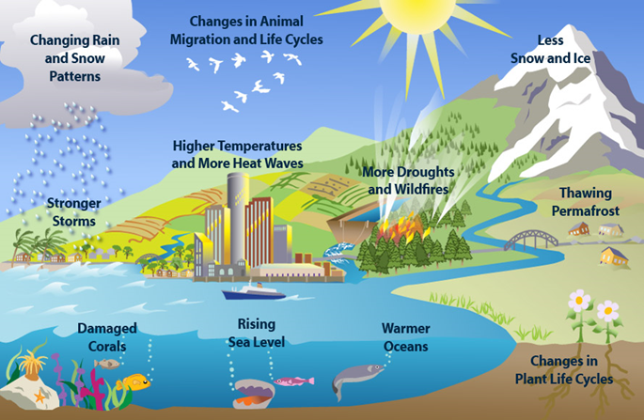
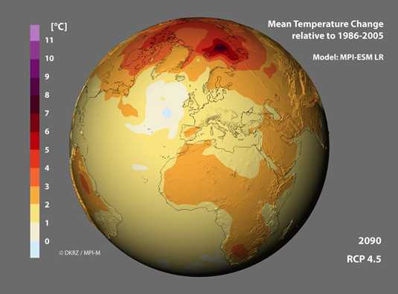
Global Warming vs. Climate Change
More detailed definitions:
Global warming: Rise in global temperatures because of the trapping of more heat in the lower atmosphere.
Average temp. of Earth has already risen by 1.4°F since 1880
Predicted to rise another 2.5°F during this century (IPCC 2015)
Global climate change: Long-term change in average weather conditions in an area. Changes may include:
Temperature – warmer or cooler
Rainfall – more or less
Wind patterns

Slide 8
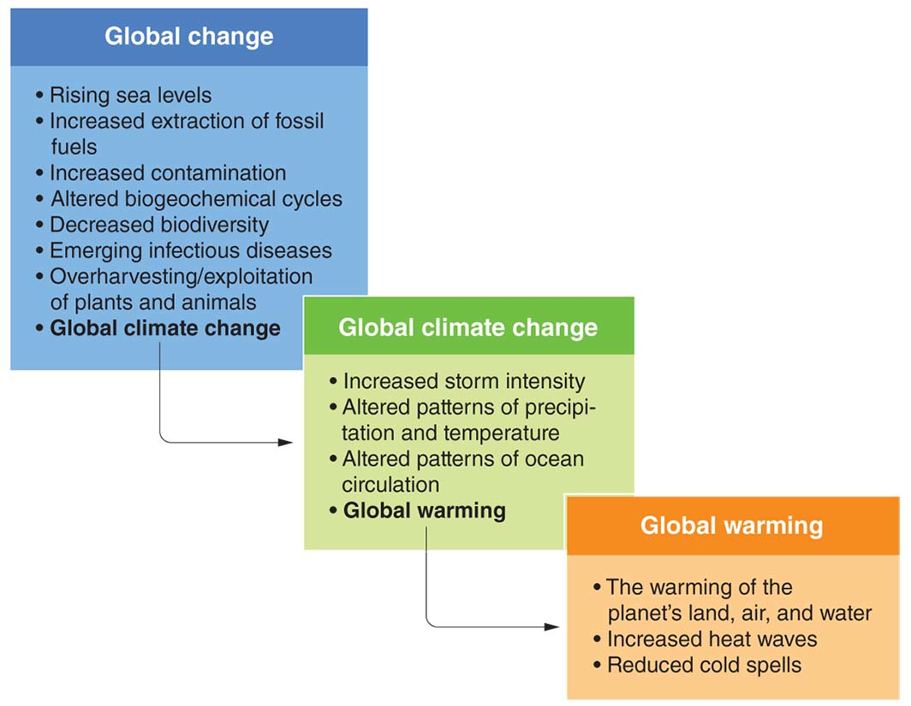
Global Change
Global change: Change that occurs in the chemical, biological, and physical properties of the planet.
Global change includes a wide variety of factors that are changing over time.

Slide 9
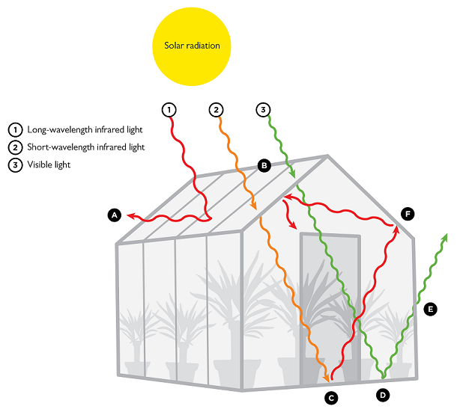
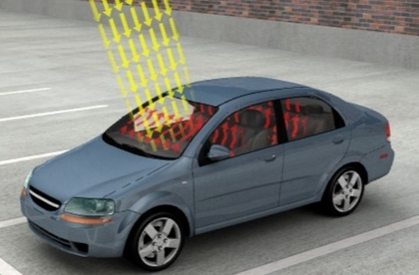
The Greenhouse Effect
At our distance from the Sun, the Earth should have an average global temp. of around -2º F (-19º C).
Instead, the Earth’s average temp is 57º F (14º C)
WHY??
The Earth’s natural greenhouse effect

Slide 10
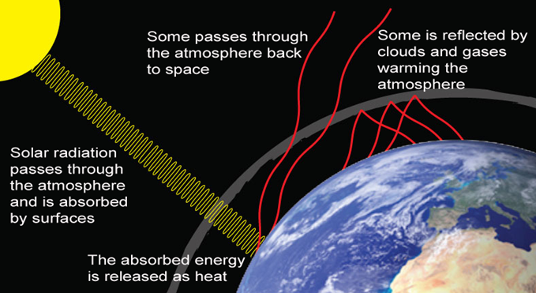
The Greenhouse Effect
The Greenhouse Effect (GHE): Absorption of infrared radiation by atmospheric gases and re-radiation of the energy back toward Earth.
As solar energy reaches Earth’s surface, a small amount of it is reflected; most of it is absorbed.
The absorbed energy warms the earth, which radiates heat back towards space as infrared energy (heat).
Greenhouse gases absorb some of the outgoing infrared energy.
Heat energy remains trapped near earth’s surface, keeping it warmer.

Slide 11
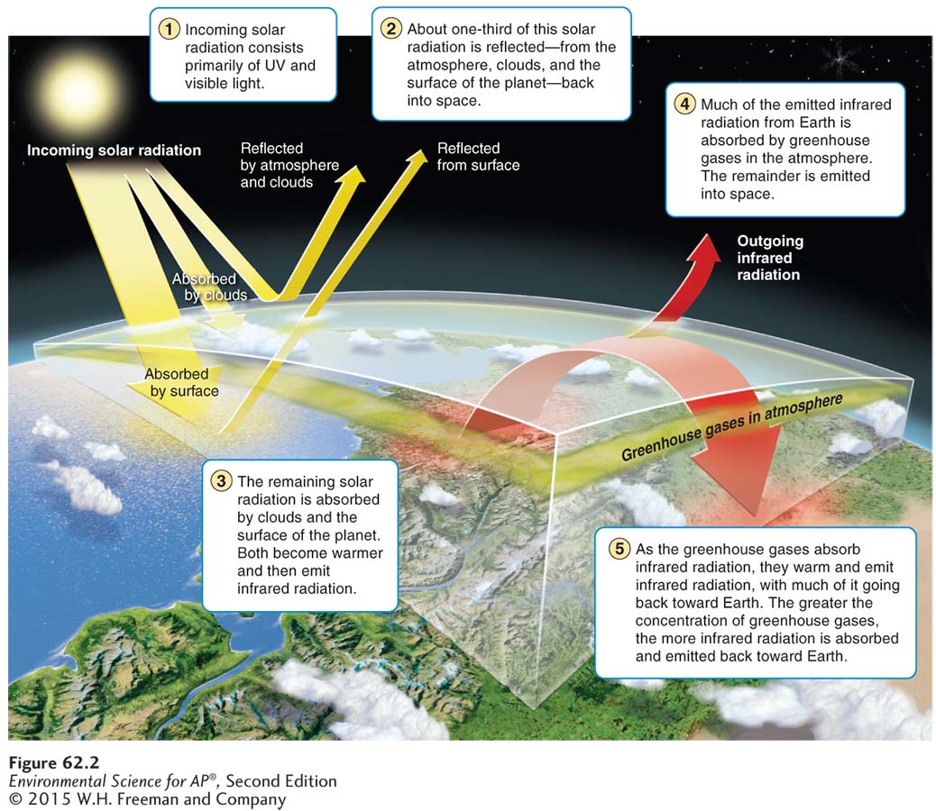
The Greenhouse Effect

Slide 12
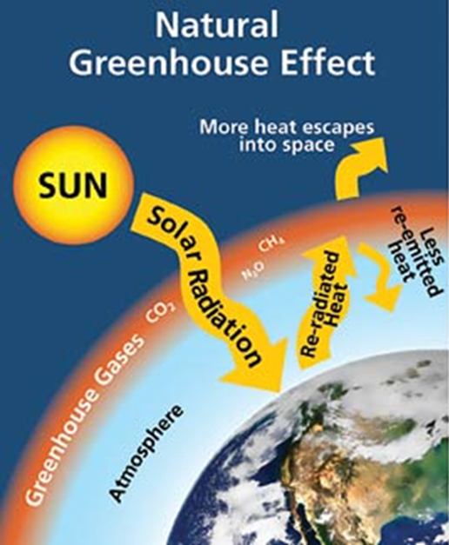
Greenhouse Effect vs. Global Warming
The greenhouse effect is a natural process and without it, Earth would be too cold to support life.
However, the natural GHE can be “enhanced” by too many greenhouse gases in the atmosphere
Too much energy trapped means rising temperatures on earth = GLOBAL WARMING

Slide 13
The Gases That Cause the Greenhouse Effect
The major greenhouse gases are:
Water Vapor (H₂O): the most abundant greenhouse gas, warmer air holds more water vapor (positive feedback)
Carbon Dioxide (CO₂): enters the atmosphere through the burning of fossil fuels, solid waste, trees and wood products, etc. It is removed from the atmosphere or “sequestered” when it is absorbed by plants as part of the carbon cycle.
Methane (CH₄): emitted during the production and transport of fossil fuels, from livestock and other agricultural practices, and by the decay of organic waste in municipal solid waste landfills.
Nitrous Oxide (N₂O): emitted during agricultural and industrial activities and during combustion of fossil fuels and solid waste.

Slide 14
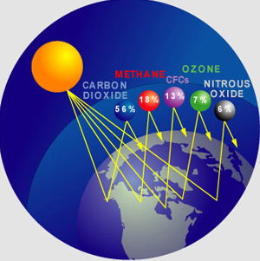
The Gases That Cause the Greenhouse Effect
Other greenhouse gases:
Tropospheric Ozone (O₃): A secondary pollutant created at ground level that absorbs infrared energy.
Chlorofluorocarbons (CFCs):
Do not exist naturally.
In the troposphere, they
absorb infrared energy.
We know what they do
in the stratosphere…

Slide 15
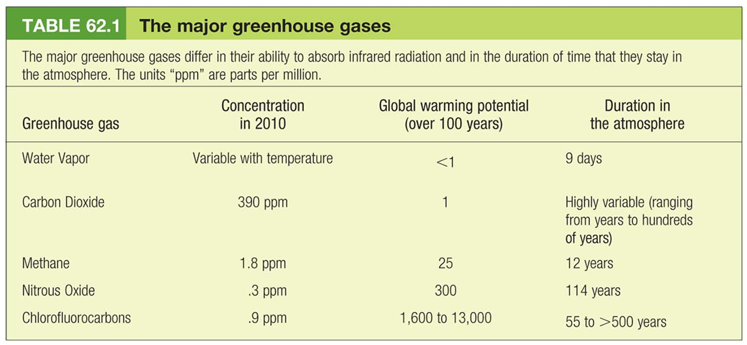
Greenhouse Gases
Greenhouse warming potential: How much a GHG molecule can contribute to global warming over a period of 100 years relative to a molecule of CO₂.
The contribution of each gas to global warming depends on its greenhouse warming potential and its concentration.

Slide 16
Natural Sources of Greenhouse Gases
Natural sources of greenhouse gases:
Volcanic eruptions
Ash: reflects sunlight; short-term cooling effect
Carbon dioxide: significant amounts added over time
Decomposition and digestion
Carbon dioxide: high oxygen conditions
Methane: low oxygen conditions (under water or in guts)
Denitrification
Nitrous oxide: low oxygen wet soils
Evaporation and evapotranspiration
Water vapor: evaporation from land or bodies or water; transpiration from plants.

Slide 17
Anthropogenic Sources of Greenhouse Gases
Anthropogenic sources of greenhouse gasses:
Burning of fossil fuels
Carbon dioxide: burning coal produces the most CO₂, following by gasoline. Natural gas produces the least.
Particulates: reflects sunlight, but also coats snow/ice lowering albedo so it melts faster.
Agricultural practices
Nitrous oxide: excess nitrates in the soil
Methane: livestock manure lagoons
Deforestation
Carbon dioxide: loss of trees decreases CO₂ taken out of atmosphere; if trees are burned, excess CO₂ is put into atmosphere

Slide 18
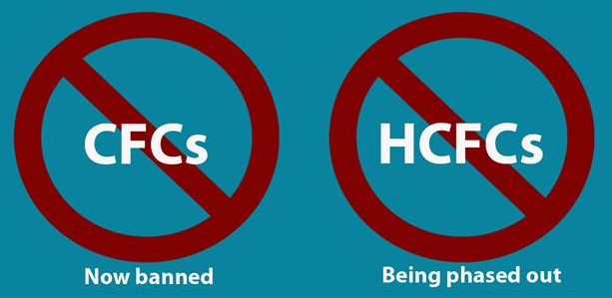
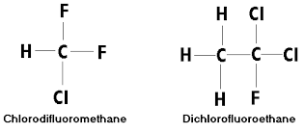
Anthropogenic Sources of Greenhouse Gases
Anthropogenic sources of greenhouse gasses:
Landfills
Methane: decomposition of organic matter
Industrial production
CFCs: refrigerant, coolant, propellant
Hydrochlorofluorocarbons (HCFCs): CFC substitutes that do not harm the ozone layer, but act as greenhouse gases.
Phased out by 2030

Slide 19
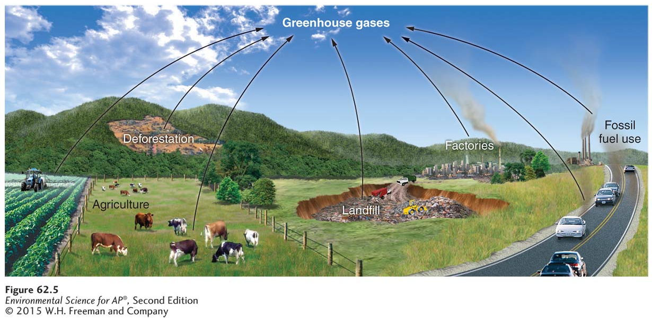
Anthropogenic Causes of Greenhouse Gases
Can you name the greenhouse gases emitted by the following human activities?

Slide 20
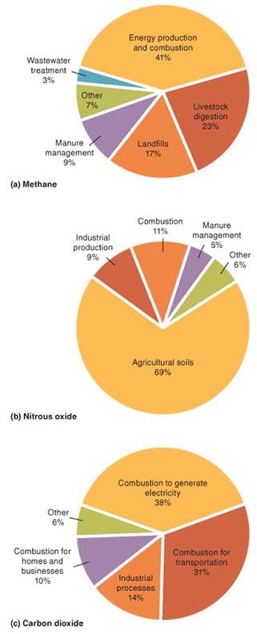
Anthropogenic Causes of Greenhouse Gases
Methane
Bacteria that breakdown livestock manure
Landfill decomposition
Leaks from production, storage, and transport of natural gas and petroleum products.
Nitrous oxide
Nitrogen from applied fertilizers
Combustion of fossil fuels
Industrial production of fertilizers
Carbon dioxide
Burning of fossil fuels in different forms

Slide 21
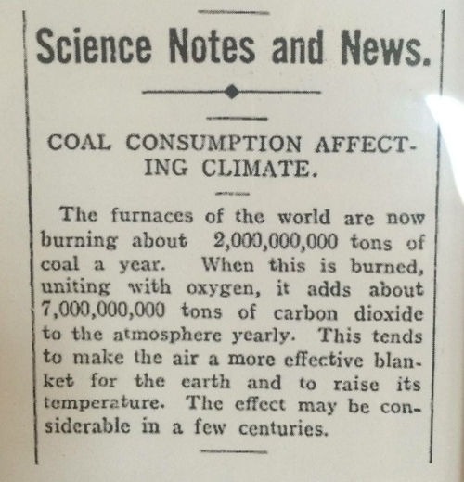
Anthropogenic Causes of Greenhouse Gases
Early timeline on the greenhouse effect:
1824 - Joseph Fourier, a French physicist, describes the Earth's natural "greenhouse effect".
1859 - John Tyndall, an Irish physicist, shows the greenhouse effect is created by water vapor and other gases including carbon dioxide and describes it as a necessary blanket around the earth.
1896 - Svante Arrhenius, a Swedish chemist, recognizes industrial-age coal burning will add to the natural greenhouse effect.

Slide 22
Module
63
The Evidence for
Global Warming
Learning Objectives
After this module, you should be able to:
explain how CO2 concentrations have changed over the past 6 decades and how emissions compare among the nations of the world.
explain how temperatures have increased since records began in 1880.
discuss how we estimate temperatures and levels of greenhouse gases over the past 500,000 years and into the future.
explain the role of feedbacks on the impacts of climate change.

Slide 23
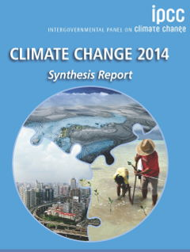
The Evidence for Global Warming
In 1988, the UN established the Intergovernmental Panel on Climate Change (IPCC).
It is the international body for assessing the science related to climate change
It includes more than 3,000 climate scientists in more than 130 countries.
Stated goals/purpose:
To provide policymakers with regular assessments of the scientific basis of climate change, its impacts and future risks, and options for adaptation and mitigation.
IPCC assessments provide a scientific basis for governments at all levels to develop climate related policies.

Slide 24
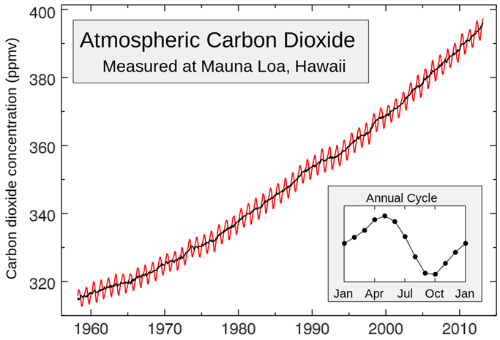
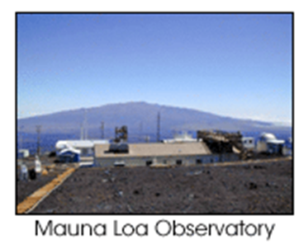
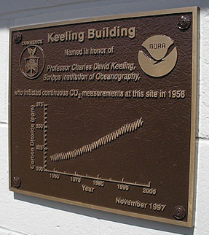
CO₂ concentrations have been increasing for the past 6 decades
A record of CO₂ measurements taken at the top of Mauna Loa volcano in Hawaii since 1958.
Commonly known as the “Keeling Curve” after Charles David Keeling who supervised the measurements

Slide 25
CO₂ emissions differ among nations
Countries with the largest CO₂ emissions:
China (24%)
This number has more than doubled since 2000
United States (18%)
According to the International Energy Agency (IEA), global CO₂ emissions have remained flat for the last 3 years!
Emissions from China and the U.S. have gone down

Slide 26
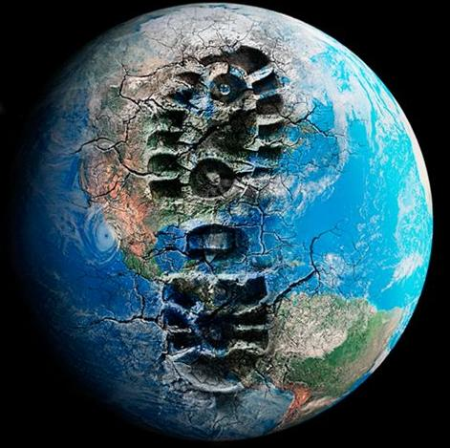
CO₂ emissions differ among nations
What is your carbon footprint?
The impact you have of the Earth (in terms of CO2 emissions) through your actions, decisions, and purchases.

Slide 27
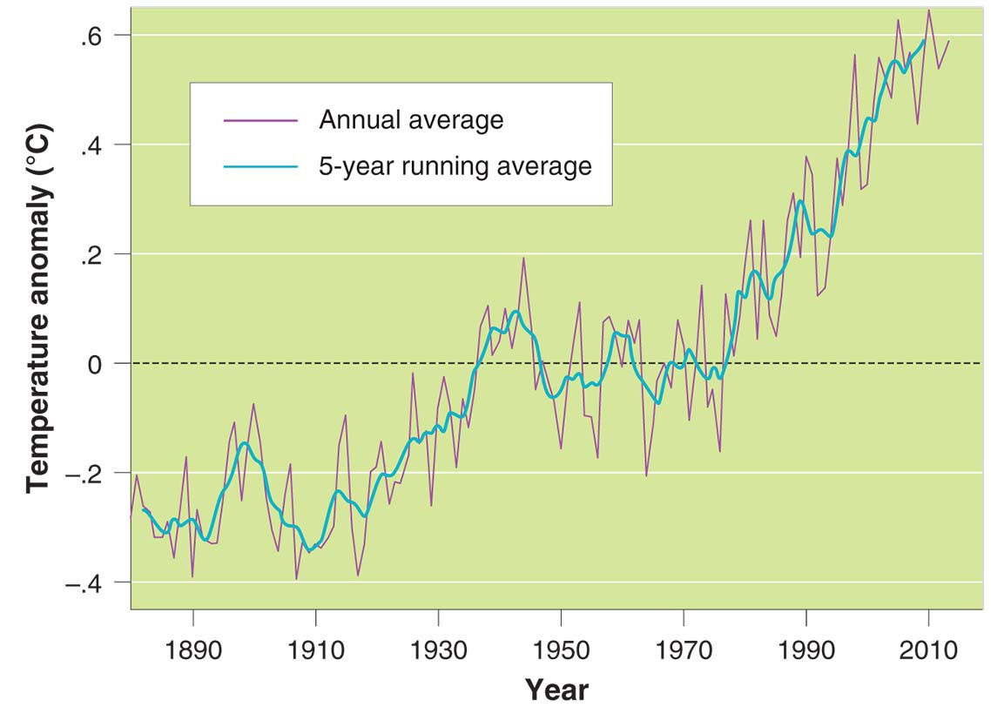
Global temperatures have steadily increased since records began in 1880
To determine if the increase in atmospheric CO₂ is leading to an increase in global temps we need lots of data.
Direct measurements since 1880
More recently, satellite data as well

Slide 28
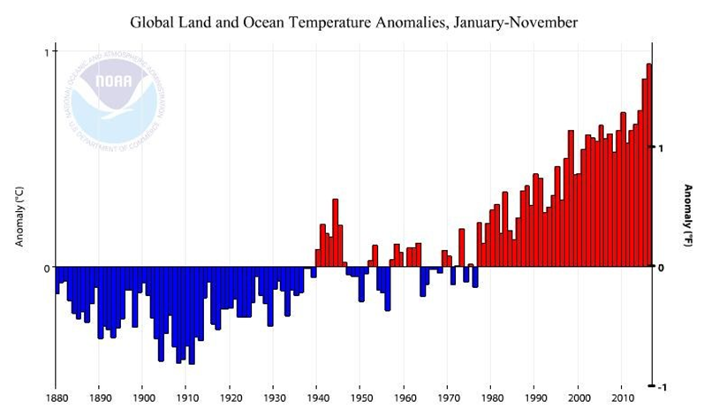
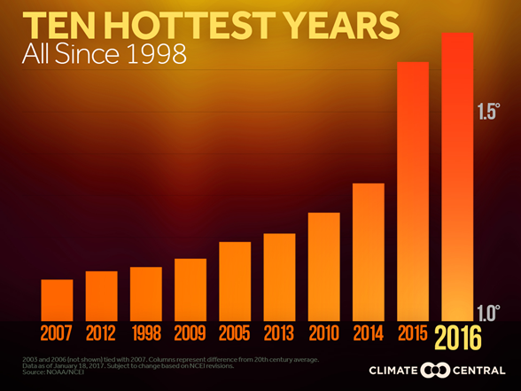
Global temperatures have steadily increased since records began in 1880
Statistical analysis of the warming trend shows a less than 0.01% likelihood that is the result of natural variation.
Of the factors (natural or anthropogenic) that drive climate, the only one that has shown change that mirrors this trend is the release of CO₂ by human activities.

Slide 29
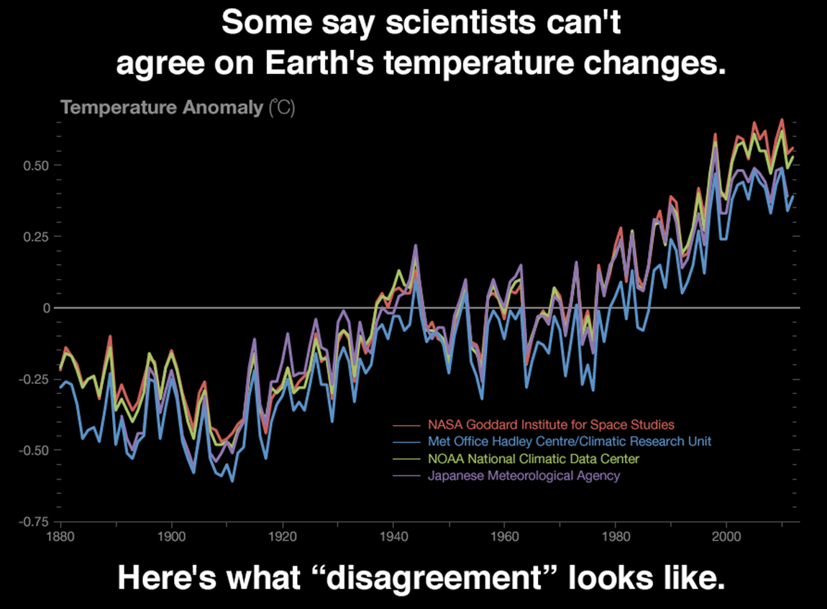
Global temperatures have steadily increased since records began in 1880

Slide 30
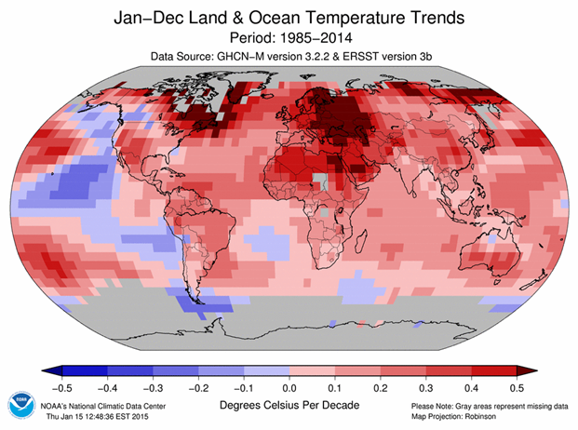
Global Temperatures Since 1880
The average temp. of Earth has already risen by 1.4°F since 1880
However, changes in mean annual temperature are different for different regions of the world.
The majority of the warming is occurring in the artic

Slide 31
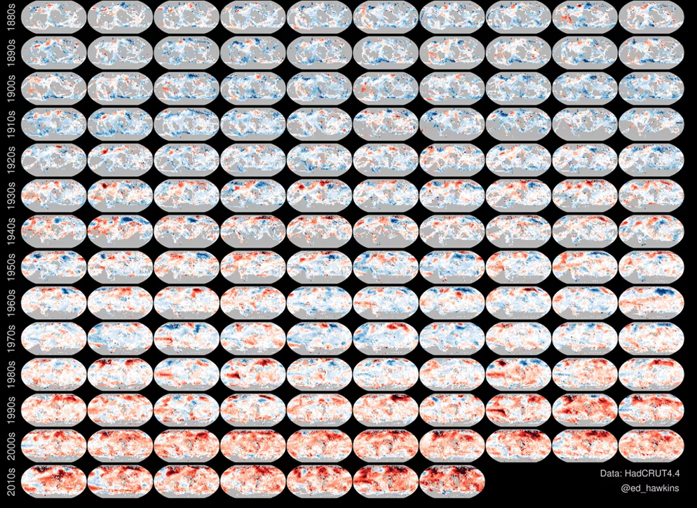
Global Temperatures Since 1880
Very cool visualization;
http://www.vox.com/2016/5/10/11643864/global-warming-spiral-temperatures

Slide 32
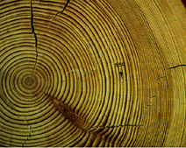
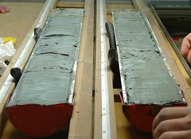
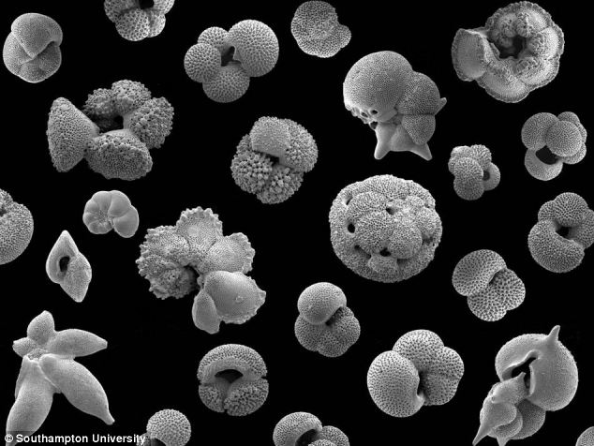
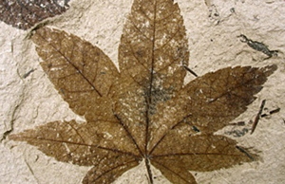
How Do We Estimate Past Temperature Changes?
To put this modern warming into perspective, we must look as far into the past as possible.
However, direct measurements of temperature then become impossible.
Indirect methods of obtaining atmospheric CO₂ and temperature levels must be used.
Tree rings
Pollen from bottom of deep lakes/bogs
Ocean floor sediments
Radioisotopes in rocks and fossils
Past glaciation formations
Air bubbles in ancient glaciers…

Slide 33
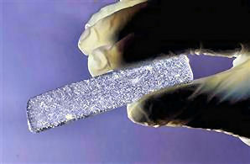
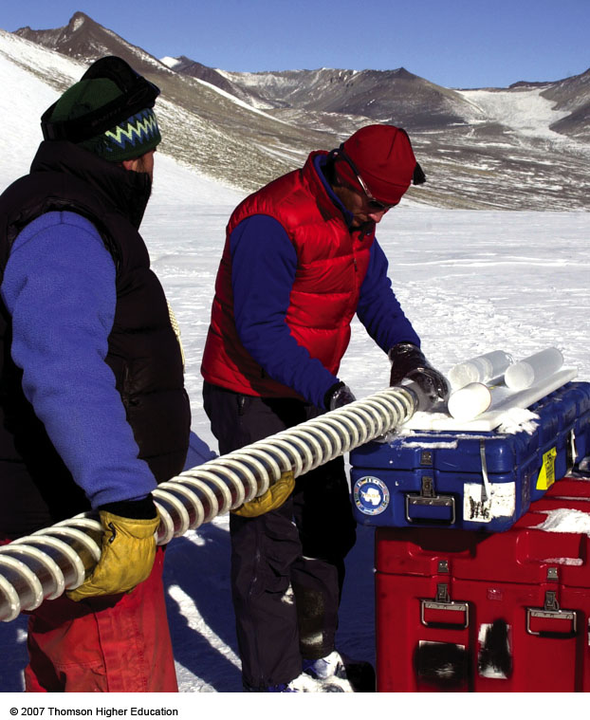
How Do We Estimate Past Temperature Changes?
As snow piles up it compresses and seals pockets of air in tiny bubbles.
Scientists analyze the gas isotopes found in tiny air samples trapped in ice cores to learn about past:
troposphere composition
temperature trends
greenhouse gas concentrations
solar activity
snowfall amounts
forest fire activity

Slide 34
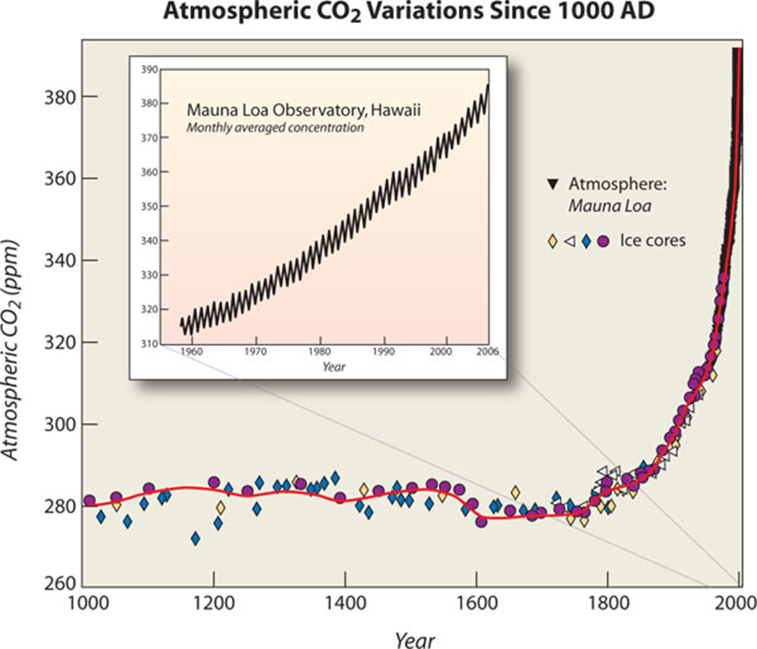
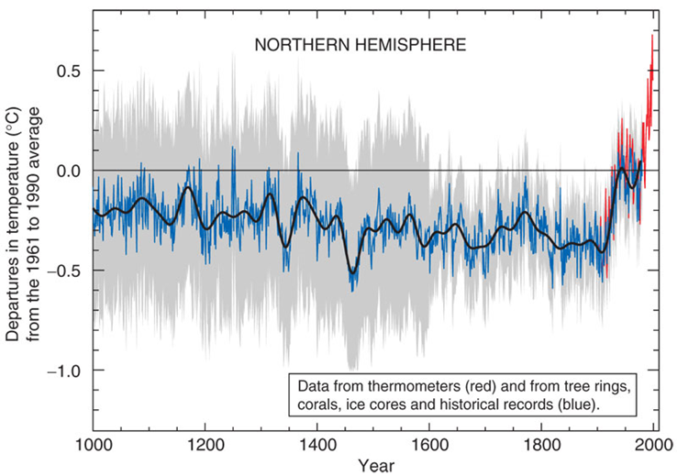
The Record of Historical Climate
For the past 1,000 years temperatures have remained fairly stable but began to rise during the last century.
This increase coincides with the beginning of the industrial revolution, large scale deforestation, and the widespread use of fossil fuels.

Slide 35
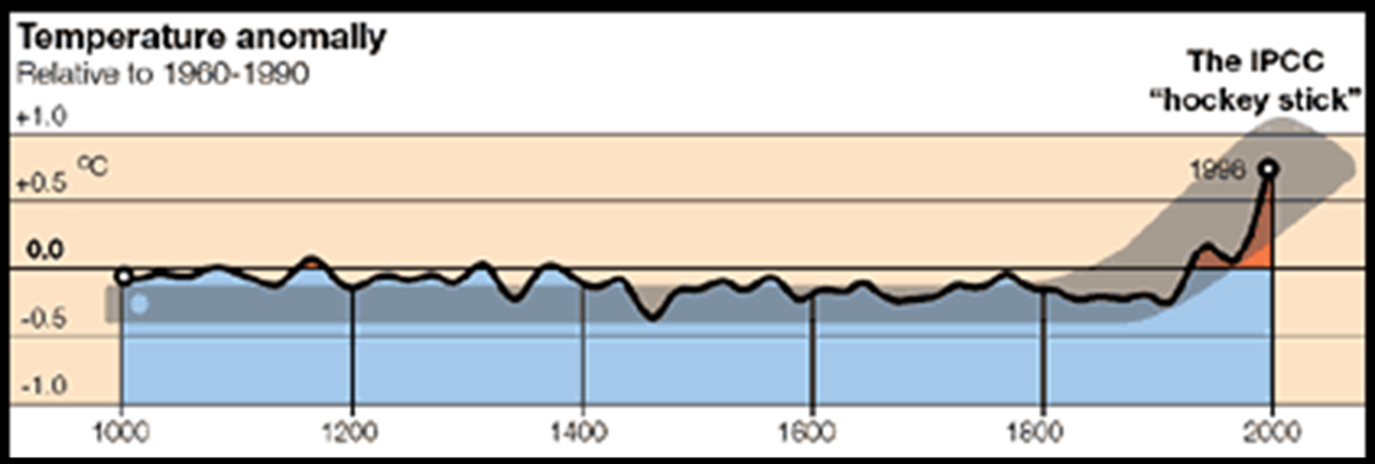
The Record of Historical Climate
For the past 1,000 years temperatures have remained fairly stable but began to rise during the last century.
This increase coincides with the beginning of the industrial revolution, large scale deforestation, and the widespread use of fossil fuels.
This graph is referred to as “The Hockey Stick” graph

Slide 36
The Record of Historical Climate
It’s not just CO2 levels…
Average concentrations of CO₂, CH₄, and N₂O emissions are much higher
Mostly due to: burning of fossil fuels, agriculture, and deforestation

Slide 37
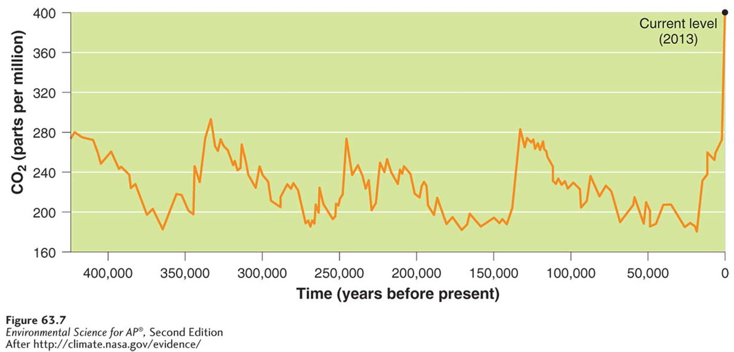
The Record of Historical Climate
Scientists have found that for more than 400,000 yrs CO₂ concentrations never exceeded 300 ppm.
In the last 100 yrs, CO₂ concentrations have sharply increased to their current level of just over 400 ppm.

Slide 38
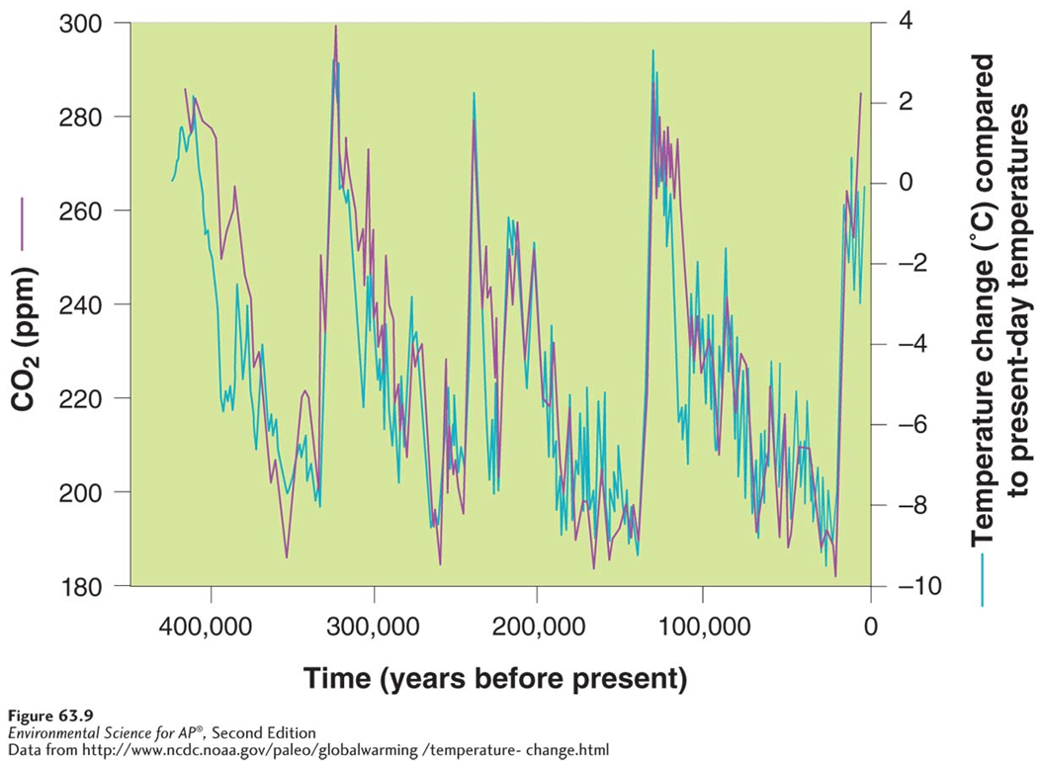
The Record of Historical Climate
Ice cores used to estimate historic temperatures and CO₂ concentrations indicate that the two vary together.
This is the pattern one would expect if CO₂ changes temp.

Slide 39
Greenhouse Gases versus Increased Solar Radiation
Since the Earth’s temperature changed long before humans starting putting CO₂ into the atmosphere, could changes in solar output be causing the warmer we are seeing?
No.
This graph is a peak into the rationale…
Also,
Since 1975, the lower troposphere has warmed while the stratosphere has cooled. A hotter sun would cause the entire atmos. to warm

Slide 40
Climate Models and the Prediction of Future Global Temperatures
Mathematical models used for predictions
They represent simplified models of major processes that interact to determine the average temperature and greenhouse gas content of the troposphere.
Most models show:
Global warming will continue to occur at a rapid rate
Human factors are the major cause of temperature rise since 1950
Human activities will play an ever increasing role in the warming trend during the next century

Slide 41
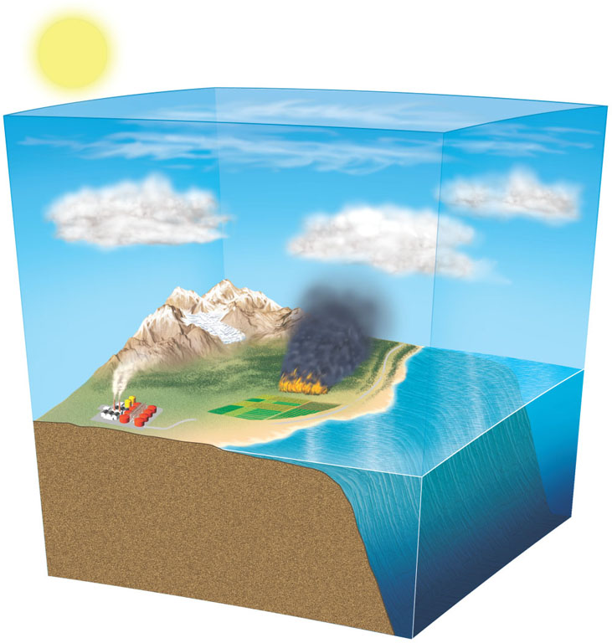
Climate Models
Troposphere
CO₂ removal by plants and soil organisms
Greenhouse
gases
Cooling from increase
Heat and
CO₂ removal
Warming
from
decrease
CO₂ emissions from land cleaning, fires, and decay
Aerosols
Heat and
CO₂ emissions
Ice and snow cover
Shallow ocean
Land and soil biotoa
Long-term
storage
Natural and human emissions
Deep ocean

Slide 42
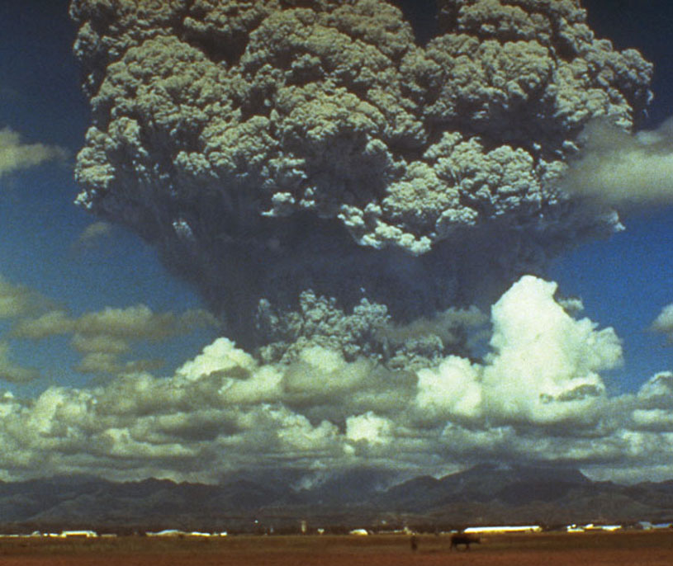
Case Study: Studying a Volcano to Understand Climate Change
NASA scientists correctly predicted that the 1991 eruption of Mount Pinatubo in the Philippines would cool the average temperature of the earth by 0.5º C over a 15 month period and then return to normal by 1995.
Particulates and SO₂ were the main reasons for the temp. decrease.
The success convinced scientists and policy makers that climate model projections should be taken seriously.

Slide 43
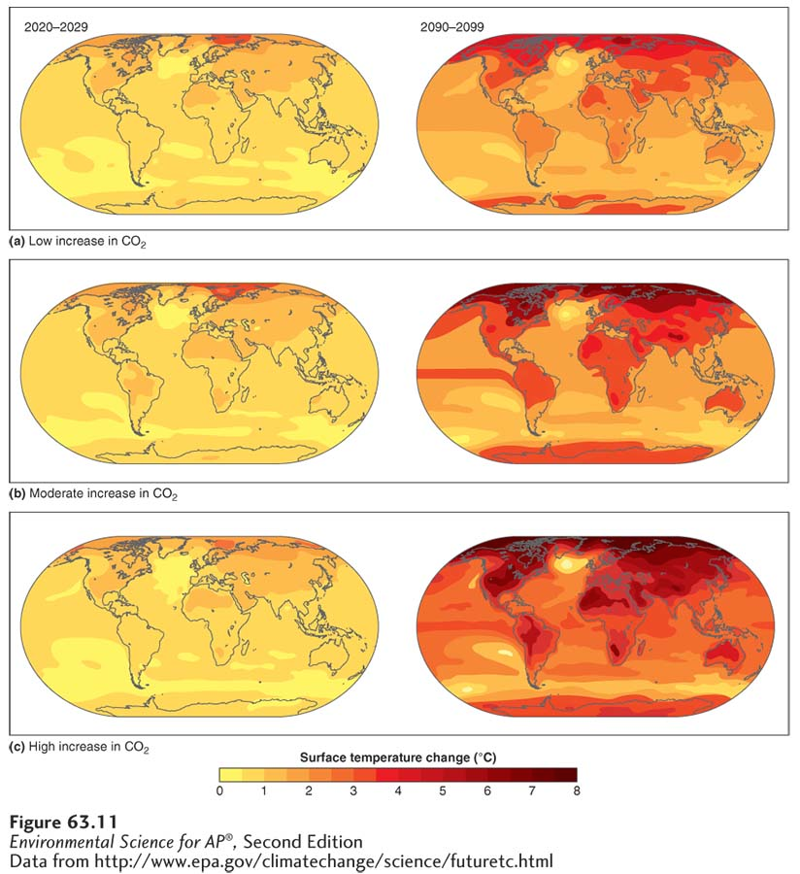
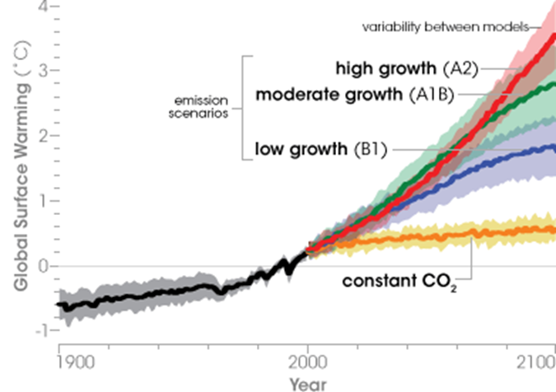
Climate Models and the Prediction of Future Global Temperatures
Predicted increase in global temperatures by 2100.
The predictions depend on whether we expect low, moderate, or high increases in how much CO₂ the world emits during the current century.

Slide 44
Climate Feedback Loops
The climate is very complex with many systems and sub-systems. Many of these systems interact with each other in feedback loops.
Positive feedback loops amplify change; small inputs lead to large changes.
Negative feedback loops dampen change.

Slide 45
Feedbacks can increase the impact of climate change
Positive feedback: The melting of snow/ice in the polar regions
The ice was reflecting 90% of the sunlight back into space…when it melts it is replaced by water which absorbs 90% of the sunlight.

Slide 46
Feedbacks can increase the impact of climate change
Positive feedback: Melting permafrost
As arctic temperature increases, permafrost melts, the organic matter in soils and lake bottoms decomposes, releasing CH₄

Slide 47
Feedbacks can increase the impact of climate change
More examples of positive feedback:

Slide 48
Feedbacks can decrease the impact of climate change
Negative feedback: Carbon dioxide and producers
Increased CO₂ in the atmosphere from anthropogenic sources can be partially removed by increased photosynthesis by producers.

Slide 49
There Is Uncertainty about the Effects of Cloud Cover on Global Warming
Positive AND Negative feedback: Water vapor
Water vapor is a greenhouse gas
Warmer temperatures create more clouds
Thick, low altitude clouds: decrease surface temperature
Thin, high altitude cirrus clouds: increase surface temperature
Further complicating things, warm air can hold more water vapor

Slide 50
Module
64
The Consequences of Global Climate Change
Learning Objectives
After this module, you should be able to:
discuss how global climate change has affected the environment.
explain how global climate change has affected organisms.
identify the future changes predicted to occur with global climate change.
explain the global climate change goals of the Kyoto Protocol.

Slide 51
The Consequences of Global Climate Change
Change that is already happening…

Slide 52
Polar Ice is Melting
Because northern latitudes have experienced the greatest amount of global warming, the extent of the ice cap near the North Pole has been declining over the past 3 decades.

Slide 53
Polar Ice is Melting

Slide 54
Glaciers are Melting
1948
2004

Slide 55
Permafrost is Melting
Remember, permafrost is ground that is permanently frozen throughout the year.
In addition to the methane feedback loop, there are many problems with trees, human structures, and pipelines.

Slide 56
The Loss of Earth’s Cryosphere
The world’s sea ice sheets and land-based glaciers are slowly melting.
The loss of ice is happening much faster than scientists thought possible.
Why should we care if snow and ice are melting?
Arctic ice regulates the temperature and precipitation of regions to the south (North America, Europe)
Mountain glaciers play a vital role in the water cycle and the availability of fresh water for hundreds of millions of people.
Drinking
Agriculture

Slide 57
Rising Sea Levels
Average sea level has been slowly rising and the rate is increasing
2/3 of the rise is the from the thermal expansion of warm water
The remaining 1/3 of the rise is from the melting of land-based ice
Floating ice is already in the water (buoyancy)

Slide 58
Rising Sea Levels
Projected irreversible effect
Degradation and loss of 1/3 of coastal estuaries, wetlands, and coral reefs
Disruption of coastal fisheries
Flooding of agricultural lowlands and deltas
Contamination of freshwater aquifers (groundwater)
Submergence of low-lying islands
The small island of Tuvalu may be the first to disappear

Slide 59
Areas to flood if average sea level rises by one meter
Rising Sea Levels
13% of the world’s urban population lives near sea level
Many cities would be devastated by even relatively small increases in sea level

Slide 60
Global climate change is already affecting organisms
The growing season for plants has changed and animals have the potential to be harmed if they can’t move to more appropriate climates.

Slide 61
Global climate change is already affecting organisms
Changes in climate patterns will cause many species to seek new habitats or face extinction.
Specialist species that cannot evolve or migrate fast enough are the most vulnerable.
An estimated 30% of land plants/animals could go extinct with only a 2ºC temp. increase
Changes in the ranges of pest populations will cause problems as well.
Exploding Populations of Mountain Pine Beetles in British Columbia, Canada

Slide 62
Global climate change is already affecting organisms
Corals are particularly sensitive:
They require warm water, but if it is too warm, it can lead to coral bleaching and the death of the corals.
Ocean acidification: an increase in ocean CO₂ causes more CO₂ to be converted to carbonic acid, which lowers the pH of the water.
Dissolves hard parts of organisms
Changes in Average Ocean Temperatures, Relative to Coral Bleaching Threshold

Slide 63
The Consequences of Global Climate Change
Change that is predicted to happen…

Slide 64
Predicted Effects: Temperature and Precipitation
A changing climate will lead to prolonged heat waves and droughts in some areas and prolonged heavy rains and increased flooding in other areas.
Drought accelerates warming, leads to more droughts (positive feedback)
Severe lack of water, growth of plants will slow
Less CO₂ taken out of atmosphere
Also, more forest and grass fires will add CO₂ to the atmosphere

Slide 65
Predicted Effects: Temperature and Precipitation
Extra heat energy in the Earth’s climate system will alter air circulation, greatly changing the frequency and severity storms.
Even if it the same amount of precipitation is received, the pattern can be different.
Long dry periods followed by heavy downpours
Hurricanes and typhoons feed off the warm ocean waters. If these waters are warmer, that means more energy for the storms and stronger storms.

Slide 66
Predicted Effects: Ocean Currents
Ocean currents act like large conveyor belts redistributing heat all over the planet.
Global warming can change ocean currents by increasing the temp. of the water, adding large amounts of freshwater from melting ice, and increasing salinity by increasing evaporation.
The temp. of water greatly effects the temp. of the air above it.
Many areas have warmer climates despite their higher latitudes; that will change if the ocean currents change

Slide 67
Predicted Effects on Humans
Global warming will increase human deaths from:
Heat stroke
Increased flooding and other severe weather events
Malnutrition and starvation from disruption of food supply
Spread of tropical diseases to temperate regions
Increased poverty

Slide 68
Predicted Effects on Humans
Regions of farming may shift
Decrease in tropical and subtropical areas
Increase in northern latitudes
However, it will be less productive; soil not as fertile
Loss of productivity could be offset by a longer growing season
Genetically engineered crops developed to be more tolerant to drought and temperature extremes

Slide 69
Assessing Uncertainty
In it’s 2013 report, the IPCC indicated a 95–99% likelihood that the lower atmosphere is warming AND that human activity is responsible for most of the recent warming.

Slide 70
Assessing Uncertainty

Slide 71
Assessing Uncertainty

Slide 72
Dealing with Climate Change is Difficult
Climate change is such a difficult problem to deal with because:
The problem is global
The effects will last a long time
The harmful and beneficial impacts of climate change are not spread evenly
It is a long-term political issue
Many actions that might reduce the threat can be seen as controversial because they can impact economies and lifestyles
No one country can address it by themselves
Notes:
72

Slide 73
The Kyoto Protocol addresses climate change at the international level
In 1997, delegates from 161 countries met in Kyoto, Japan to negotiate a treaty on global warming which went into effect January, 2005.
Kyoto Protocol: An international agreement that sets a goal for global emissions of greenhouse gases.
It requires 38 participating developed countries to cut their emissions of CO₂, CH₄, and N₂O to 5.2% below their 1990 levels by 2012.
This represents a reduction of 2010 levels by 29%
Developing countries were excluded.
192 countries have signed and ratified the protocol.
Notes:
73

Slide 74
The Kyoto Protocol addresses climate change at the international level
Although the United States signed the original Kyoto Protocol, the U.S. Congress never ratified the agreement and the protocol has never been legally binding on the United States.
Why?
Developing countries such as China, India and Brazil were considered exempt
Belief that it would hurt the U.S. economy
The U.S. did not sign, but 10 U.S. states and 740 U.S. Cities are participating.
The Kyoto Protocol will have little effect on global warming without support and action by the U.S., China, and India.
Notes:
74

Slide 75
So What Are Our Options?
Option #1
Mitigation
Mitigation: the act of decreasing/reducing something
Taking actions aimed at reducing the extent of global warming by targeting greenhouse gases
Reduce the amount of greenhouse gases entering the atmosphere.
Energy efficiency, renewable energy sources, carbon tax, cap-and-trade program
Remove greenhouse gases from the atmosphere.
Reforestation, carbon sequestration
Notes:
75

Slide 76
Carbon Tax vs. Cap-and-trade Program
Big idea:
When putting carbon into the atmosphere costs money, we will do less of it.
Carbon Tax: a fee for making users of fossil fuels pay for releasing carbon dioxide into the atmosphere, and for motivating switches to clean energy.
Usually proposed as an extra tax on gasoline or based upon how much coal/nat. gas is burned.
A similar approach is to increase subsidies and tax breaks for energy efficiency and renewable energy, and/or decrease subsidies and tax breaks for fossil fuels.

Slide 77
Carbon Tax vs. Cap-and-trade Program
Cap-and-Trade Program (emissions trading)
The cap on greenhouse gas emissions is a limit based on Science and enforced by the government.
Based on the cap, allowances are given out to companies/industries in a given area that permit them to emit only a certain amount of carbon.
Companies pay penalties, which gets stricter over time, if they exceed their allowance.
The trade part is a market for companies to buy and sell allowances. Trading gives companies a strong incentive to save money by cutting emissions.
Spend money to buy extra allowances
Make money by selling extra allowances

Slide 78
Carbon Tax vs. Cap-and-trade Program
This type of program has been very successful in limiting the amount of SO₂ in the atmosphere.

Slide 79
Carbon Sequestration
Carbon sequestration: Removing CO₂ from the atmosphere and storing it.
Low-tech methods include planting trees, restoring grasslands, or efforts to increase the organic content of soils.
Researchers are looking at cost-effective ways of capturing CO₂ from the air, from coal-burning power stations, and from other emission sources.
Artifical trees??

Slide 80
Carbon Sequestration
Captured CO₂ would be compressed and pumped into abandoned oil wells or the deep ocean.

Slide 81
So What Are Our Options?
Option #2
Adaptation
Adaptation: change along with the changing climate
Adaptation refers to dealing with the impacts of climate change.
We recognize that some warming is unavoidable and devise strategies to reduce its harmful effects, or live with the outcome.
It involves taking practical actions to manage risks from climate impacts, protect communities, and strengthen the resilience of the economy.
Notes:
81

Slide 82
So What Are Our Options?
Adaptation strategies:

Slide 83
So What Are Our Options?

Slide 84
So What Are Our Options?
A program to slow and adapt to global warming now is very likely to cost less than waiting and having to deal with its harmful effects later.
Notes:
84

Slide 87
Alright, time for some satire…
A special message from a former president:
http://www.youtube.com/watch?v=rKMpQ6NqB3Q&feature=player_embedded
Not satisfied with the overwhelming evidence for climate change?
Here is a “Second Opinion” on climate change:
http://www.cc.com/video-clips/pkx5sp/the-colbert-report-the-word---second-opinion
The New Abnormal:
http://thecolbertreport.cc.com/videos/mm5bdz/the-word---the-new-abnormal

