Slide 1
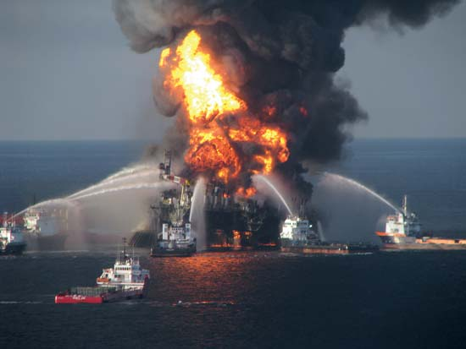
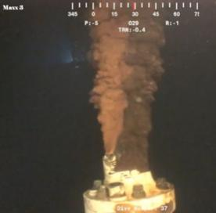
Deepwater Horizon Oil Spill
On April 20, 2010, an explosion on the Deepwater Horizon MC252 drilling platform in the Gulf of Mexico caused the rig to sink and oil began leaking into the Gulf. Before it was finally capped in mid-July, almost 5 million barrels of oil were released into the Gulf. The magnitude of this spill is something our nation has not seen before, causing significant impacts to wildlife and the fishing community along the large coastal areas of Louisiana, Mississippi, Texas, Alabama, and Florida.
http://en.wikipedia.org/wiki/Deepwater_Horizon_oil_spill

Slide 2
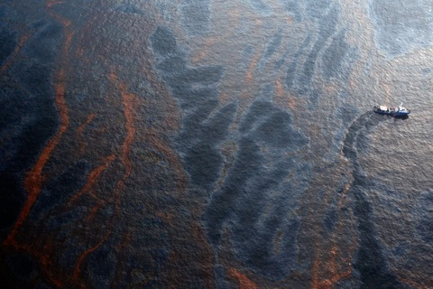
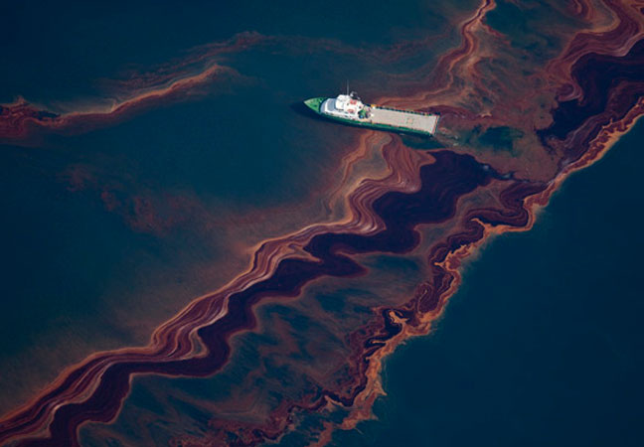
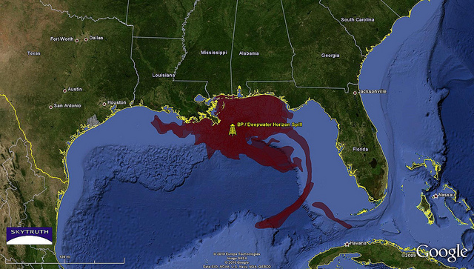
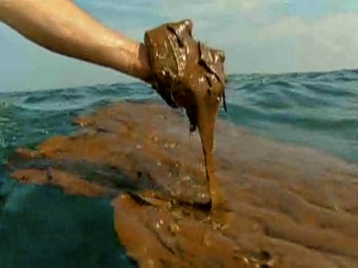

Slide 3
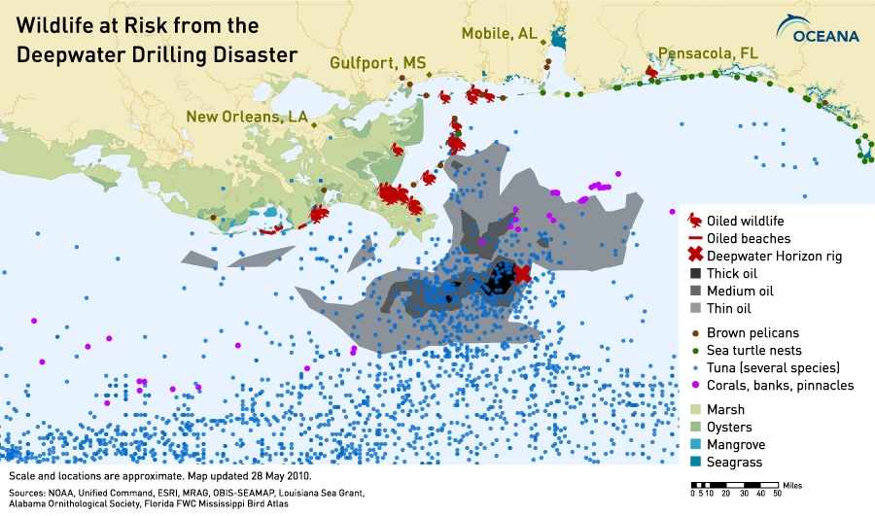

Slide 4
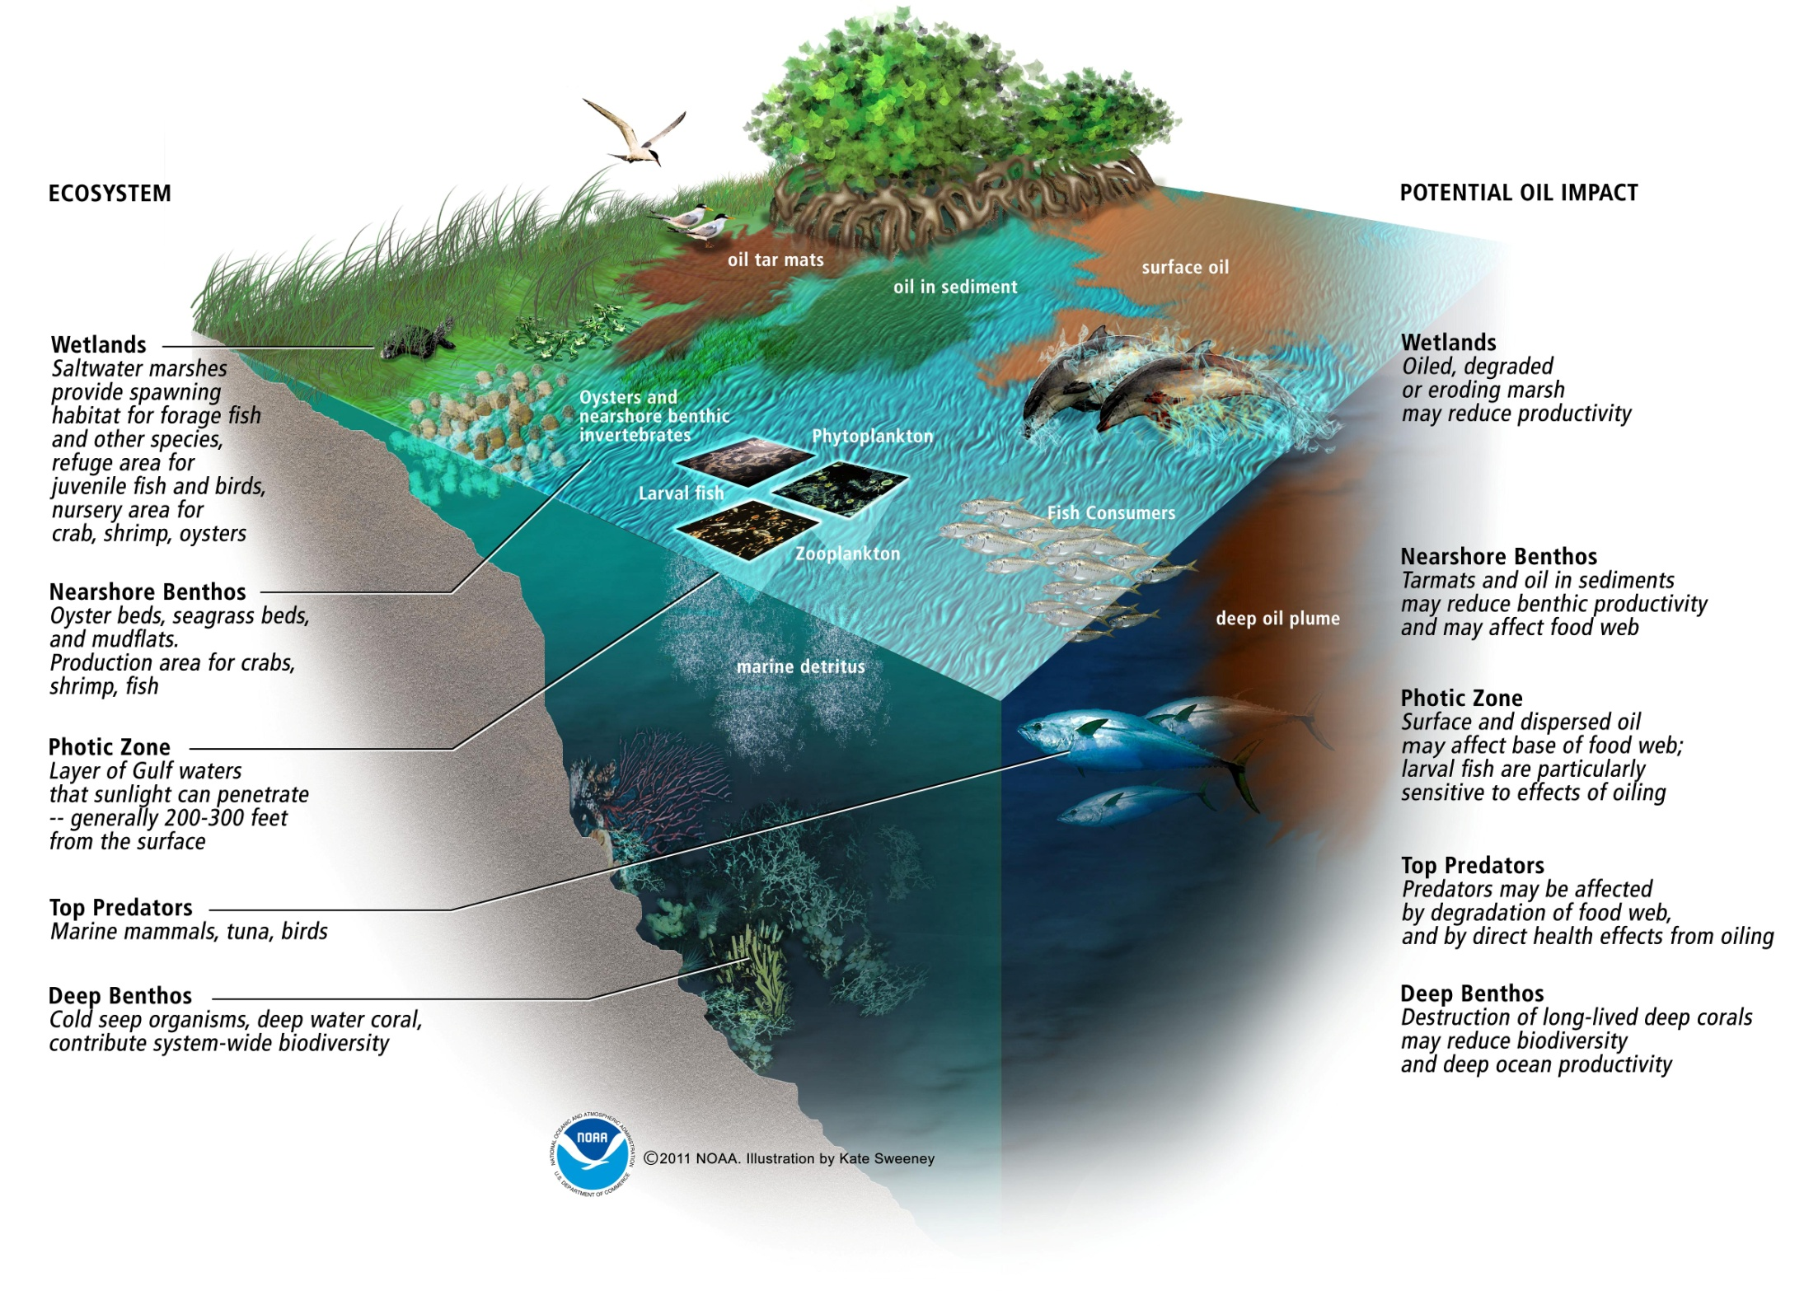

Slide 5
What could they ask?
Characteristics of the ecosystems affected?
Estuaries, mangrove forests, salt marshes, etc.
Negative consequences of oil pollution?
Alternatives to using oil?
Other major oil spills?
Exxon Valdez

Slide 6
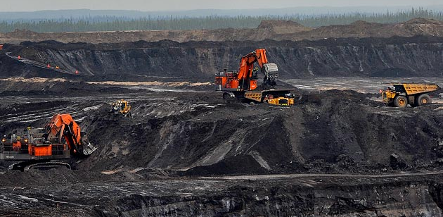
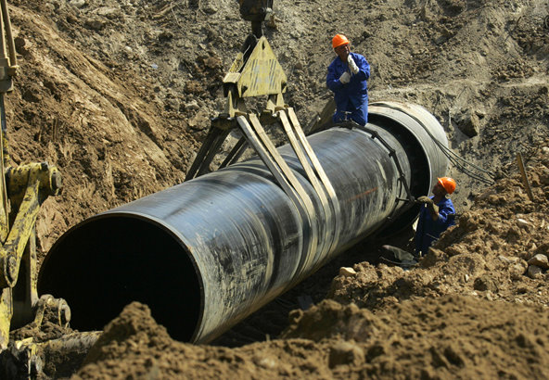
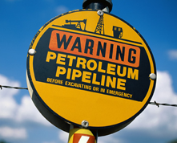
Keystone XL Pipeline
A company called TransCanada has proposed a tar sands pipeline – called "Keystone XL" – that would carry up to 830,000 barrels per day of tar sands oil from Alberta, Canada more than two thousand miles to refineries on the U.S. Gulf Coast. The pipeline would cross six states including Montana, South Dakota, Nebraska, Kansas, Oklahoma and Texas and put people and wildlife at risk from toxic oil spills, polluted water and more. Perhaps most dangerously, Keystone XL would drive development in Canada’s tar sands region, one of the biggest threats to our global climate. The added capacity of Keystone XL and the other two pipelines that have been built recently could more than triple U.S. consumption of tar sands oil – one of the most polluting and carbon-intensive fuels in the world.
https://en.wikipedia.org/wiki/Keystone_Pipeline

Slide 7
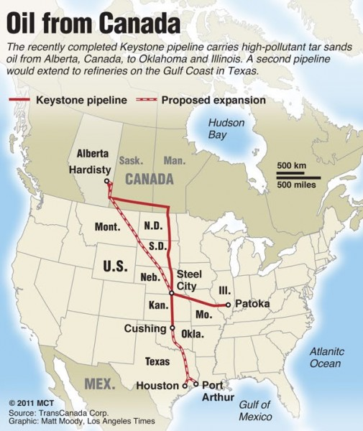
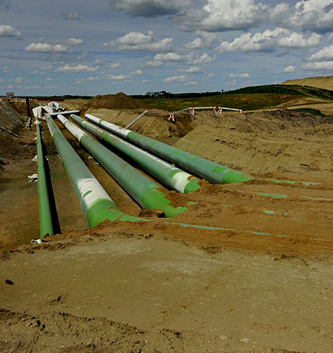
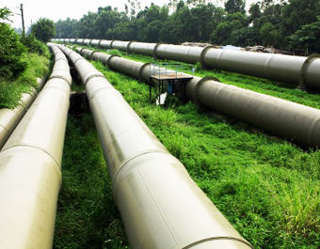

Slide 8
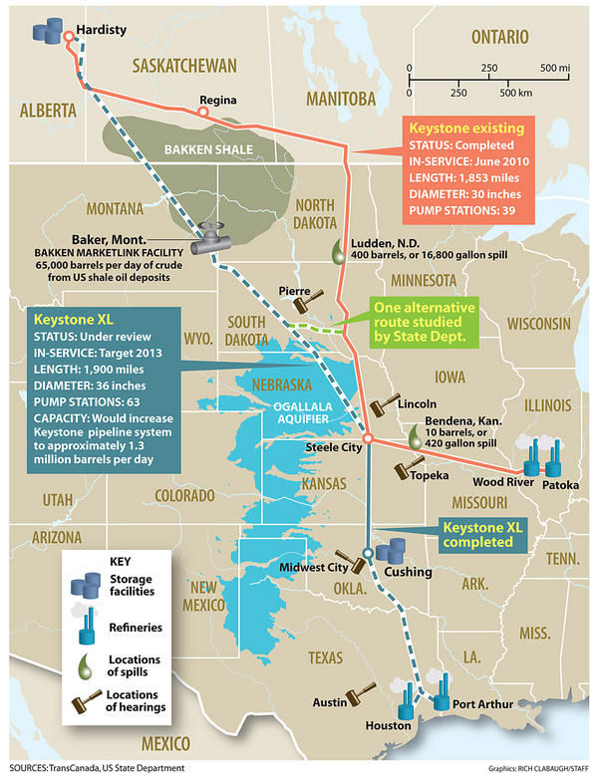
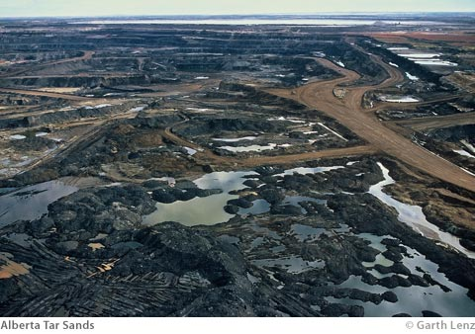
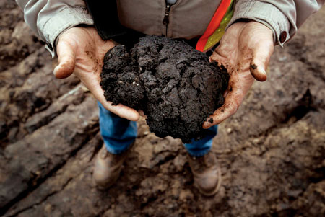
Tar sands oil is has a very high negative impact. It requires much more disruption of land, use of water (which then needs to be treated), and contains very high amounts of sulfur.

Slide 9
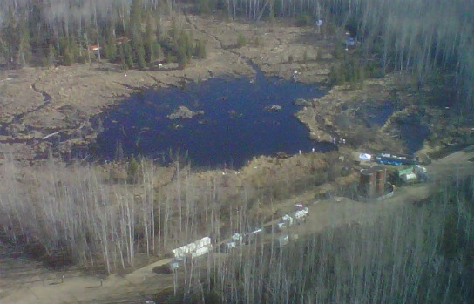
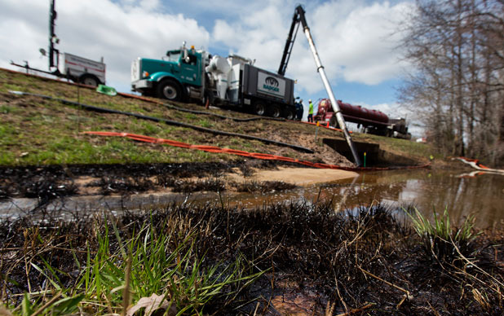
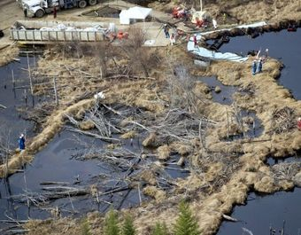
Pipelines leak
In the week from March 25-April4 2013, there were 4 spills or leaks in the U.S.

Slide 10
What could they ask?
U.S. oil usage?
Oil refining process?
Negatives of tar sands oil?
Alternatives to using oil?

Slide 11
Fukushima Nuclear Power Plant
On 11 March 2011, a magnitude 9.0 earthquake struck off the coast of Japan, followed by a tsunami that slammed the country’s north-eastern coast, destroying communities, taking the lives of tens of thousands of people, and triggering the biggest nuclear disaster since Chernobyl.
The earthquake led to the loss of external power at the Fukushima Daiichi nuclear power plant. The subsequent tsunami flooded the plant’s back-up diesel generators, causing complete loss of power and failure of the cooling systems. As temperatures rose, nuclear fuel melted in the reactors, and damaged fuel led to a build up of hydrogen gas, and eventually, explosions in the reactors. The nuclear disaster was eventually rated at Level 7 on the International Nuclear Event Scale (INES), the highest level. It is estimated that the amount of radioactive cesium sent into the atmosphere by the explosions was equivalent to 168 Hiroshima bombs. http://en.wikipedia.org/wiki/Fukushima_Daiichi_nuclear_disaster

Slide 12
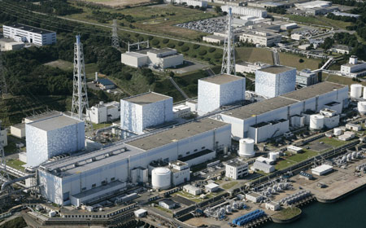
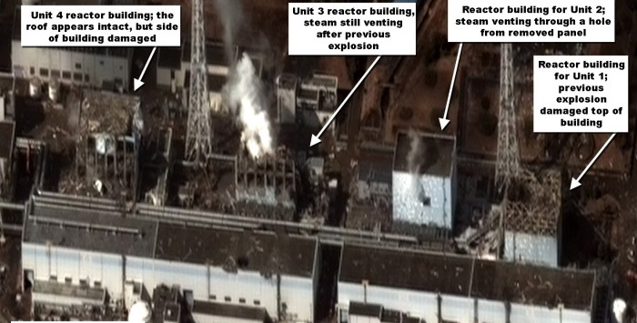

Slide 13
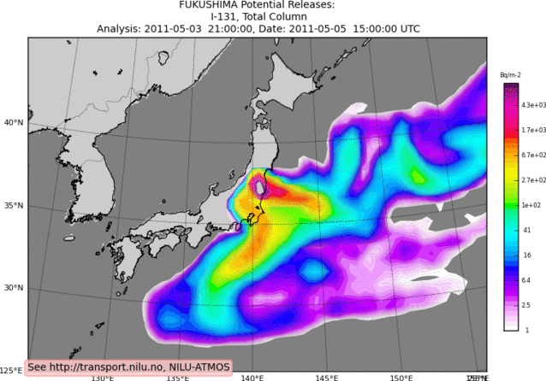
Biological impacts on land and in the ocean.
http://www.greenpeace.org/international/Global/international/publications/nuclear/2012/Fukushima/Fact%20Sheets/Fukushima%20Nuclear%20Crisis.pdf

Slide 14
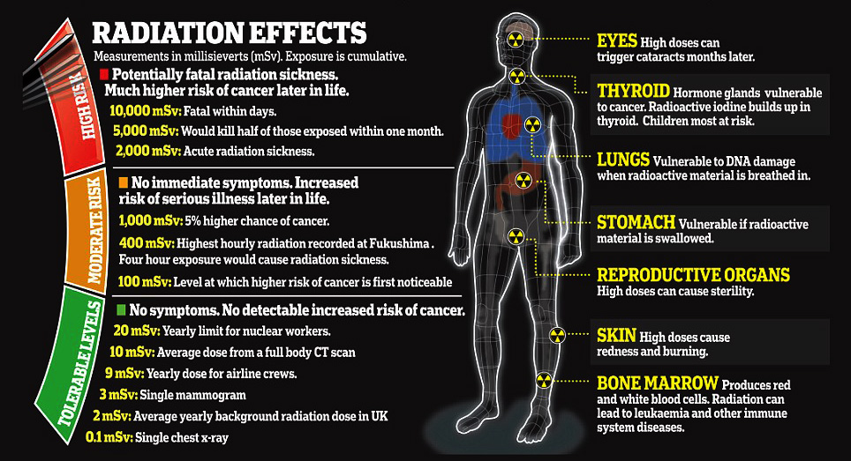

Slide 15
What could they ask?
Describe a nuclear power plant?
Negatives of nuclear power?
Alternatives to nuclear power?
Environmental or human health consequences of a nuclear accident?
Other nuclear accidents?

